Slide 1
Benefit Map
Please find enclosed the X CI Benefit Map; the document prints to A3 for ease of reading.
The Benefit Map is a pictorial representation of the business and enabling changes on which benefit realisation depends, and how these benefits contribute to organisational (including strategic) objectives. A journey (Output to Objective) has been highlighted to help understanding.
In producing this map, the Business Change (BCHG) Team have reviewed top-down direction, the X Business Case and other artefacts including significant engagements across X work streams and SMEs.
The End Benefits (3rd column) are large buckets that will be quantified by lower level activities and work streams whose targets aggregate up into and quantify, the End Benefits of the Programme.
The X Benefit Register and Benefit Profiles are used to capture the lower level activities and work stream targets (the detail). These lower level targets comprise Intermediate and Emergent Benefits and Dis-Benefits that go on to inform the End Benefits of the Programme.

Slide 2
Name of Change Initiative - Benefit Map
High Level Outputs (Main Thing)
Outcomes
End Benefits
Departmental, Portfolio &
Wider Objectives
Training
Processes: Business Model (Operations/Functions); Performance Levels; Ways of Working.
EB-01: Time Savings. Context.
OP-01: Description.
Efficiency
OP-02: Oracle Guided Learning (OGL) products
OC-01: Title. Context.
DO-1: Description.
Equipment
EB-02: Reduced Expenditure/VfM. On premise servers removed; fewer contracts; cost optimisation; fewer licenses; integration; convergence; monetised time savings; value for money; avoidance.
Internal
(low level) Departmental
Objectives
OP-03: Decommission 4 on premises Servers in London
Economic
DO-2: Description.
OP-04: Description.
OC-02: Title. Context.
Primary End Benefits
OP-05: Description.
EB-03: FTE Savings. Context.
DO-3: Description.
Personnel
OC-03: Title. Context.
Efficiency
OP-06: Description.
DO-4: Description.
Information
EB-04: Greater Integration. Context.
OP-07: Description.
Organisation: Skills; Staffing levels; Roles; Culture; Training Needs.
PO-1: Description.
OP-08: Description.
OC-04: Title. Context.
OP-09: Description.
PO-2: Description.
OP-10: Description.
OC-05: Title. Context.
EB-05: More Automation. Context.
OP-11: Description.
Portfolio Office Objectives
OC-06: Title. Context.
PO-3: Description.
OP-12: Description.
OP-13: Description.
Technology: Systems; Tools; Resources (i.e. Buildings & Infrastructure).
EB-06: Improved Data Quality. Context.
PO-4: Description.
OP-14: Resilient, secure global cloud platform and portal.
OC-07: Systems. The organisation has improved its information capabilities, business continuity, threat mitigation, technological advances, supply and demand and business efficiency.
OP-15: Description.
PO-5: Description.
OC-08: Title. Context.
Secondary End Benefits
Effectiveness
EB-07: Fewer Burdens (Physical and Cognitive). Context.
OP-16: Description.
OC-09: Title. Context.
SO-6: Description.
OP-17: Description.
Doctrine & Concepts
OC-10: Title. Context.
SO-7: Description.
OP-18: Description.
Wider
Objectives (i.e. Government)
Organisation
EB-08: Better Access to Information. Context.
SO-8: Living within our means
OP-19: Description.
OC-11: Title. Context.
OP-20: Description.
Information: New Data; Data Outcomes; Data for Reporting.
SO-9: Description.
Logistics
OC-12: Title. Context.
OP-21: Description.
Interoperability
EB-09: Information Advantage. Context.
SO-10: Description.
OP-22: Description.
OC-13: Title. Context.

Slide 3
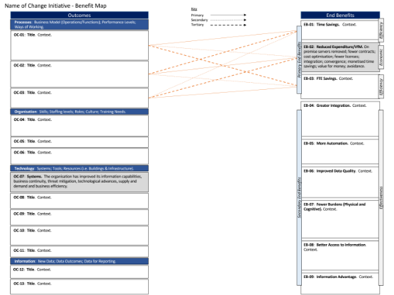
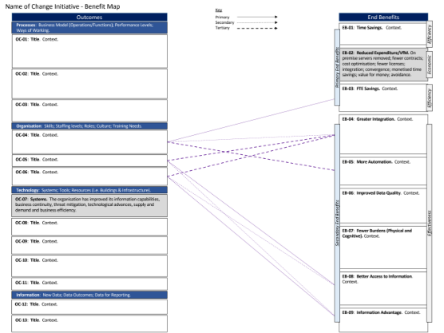
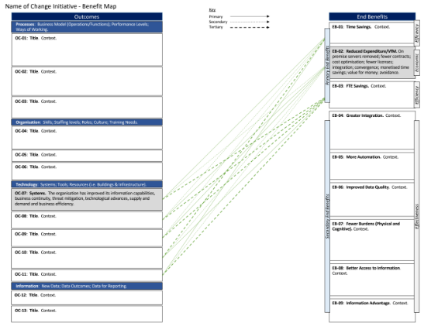

Name of Change Initiative - Benefit Map
Outcomes
Key
End Benefits
Processes: Business Model (Operations/Functions); Performance Levels; Ways of Working.
Primary
Secondary
Tertiary
EB-01: Time Savings. Context.
OC-01: Title. Context.
Efficiency
EB-02: Reduced Expenditure/VfM. On premise servers removed; fewer contracts; cost optimisation; fewer licenses; integration; convergence; monetised time savings; value for money; avoidance.
Primary End Benefits
Economic
OC-02: Title. Context.
EB-03: FTE Savings. Context.
OC-03: Title. Context.
Efficiency
EB-04: Greater Integration. Context.
Organisation: Skills; Staffing levels; Roles; Culture; Training Needs.
OC-04: Title. Context.
OC-05: Title. Context.
EB-05: More Automation. Context.
OC-06: Title. Context.
Technology: Systems; Tools; Resources (i.e. Buildings & Infrastructure).
EB-06: Improved Data Quality. Context.
OC-07: Systems. The organisation has improved its information capabilities, business continuity, threat mitigation, technological advances, supply and demand and business efficiency.
OC-08: Title. Context.
Secondary End Benefits
Effectiveness
EB-07: Fewer Burdens (Physical and Cognitive). Context.
OC-09: Title. Context.
OC-10: Title. Context.
OC-11: Title. Context.
EB-08: Better Access to Information. Context.
Information: New Data; Data Outcomes; Data for Reporting.
OC-12: Title. Context.
EB-09: Information Advantage. Context.
OC-13: Title. Context.

Slide 4
Name of Change Initiative - Benefit Map
Key
Outcomes
Primary
Secondary
Tertiary
End Benefits
Processes: Business Model (Operations/Functions); Performance Levels; Ways of Working.
EB-01: Time Savings. Context.
OC-01: Title. Context.
Efficiency
EB-02: Reduced Expenditure/VfM. On premise servers removed; fewer contracts; cost optimisation; fewer licenses; integration; convergence; monetised time savings; value for money; avoidance.
Primary End Benefits
Economic
OC-02: Title. Context.
EB-03: FTE Savings. Context.
OC-03: Title. Context.
Efficiency
EB-04: Greater Integration. Context.
Organisation: Skills; Staffing levels; Roles; Culture; Training Needs.
OC-04: Title. Context.
OC-05: Title. Context.
EB-05: More Automation. Context.
OC-06: Title. Context.
Technology: Systems; Tools; Resources (i.e. Buildings & Infrastructure).
EB-06: Improved Data Quality. Context.
OC-07: Systems. The organisation has improved its information capabilities, business continuity, threat mitigation, technological advances, supply and demand and business efficiency.
OC-08: Title. Context.
Secondary End Benefits
Effectiveness
EB-07: Fewer Burdens (Physical and Cognitive). Context.
OC-09: Title. Context.
OC-10: Title. Context.
OC-11: Title. Context.
EB-08: Better Access to Information. Context.
Information: New Data; Data Outcomes; Data for Reporting.
OC-12: Title. Context.
EB-09: Information Advantage. Context.
OC-13: Title. Context.

Slide 5
Name of Change Initiative - Benefit Map
Key
Outcomes
Primary
Secondary
Tertiary
End Benefits
Processes: Business Model (Operations/Functions); Performance Levels; Ways of Working.
EB-01: Time Savings. Context.
OC-01: Title. Context.
Efficiency
EB-02: Reduced Expenditure/VfM. On premise servers removed; fewer contracts; cost optimisation; fewer licenses; integration; convergence; monetised time savings; value for money; avoidance.
Primary End Benefits
Economic
OC-02: Title. Context.
EB-03: FTE Savings. Context.
OC-03: Title. Context.
Efficiency
EB-04: Greater Integration. Context.
Organisation: Skills; Staffing levels; Roles; Culture; Training Needs.
OC-04: Title. Context.
OC-05: Title. Context.
EB-05: More Automation. Context.
OC-06: Title. Context.
Technology: Systems; Tools; Resources (i.e. Buildings & Infrastructure).
EB-06: Improved Data Quality. Context.
OC-07: Systems. The organisation has improved its information capabilities, business continuity, threat mitigation, technological advances, supply and demand and business efficiency.
OC-08: Title. Context.
Secondary End Benefits
Effectiveness
EB-07: Fewer Burdens (Physical and Cognitive). Context.
OC-09: Title. Context.
OC-10: Title. Context.
OC-11: Title. Context.
EB-08: Better Access to Information. Context.
Information: New Data; Data Outcomes; Data for Reporting.
OC-12: Title. Context.
EB-09: Information Advantage. Context.
OC-13: Title. Context.

Slide 6
Name of Change Initiative - Benefit Map
Key
Outcomes
Primary
Secondary
Tertiary
End Benefits
Processes: Business Model (Operations/Functions); Performance Levels; Ways of Working.
EB-01: Time Savings. Context.
OC-01: Title. Context.
Efficiency
EB-02: Reduced Expenditure/VfM. On premise servers removed; fewer contracts; cost optimisation; fewer licenses; integration; convergence; monetised time savings; value for money; avoidance.
Primary End Benefits
Economic
OC-02: Title. Context.
EB-03: FTE Savings. Context.
OC-03: Title. Context.
Efficiency
EB-04: Greater Integration. Context.
Organisation: Skills; Staffing levels; Roles; Culture; Training Needs.
OC-04: Title. Context.
OC-05: Title. Context.
EB-05: More Automation. Context.
OC-06: Title. Context.
Technology: Systems; Tools; Resources (i.e. Buildings & Infrastructure).
EB-06: Improved Data Quality. Context.
OC-07: Systems. The organisation has improved its information capabilities, business continuity, threat mitigation, technological advances, supply and demand and business efficiency.
OC-08: Title. Context.
Secondary End Benefits
Effectiveness
EB-07: Fewer Burdens (Physical and Cognitive). Context.
OC-09: Title. Context.
OC-10: Title. Context.
OC-11: Title. Context.
EB-08: Better Access to Information. Context.
Information: New Data; Data Outcomes; Data for Reporting.
OC-12: Title. Context.
EB-09: Information Advantage. Context.
OC-13: Title. Context.

Slide 7
Name of Change Initiative - Benefit Map
Key
Outcomes
Primary
Secondary
Tertiary
End Benefits
Processes: Business Model (Operations/Functions); Performance Levels; Ways of Working.
EB-01: Time Savings. Context.
OC-01: Title. Context.
Efficiency
EB-02: Reduced Expenditure/VfM. On premise servers removed; fewer contracts; cost optimisation; fewer licenses; integration; convergence; monetised time savings; value for money; avoidance.
Primary End Benefits
Economic
OC-02: Title. Context.
EB-03: FTE Savings. Context.
OC-03: Title. Context.
Efficiency
EB-04: Greater Integration. Context.
Organisation: Skills; Staffing levels; Roles; Culture; Training Needs.
OC-04: Title. Context.
OC-05: Title. Context.
EB-05: More Automation. Context.
OC-06: Title. Context.
Technology: Systems; Tools; Resources (i.e. Buildings & Infrastructure).
EB-06: Improved Data Quality. Context.
OC-07: Systems. The organisation has improved its information capabilities, business continuity, threat mitigation, technological advances, supply and demand and business efficiency.
OC-08: Title. Context.
Secondary End Benefits
Effectiveness
EB-07: Fewer Burdens (Physical and Cognitive). Context.
OC-09: Title. Context.
OC-10: Title. Context.
OC-11: Title. Context.
EB-08: Better Access to Information. Context.
Information: New Data; Data Outcomes; Data for Reporting.
OC-12: Title. Context.
EB-09: Information Advantage. Context.
OC-13: Title. Context.

