Slide 1
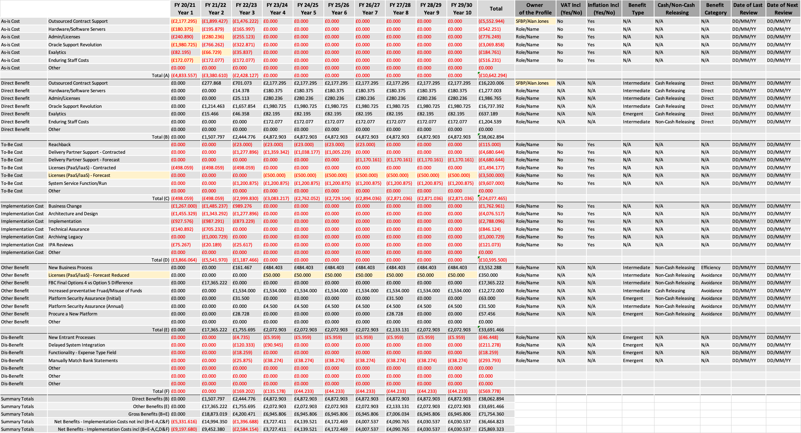
Image 6
Format of the monetary values: £MMM,TTT.HHH
These categorisations provide context behind the values and enables the information to be structured into different views.

