Slide 1
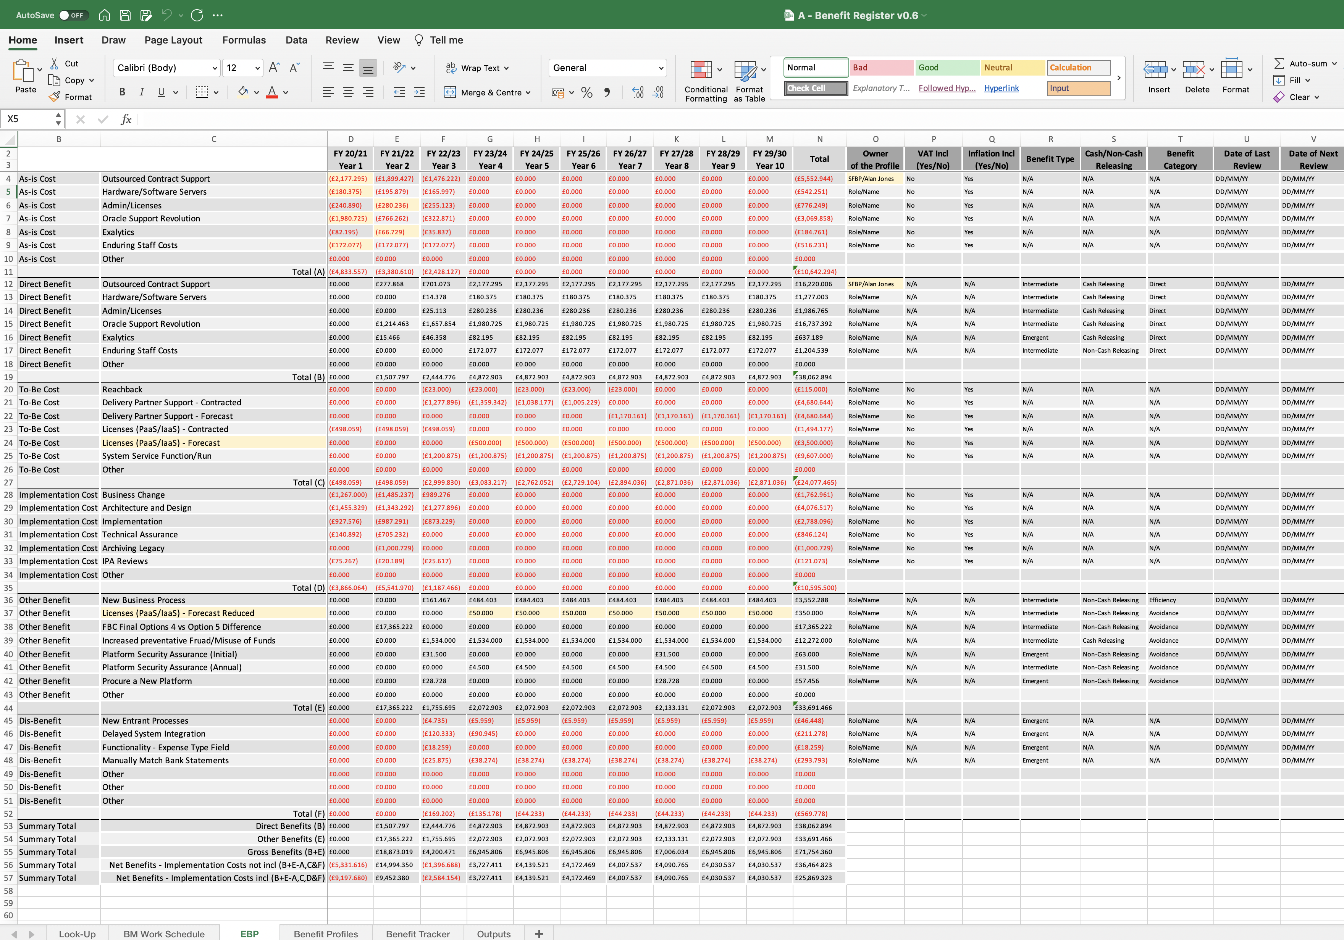
Image 7
Simple example of a Benefit Map
The lower level Intermediate & Emergent Benefits in the EBP, below, all inform and quantify the Economic End Benefit on the Benefit Map.
Outputs
Outcomes
End Benefits
Objectives
Review of Infrastructure
Improved User Experience
More Efficient
Fewer Servers
Increased Productivity
Reduced expenditure
Other…

