Slide 1
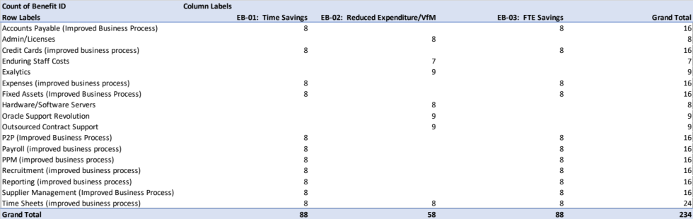
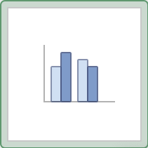
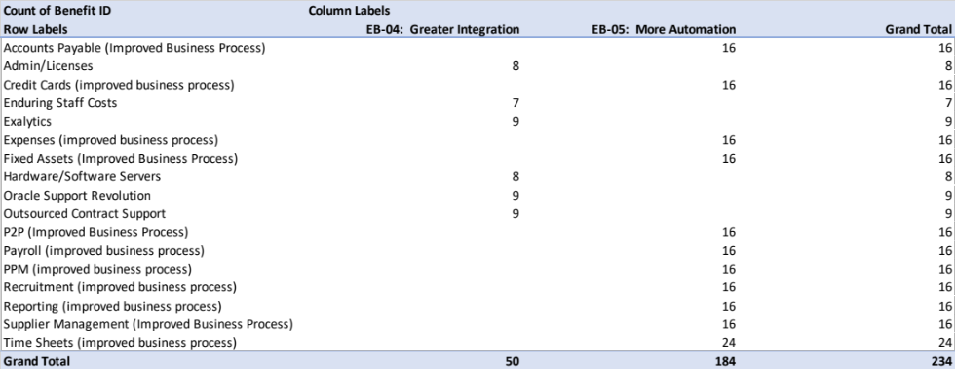
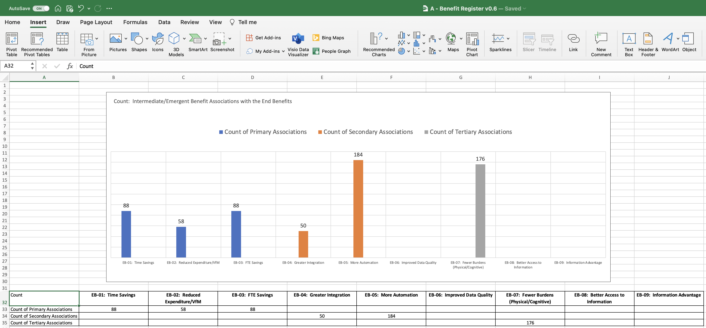
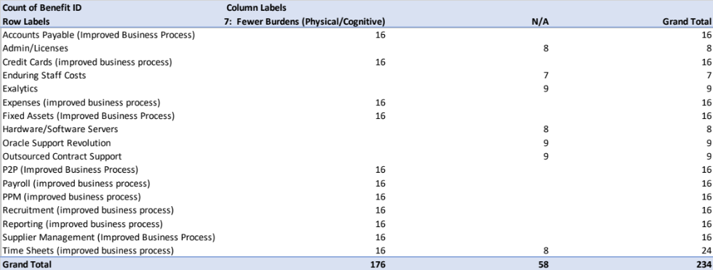
Image 100
Lastly, copy the 3 PivotTables from the 3 worksheets into a PowerPoint file as seen on the left to help with the next steps.
Create a new worksheet, call it ‘E-Ben Assoc View’, move it to the right of the 3 PivotTables previously created.
Create the small data table show at the bottom of the ‘E-Ben Assoc View’ worksheet (in reality, the End Benefits will be from the CI’s Benefit Map but for the purpose of this exercise, they have been copied from the Look-Up’ worksheet).
Populate the highlighted Primary, Secondary and Tertiary ‘Grand Totals’ (PivotTables on the left), into the data table below.
Edit field A32 in the data table, then insert a Bar Chart. Use image 72 to remind you but this time, insert the following Bar Chart.
Use your new Excel skills to tidy the chart so it looks presentable like the example below.
Ignore this column. The N/A represents those intermediate/Emergent Benefits that have been annotated with ‘N/A’ in the ‘Tertiary End Benefit’ field in the Benefit Profiles worksheet because the associations would be too tenuous.

