Slide 1
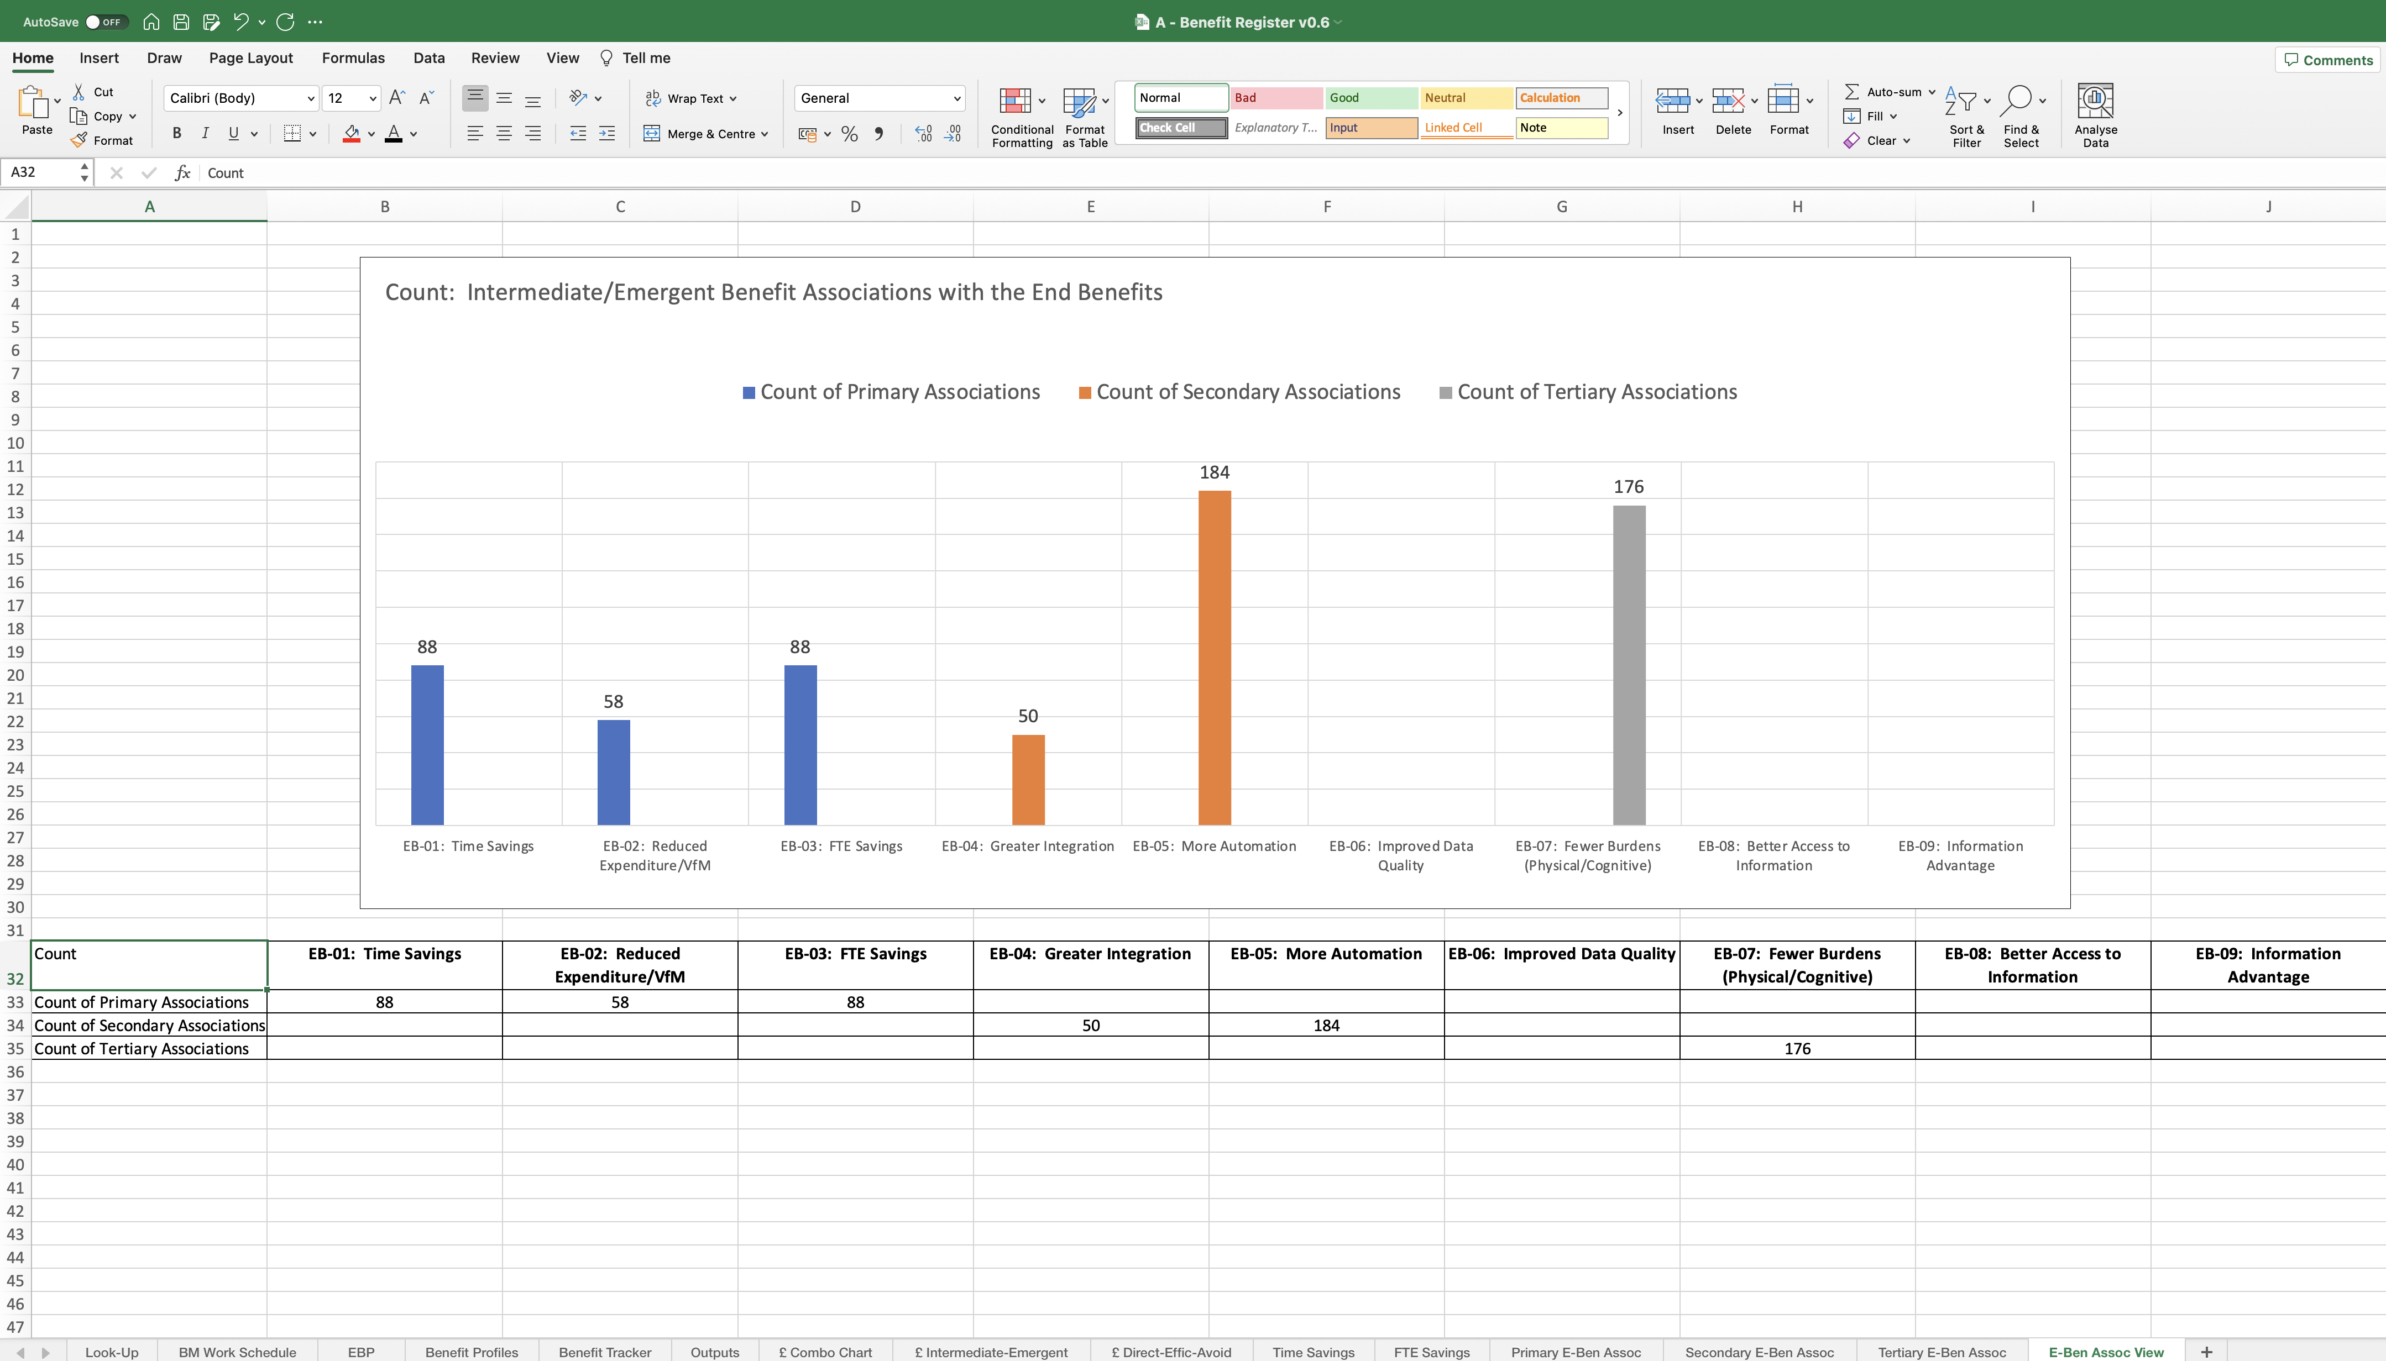
Image 101
1
Direct
Contributions
Indirect
Contributions
2
No Contributions
3

