Slide 1
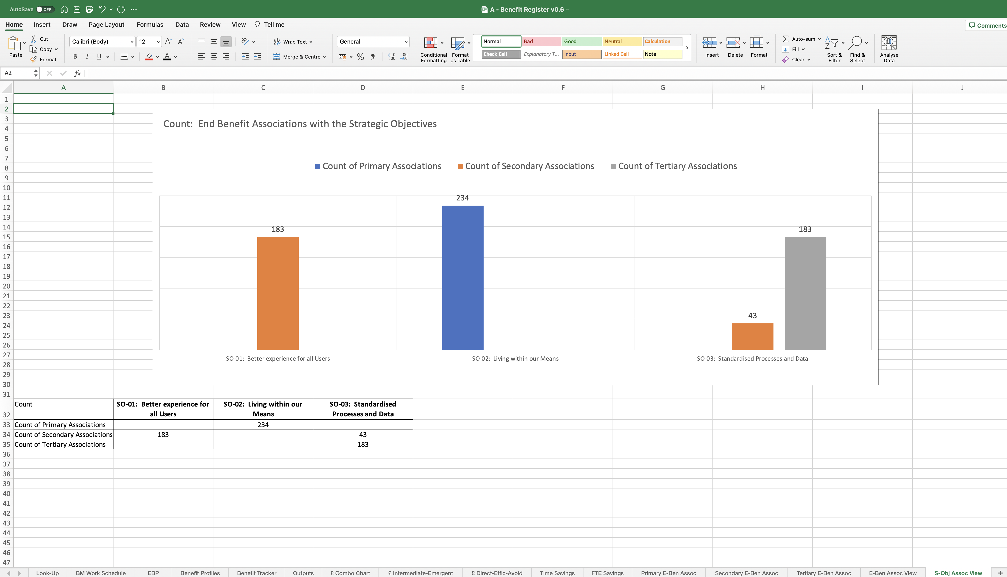
Image 102
On this occasion, you can see all 3 Strategic Objectives have direct and indirect associations.

