Slide 1
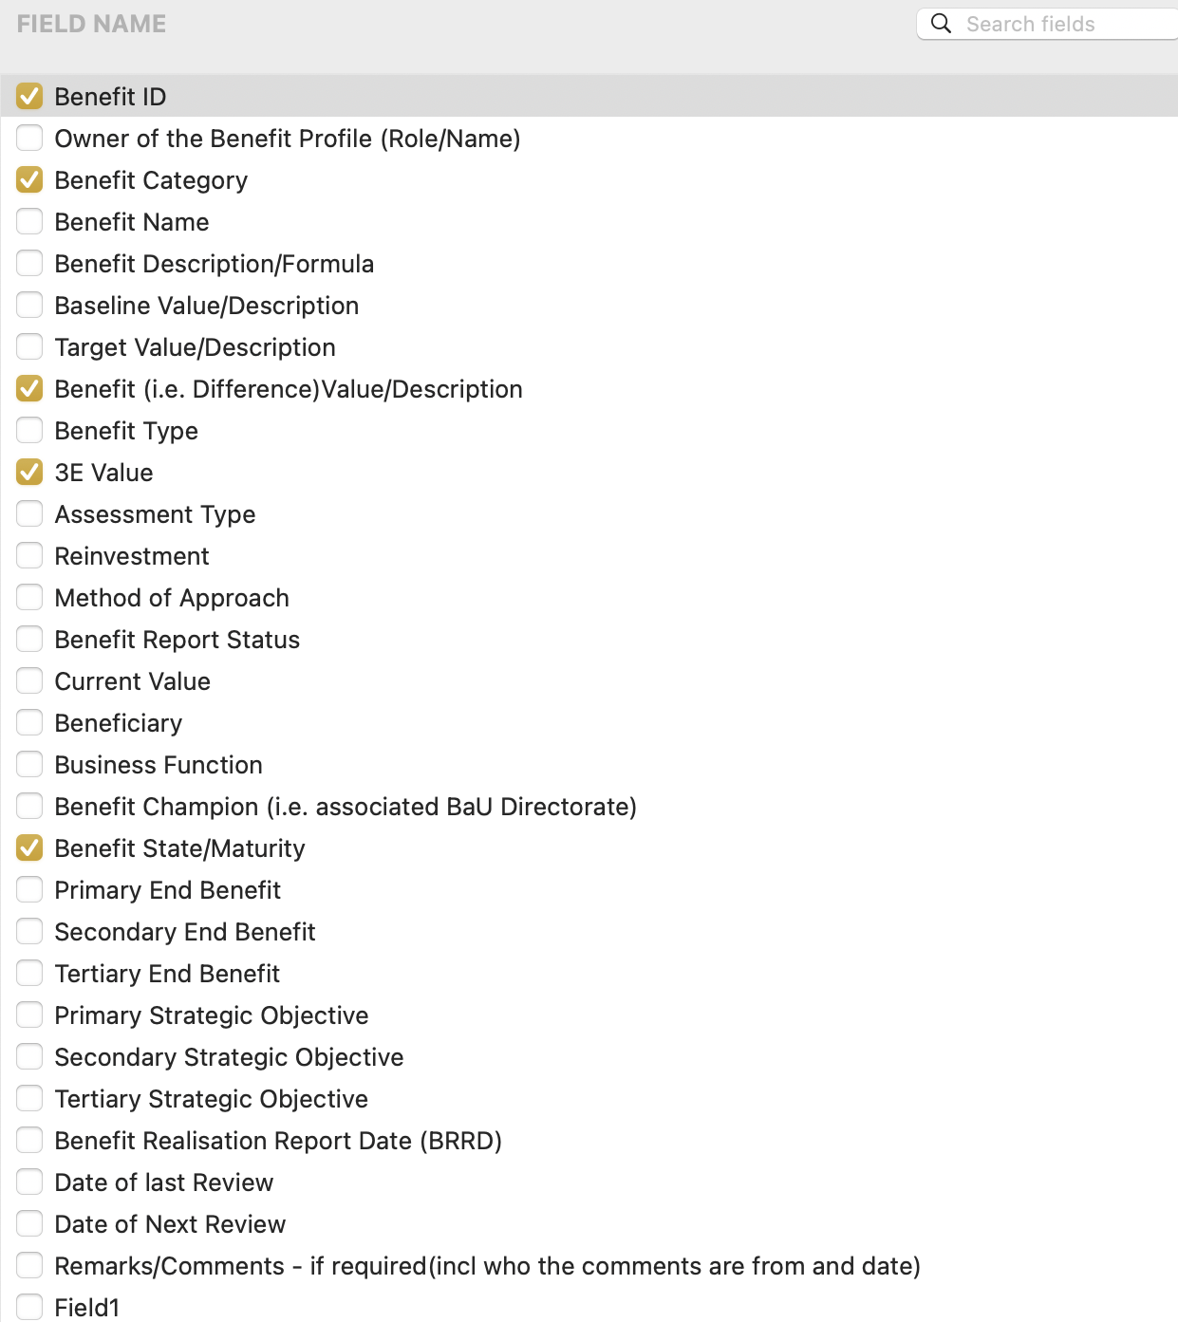
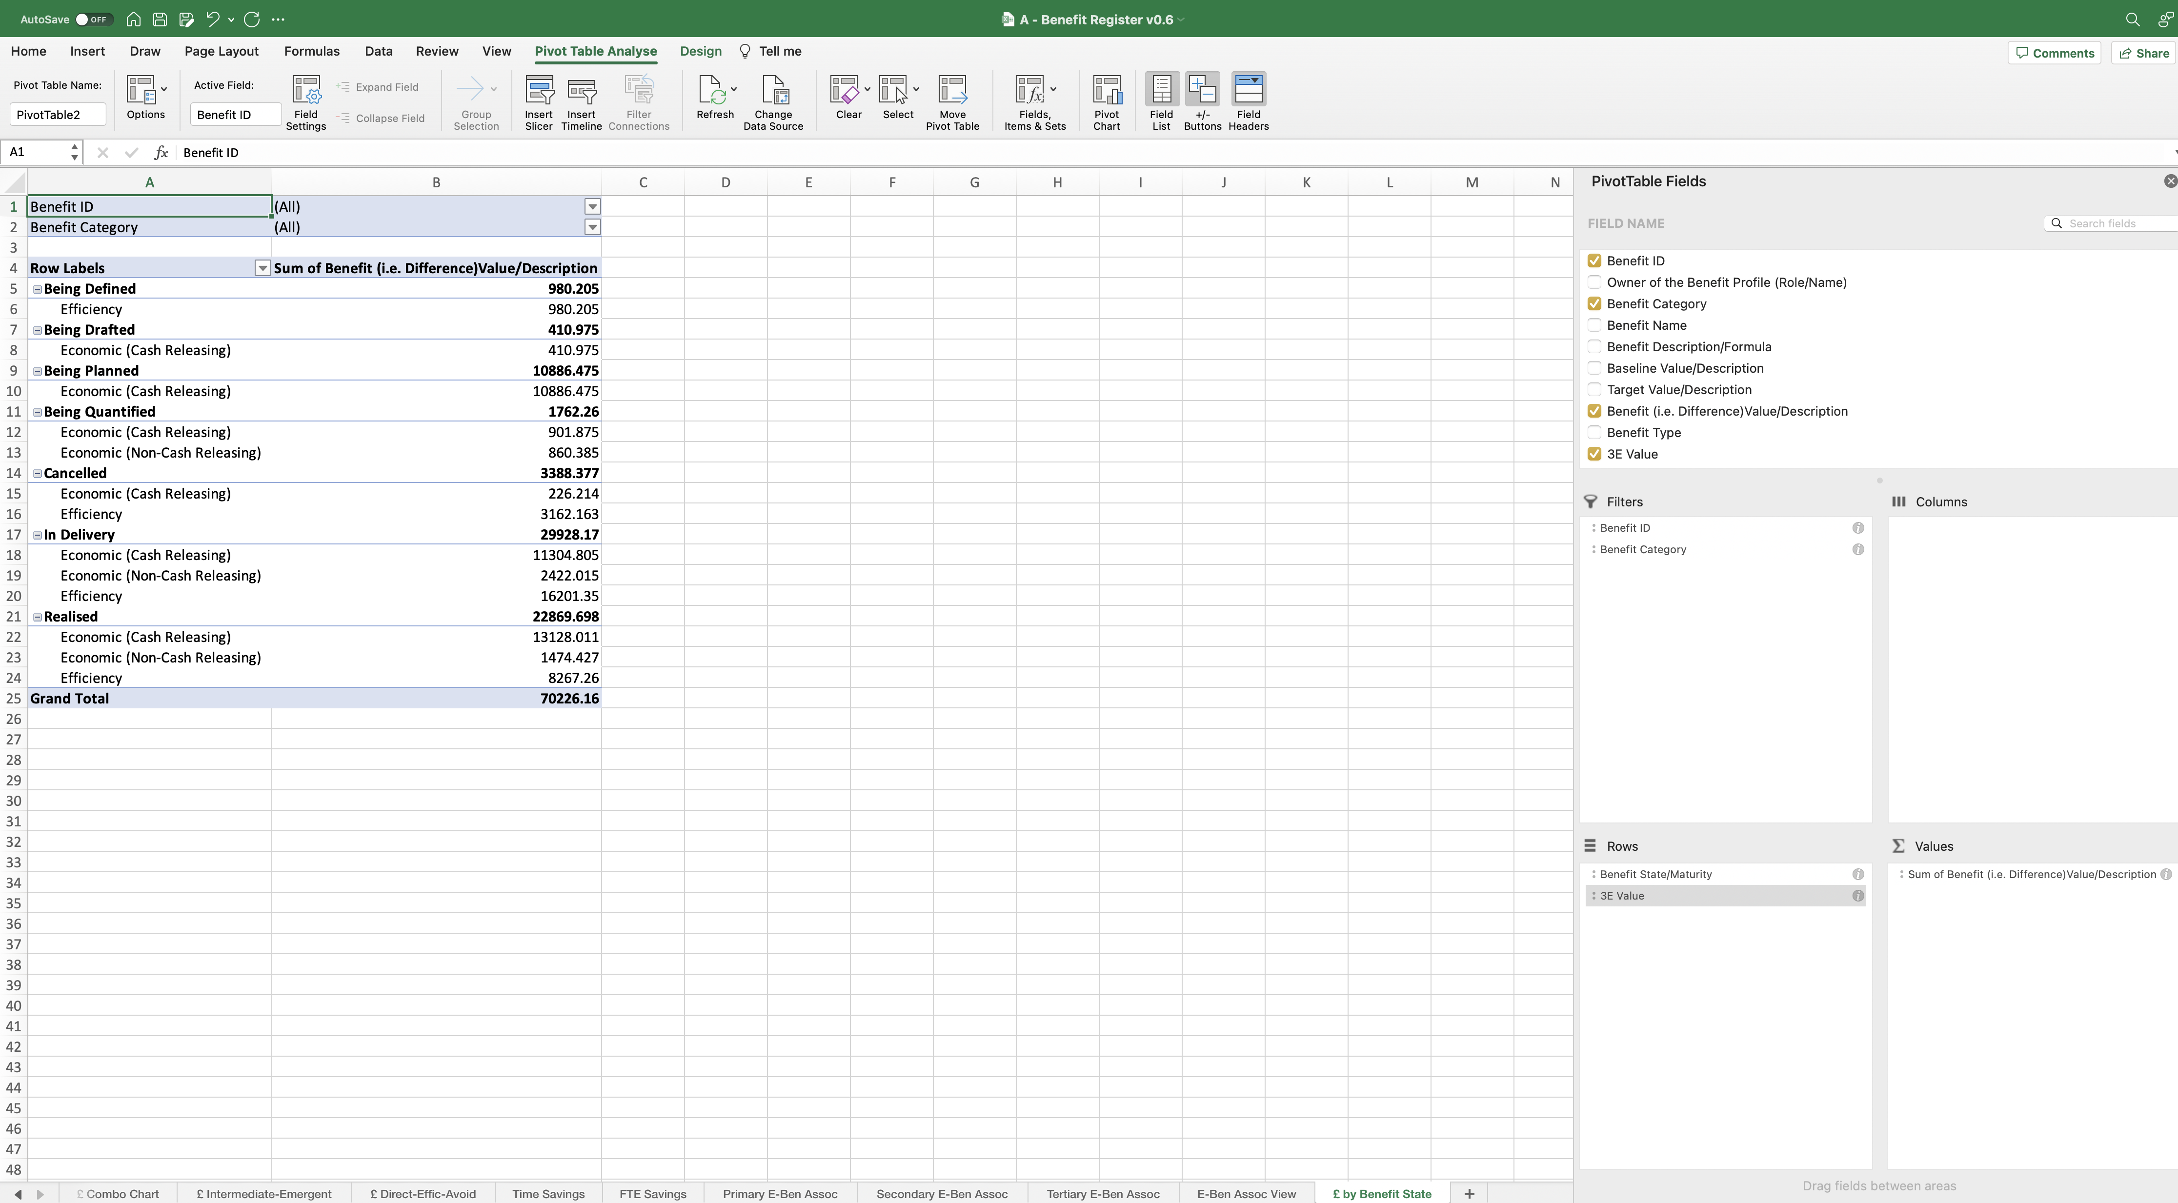
Image 105
Drag and drop the highlighted field names from the ‘Field Name’ group at the top, into the ‘Filters, Columns, Rows and Values’ fields at the bottom as shown.
When complete, the field name ‘Benefit (i.e. Difference/Value/Description)’, auto populates with the additional text ‘Sum of’, when it has been dropped into the ‘Values’ field. Allow that to happen – do nothing.

