Slide 1
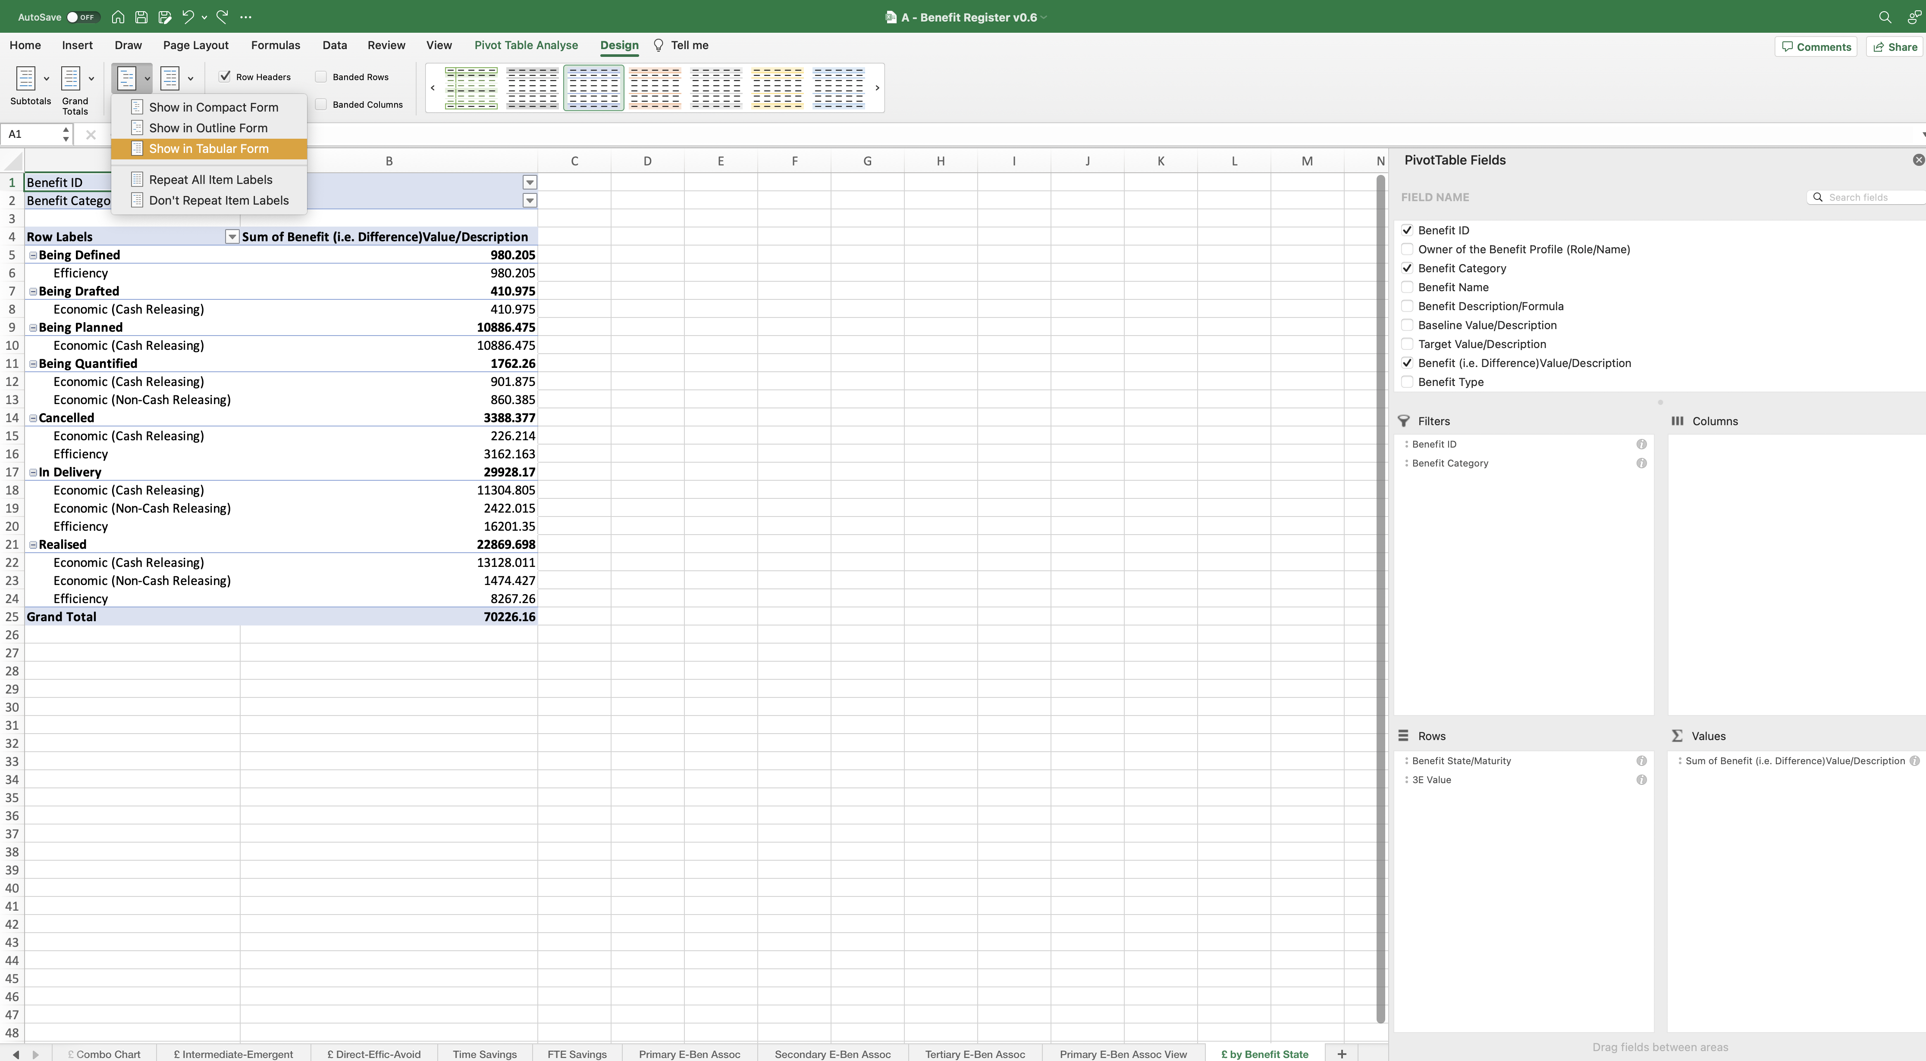
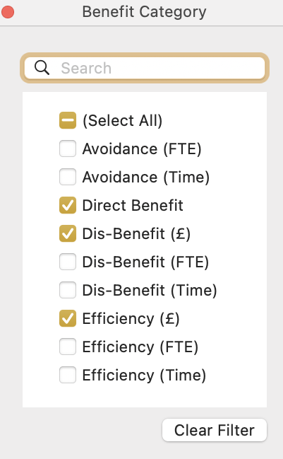
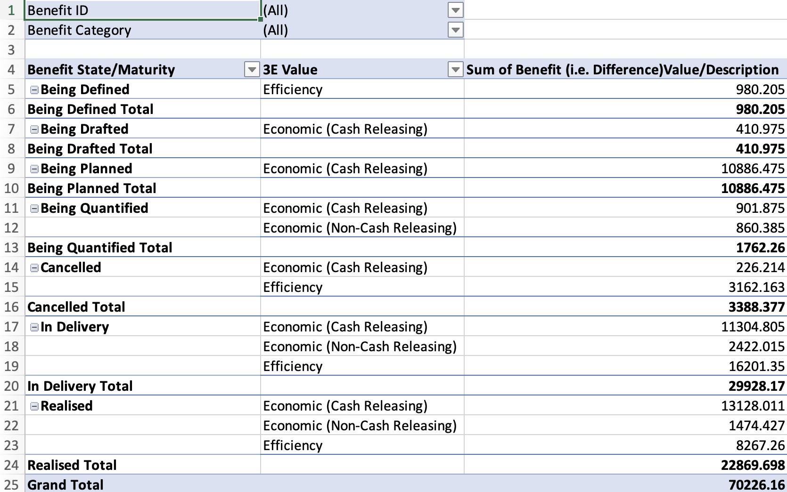
Image 106
2
Select ‘Report Layout’.
1
Select ‘Design’.
Select ‘Show in Tabular Form’.
3
When the Benefit Category window opens, select only those Benefits generating a monetary value.
6
5
Select the ‘Benefit Category’ drop down icon.
4
The PivotTable now looks like this.

