Slide 1
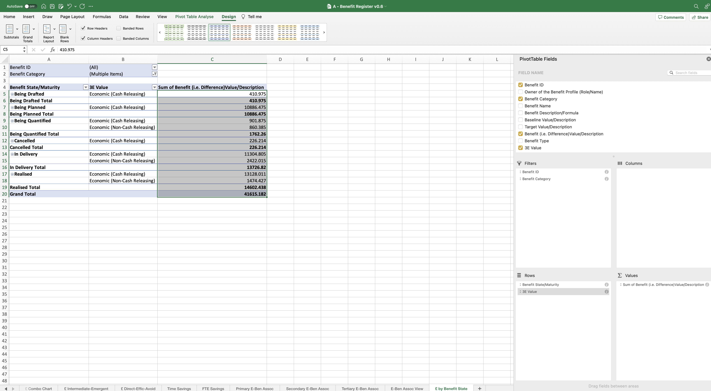
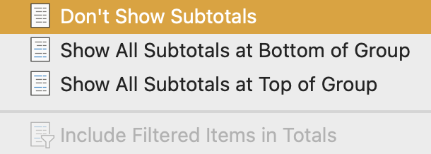
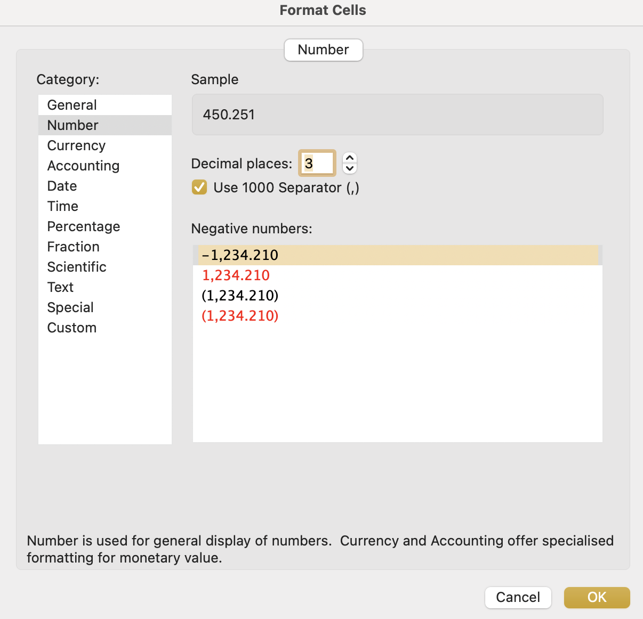
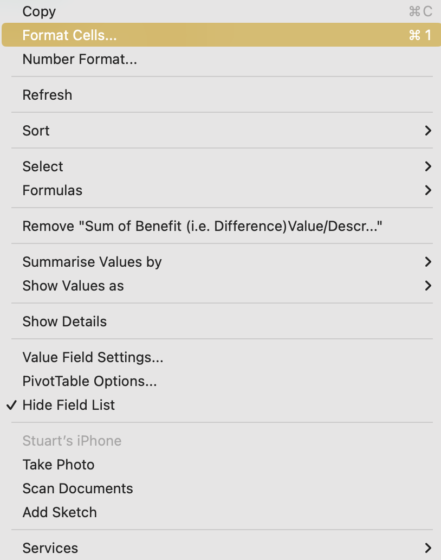
Image 107
2
Select ‘Sub Totals’.
1
Remain in the ‘Design’ field.
Select ‘Don’t Show Subtotals’.
3
The ‘Format Cells’ window will appear. Select (a) ‘Currency’ (b) ‘3 Decimal Places’ (c) ‘£ Symbol’ (d) ‘4th option for Negative Numbers’ (e) ‘OK’.
5
Now we want to format the fields. Select all of them as shown, right click onto any of the selected fields, then select ‘Format Cells’.
b
a
4
c
d
e

