Slide 1
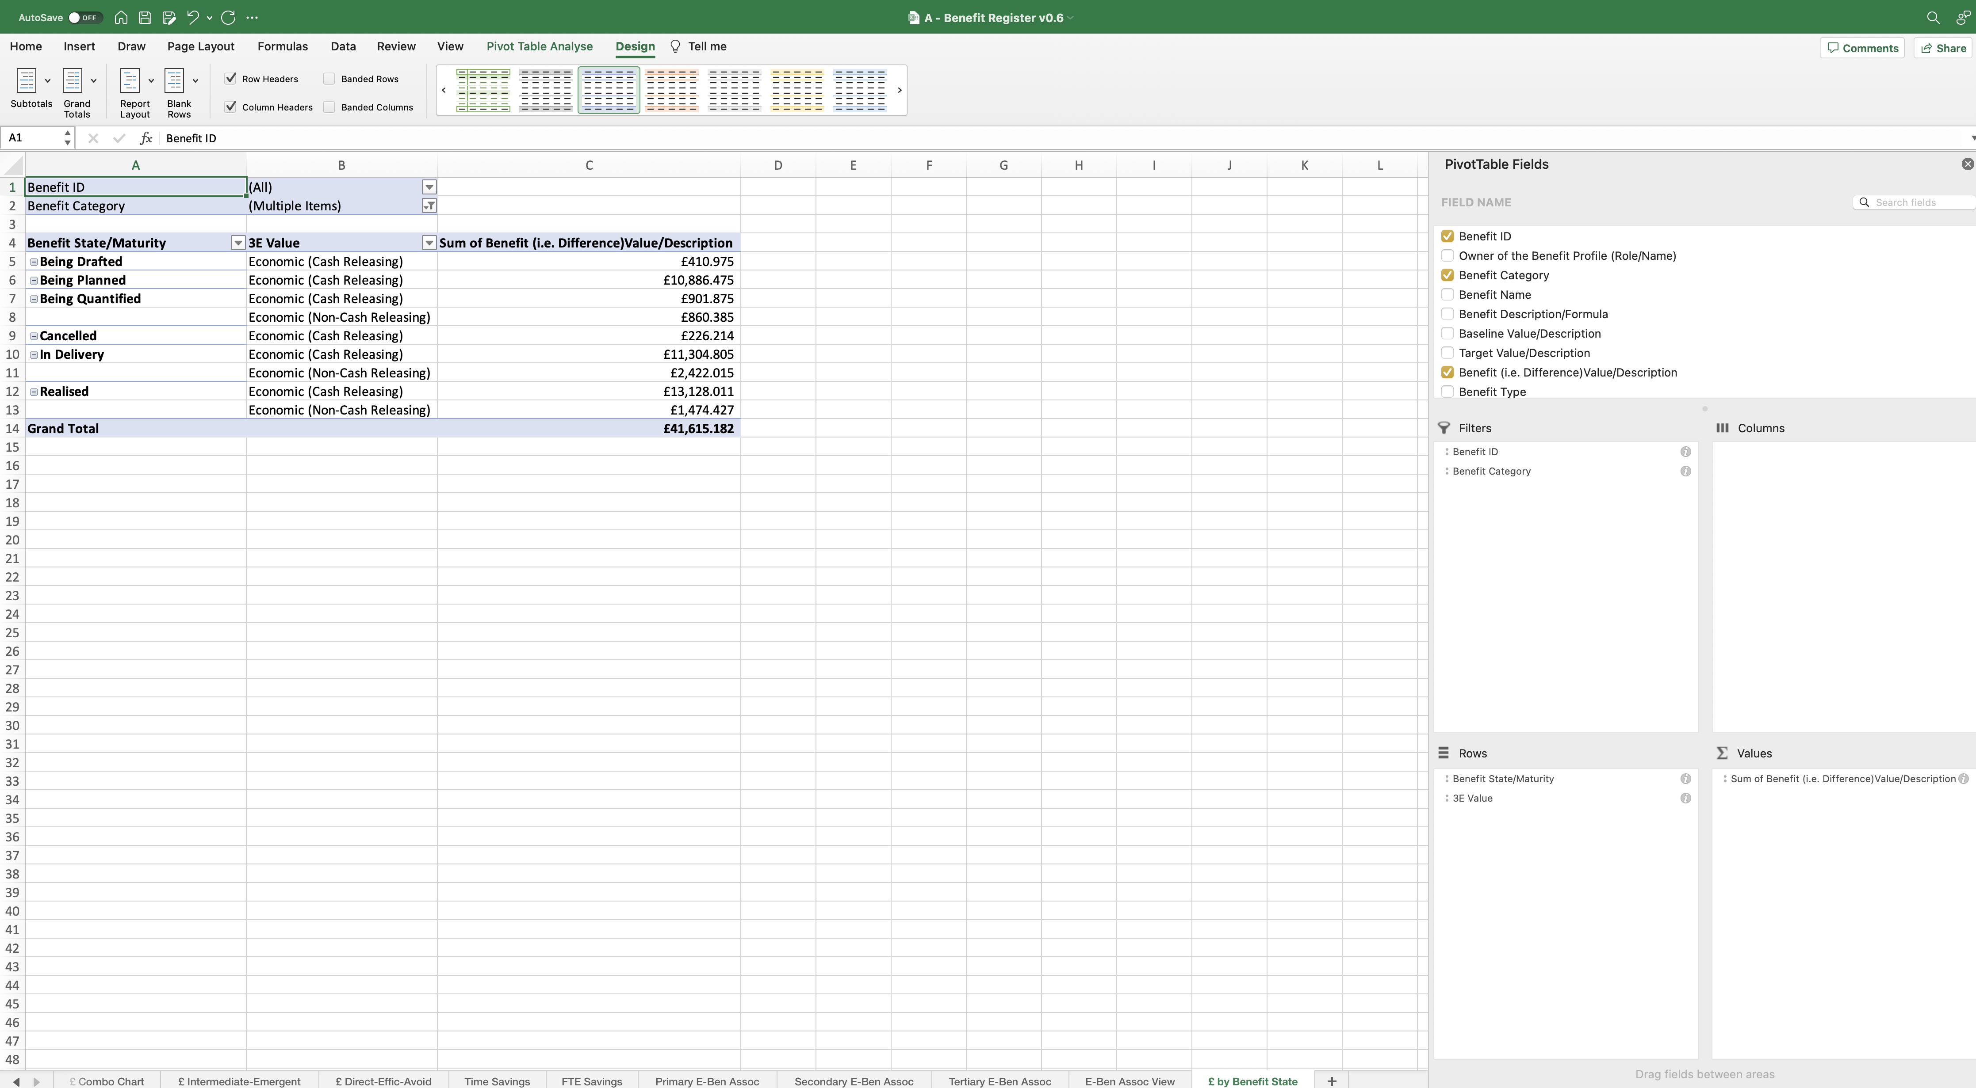
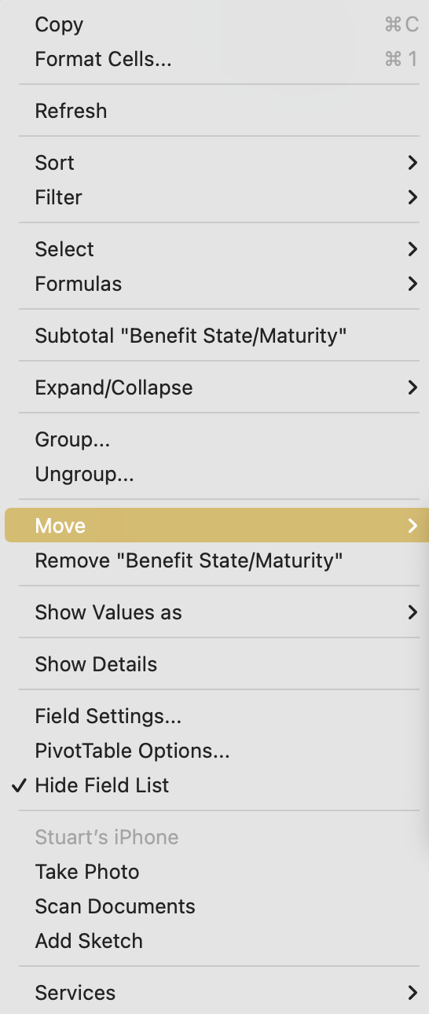
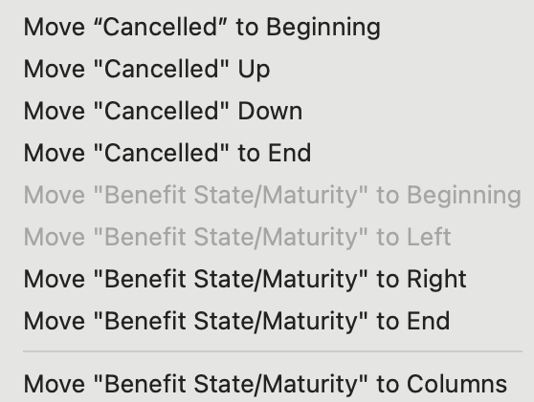
Image 108
1
The PivotTable now looks like this.
Order of the Benefit State/Maturity
Being Drafted
Being Defined
Being Quantified
Being Planned
In Delivery
Realised
Cancelled
3
When this window opens, move the order of the categorisations individually, so they appear in the order on the right.
The Benefit State/Maturity categorisations need to be ordered. Right click on them individually, then select ‘Move’.
2
Formatting of the PivotTable is now complete; the line chart can be added next.
4

