Slide 1
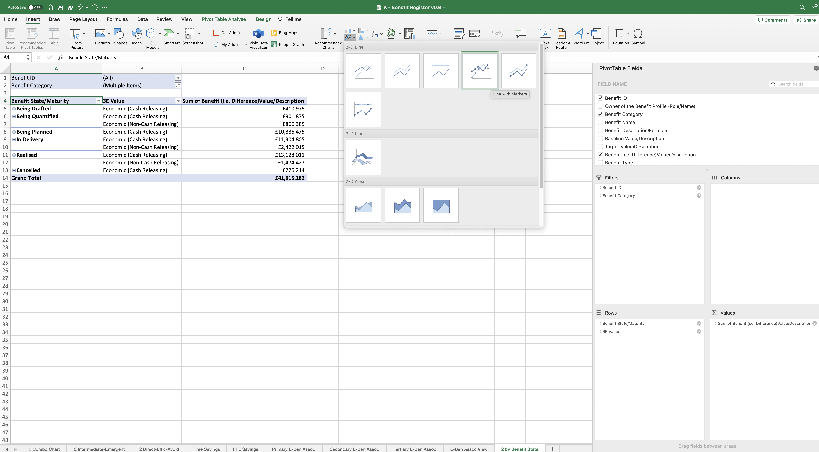

Image 109
Select the ‘Insert’ tab.
2
3
Select the ‘Line Chart’ icon.
4
Select this Line Chart.
1
Edit the PivotTable.
The Line Chart will drop into your view. Drag any one of the 4 corners to enlarge the image.
5

