Slide 1
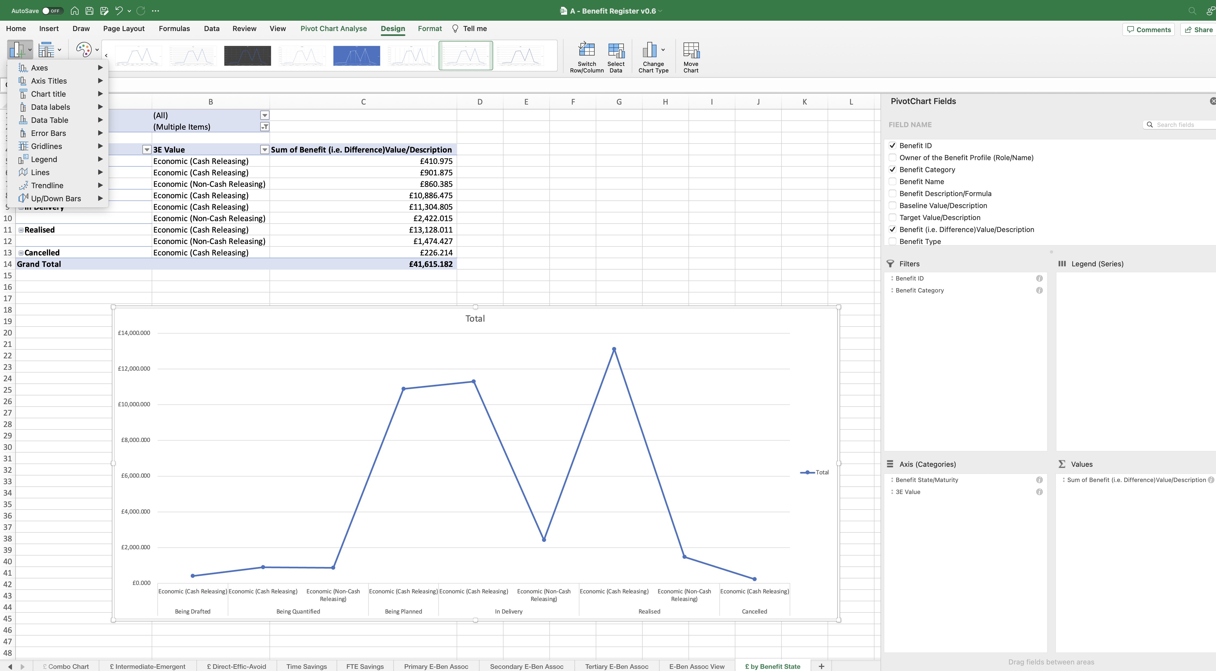
Image 110
Select the ‘Add Chart Element’ field.
6
5
Select the ‘Design’ tab.
When this window appears, exploit the options and practice formatting the Line Chart so it becomes presentable, like the example at image 111.
7
4
Edit the Line Chart in this space.
Right click on the ‘key’ then select ‘Delete’.
3
1
Right click on the ‘y-axis’ then select ‘Delete’.
Click anywhere on the ‘x-axis’, then select the ‘Home’ tab at the top of your screen to increase the size of the font as shown in image 73, step 3.
2

