Slide 1
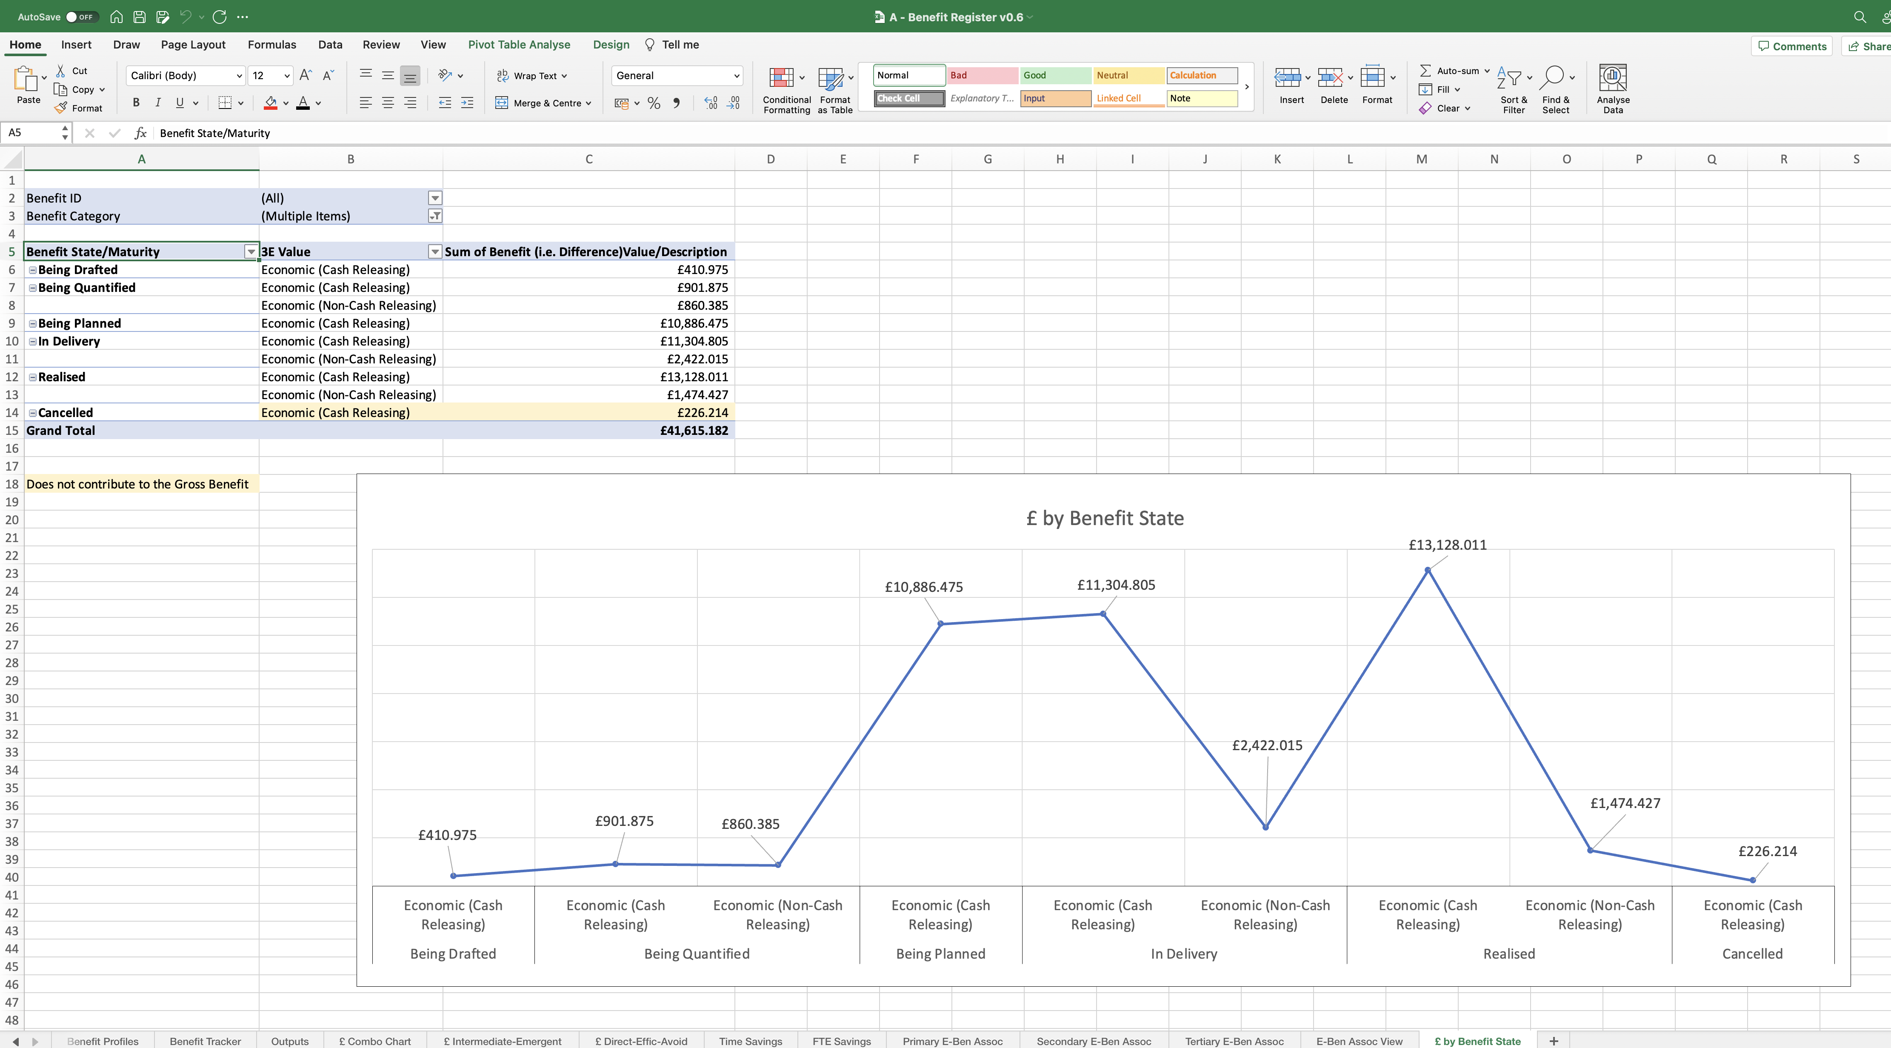
Image 111
Note comment in field A18.

