Slide 1
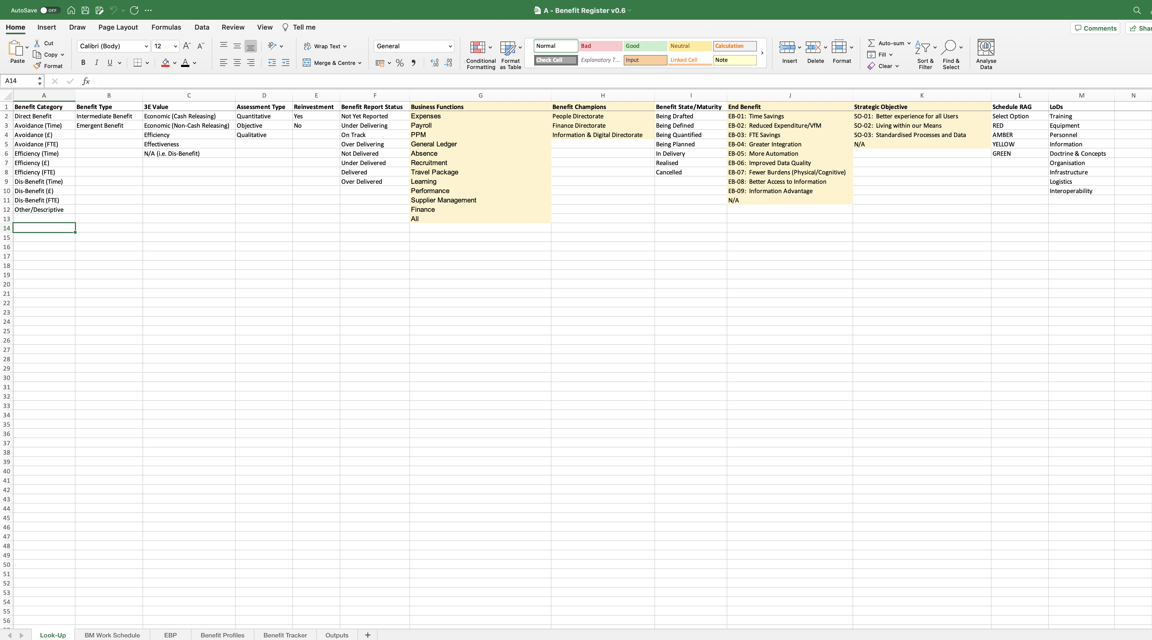
Image 19
The yellow fields represent those fields the BM would need to populate using their own Information.

