Slide 1
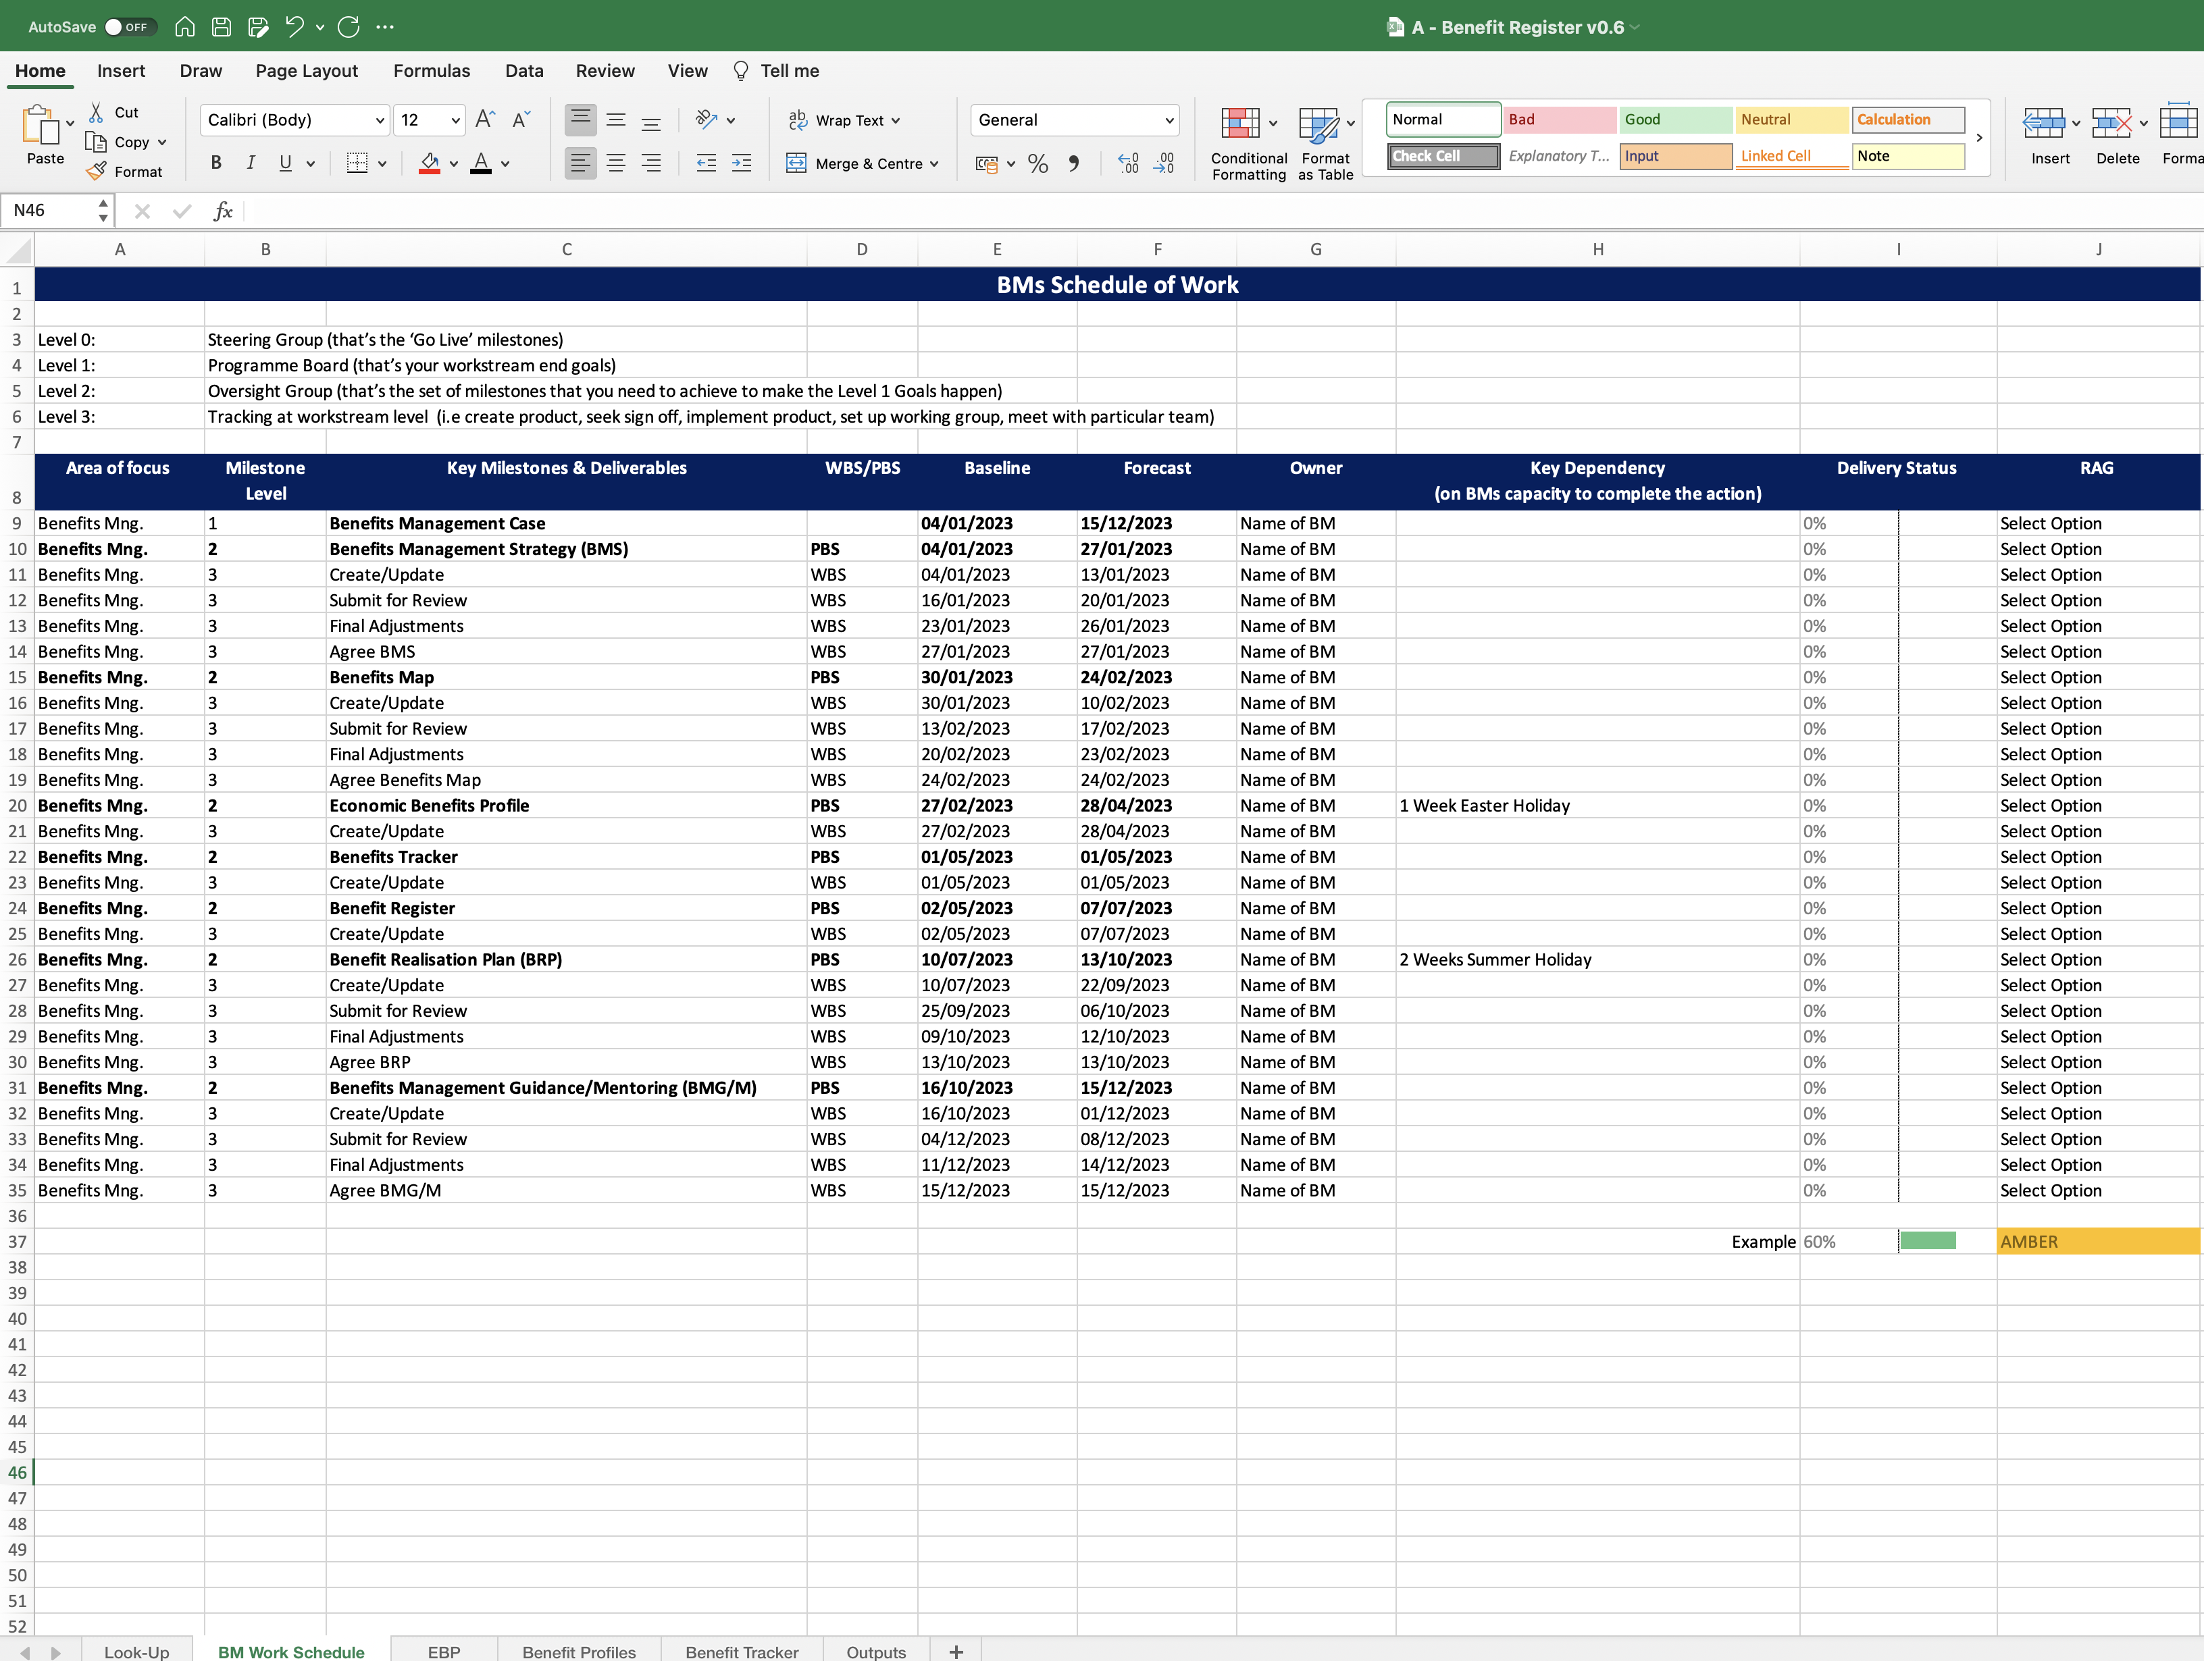
Image 20
Columns Containing Conditional Formatting.

