Slide 1
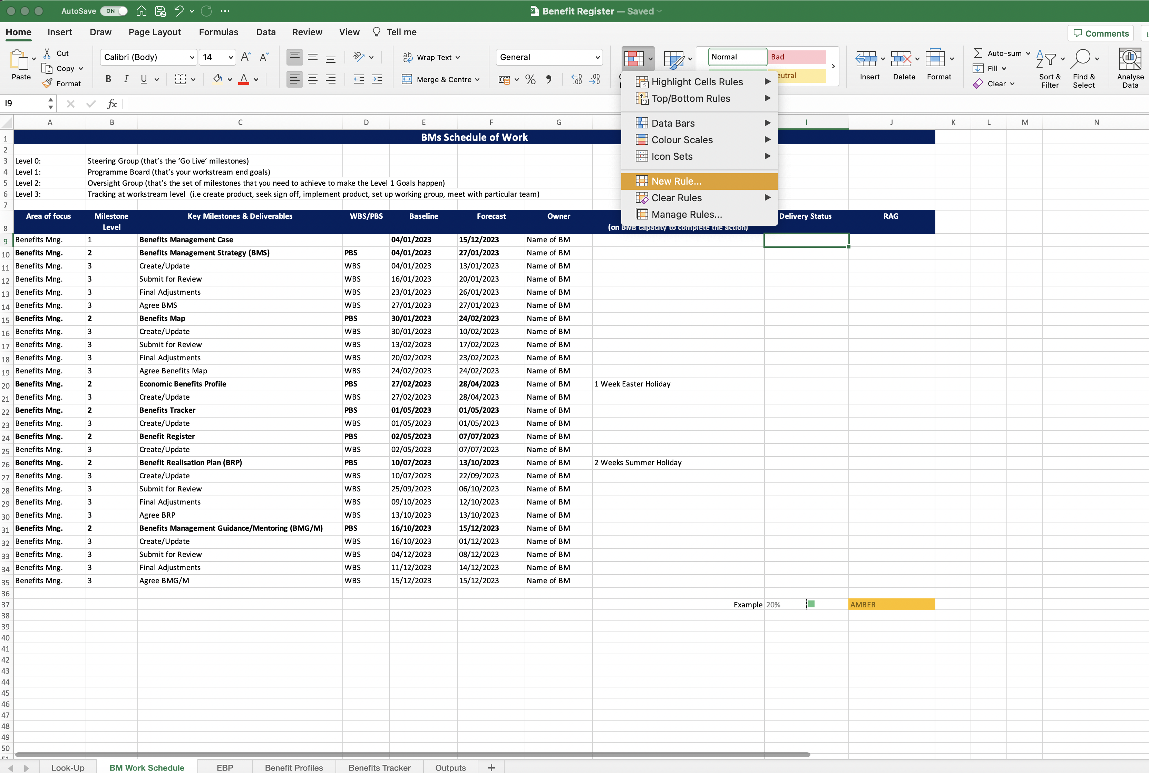
Image 21
3
Select ‘Conditional Formatting’
2
Select ‘Home’
1
Edit field
You are going to insert the conditional formatting in column I, as seen in field I37.
4
Select ‘New Rule’

