Slide 1
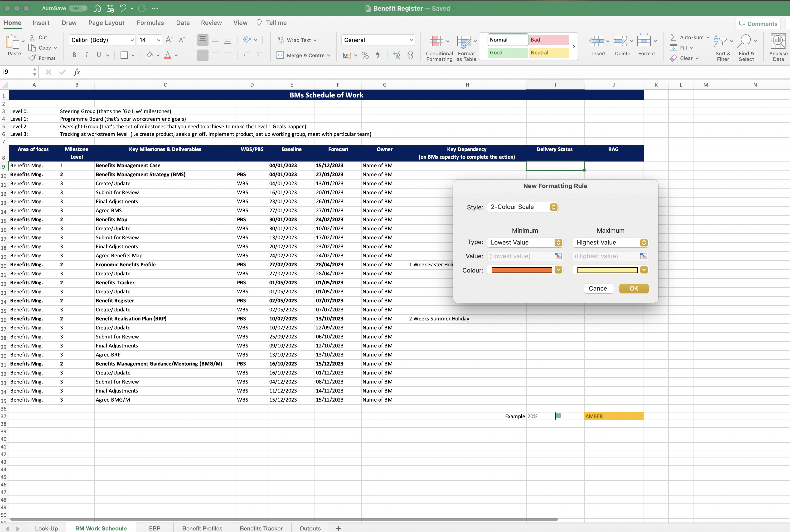
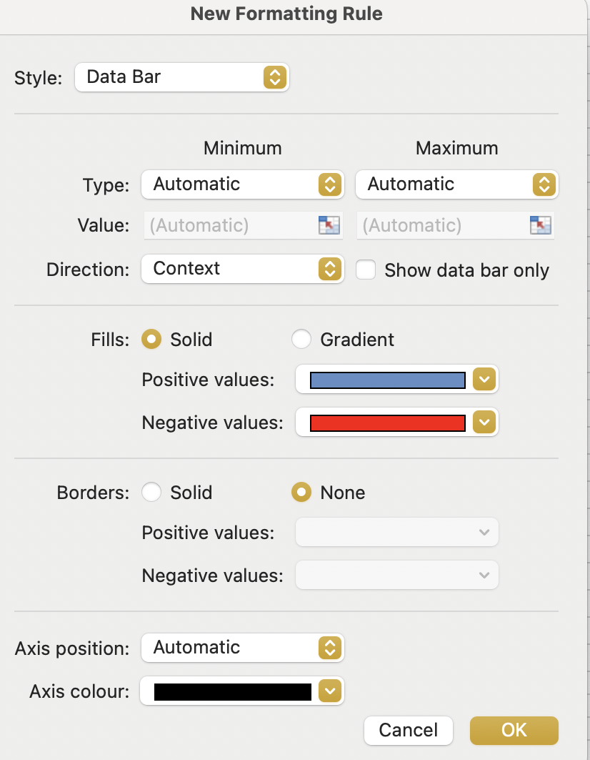
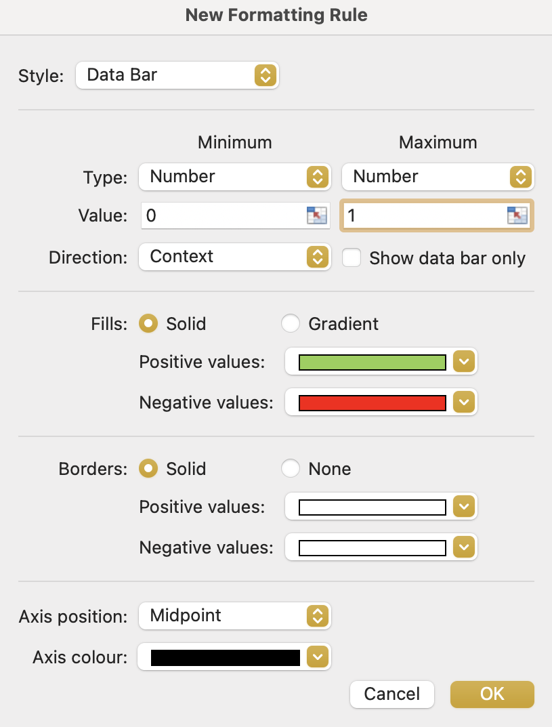
Image 22
When the ‘New Formatting Rule’ window opens, select ‘Data Bar’ from within the drop-down options.
When the ‘Data Bar’ option is selected, the window expands as shown.
1
2
Populate the fields so they look like this.
3
4
Select ‘OK’

