Slide 1
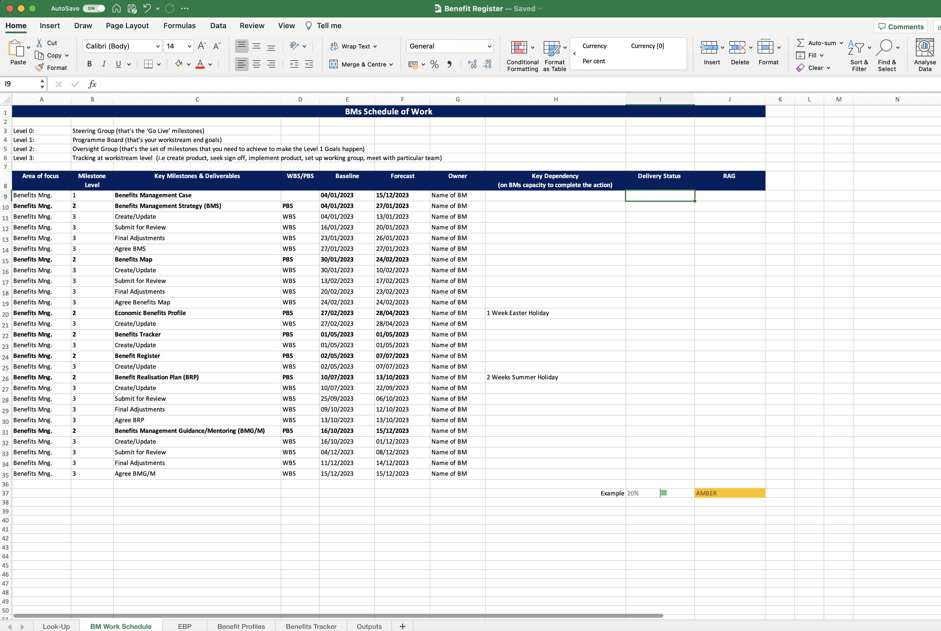
Image 23
When the new rule has been created, Excel will return you to the ‘BM Work Schedule’ worksheet.
Scroll in the window shown by the arrow until you find and select ‘Per cent’.
Copy field I9 and paste it into fields I10–I35.
Test ‘column I’ fields are working correctly (i.e. insert a numeric value ‘20’ and see if the field populates like the example in field I37.

