Slide 1
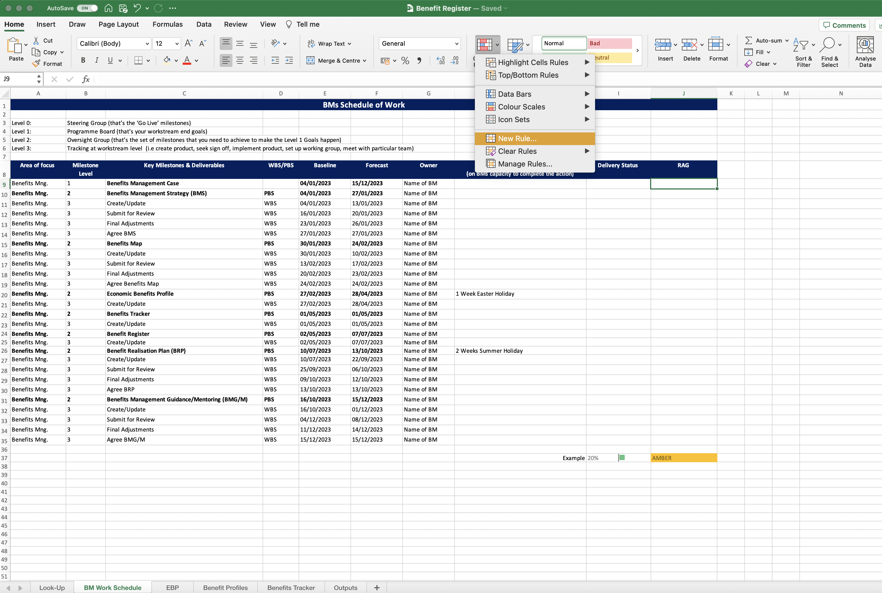
Image 24
3
Select ‘Conditional Formatting’
2
Select ‘Home’
You are going to create the RAGs (also called rating) in column J, as seen in field J37.
1
Edit field ‘J9’
4
Select ‘New Rule’

