Slide 1
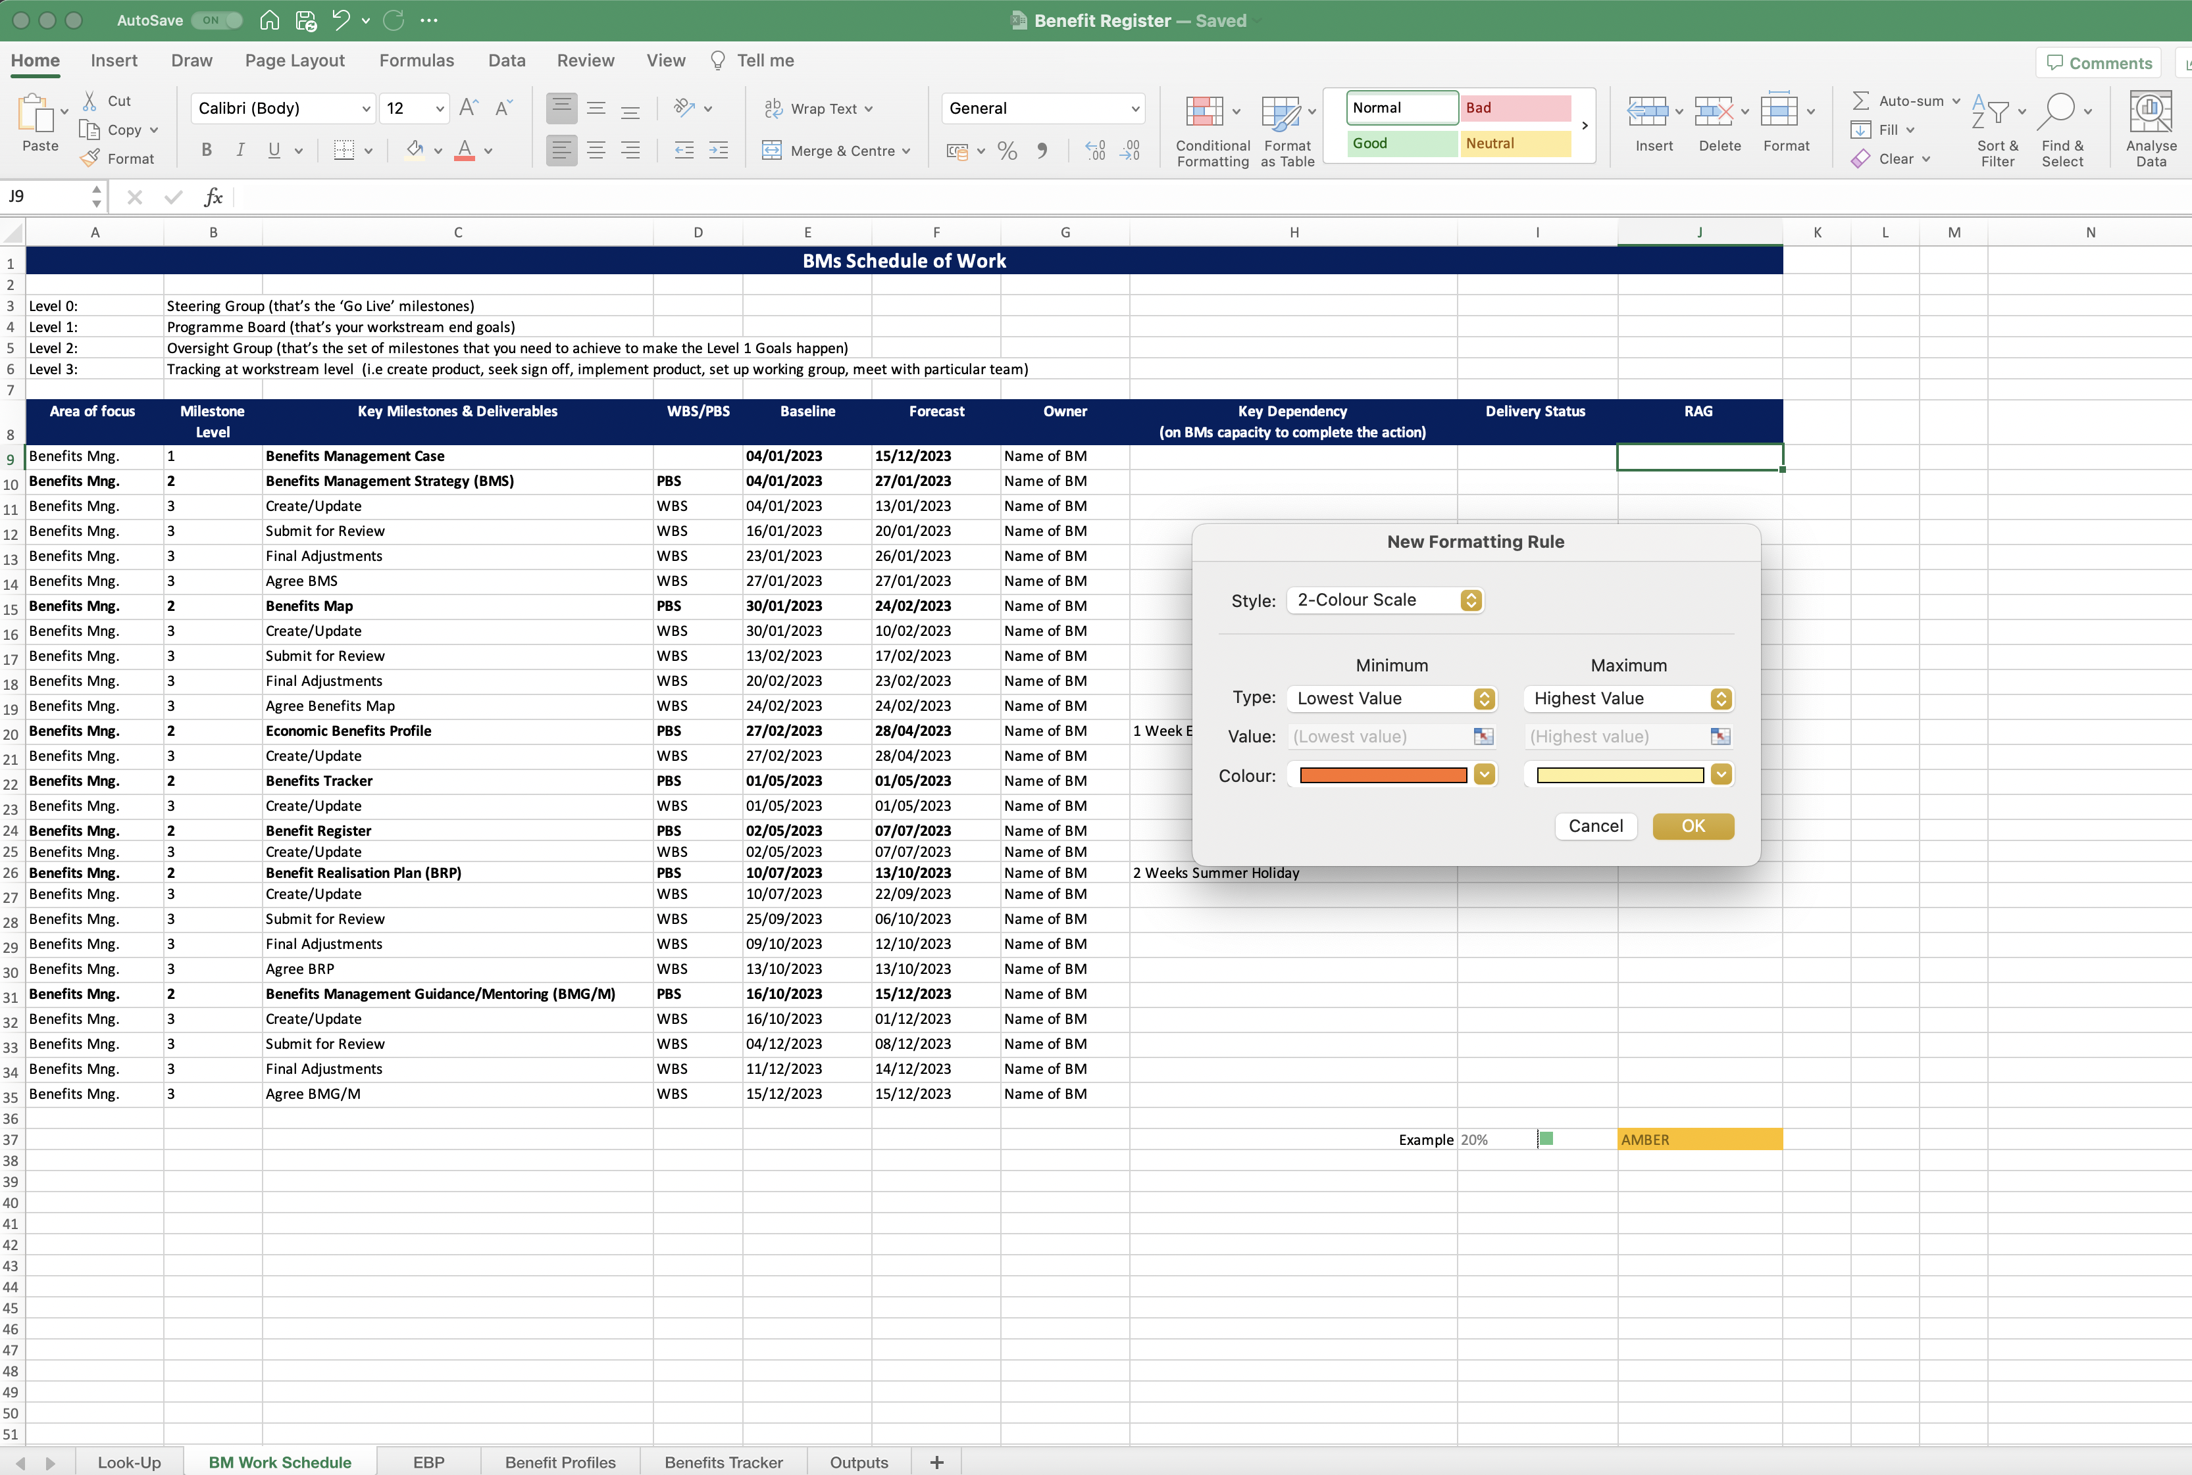
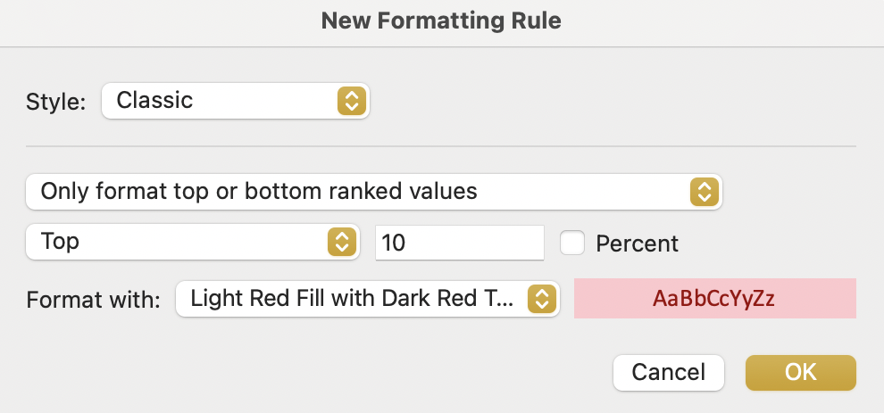
Image 25
3
When the ‘New Formatting Rule’ window opens, select ‘Classic’ from within the drop-down options.
When the ‘Classic’ option is selected, this window will appear.
Populate the fields so they look like each of the 4 steps in the next image (image 26).
In other words, undertake this process 4 times to create 4 new rules. The 4 new rules differ slightly (i.e. RED, AMBER, YELLOW, GREEN) as seen in image 26.
Note: When the rules have been created, you can see them by doing this (a) refer to image 24 step 4 then (b) select ‘Manage Rules’ instead of ‘New Rule’.
1
2

