Slide 1
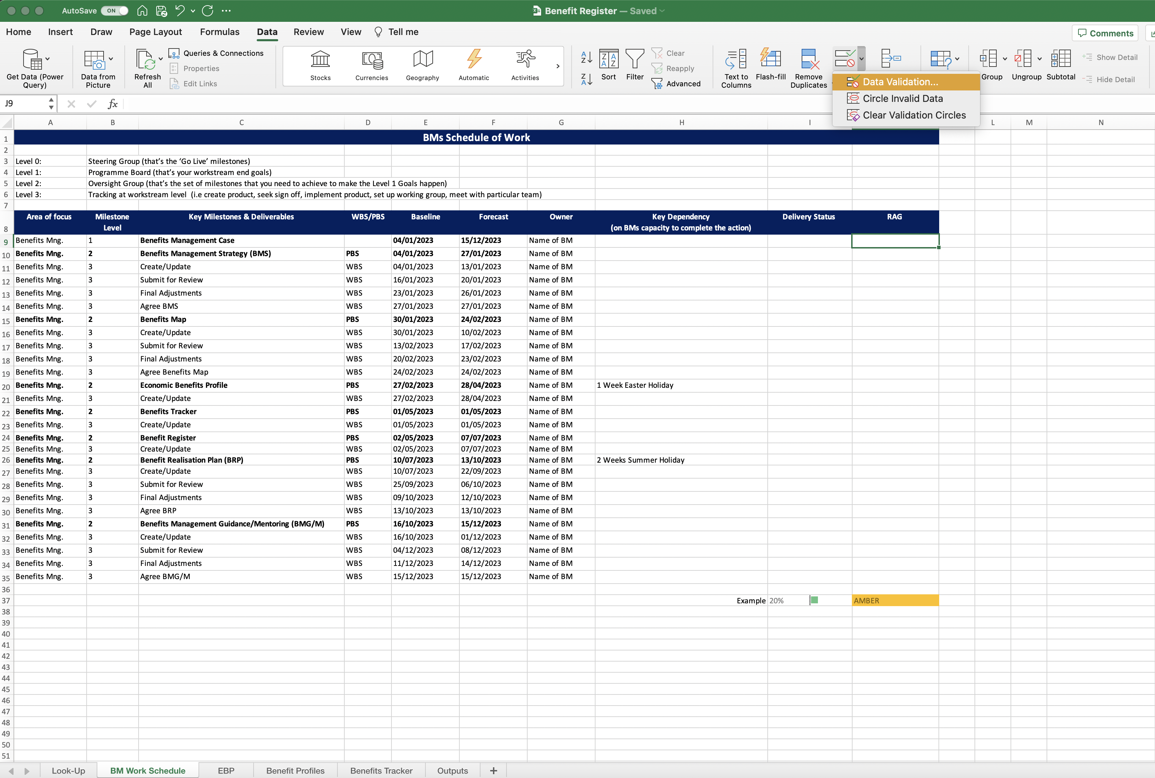
Image 27
Select ‘Data’
3
Select ‘Data Validation’
2
Select ‘Data Validation’
4
Finally, you are going to create a data validation in column J.
When the last of the 4 new rules have been created, Excel will return you to the ‘BM Work Schedule’ worksheet.
The cursor should remain in field J9. Complete steps 2, 3 and 4 to start creating the data validation.
1

