Slide 1
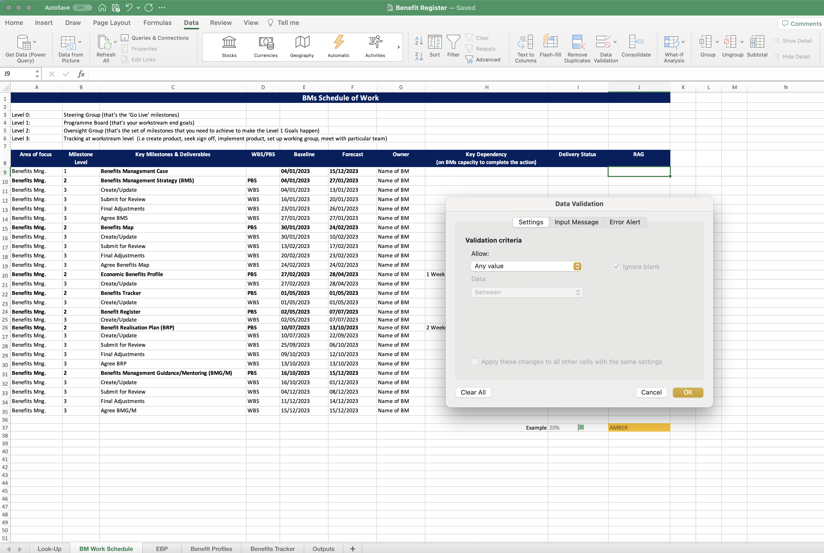
Image 28
When the Data Validation window opens, select ‘List’ from within the drop-down options, then select ‘OK’.

