Slide 1
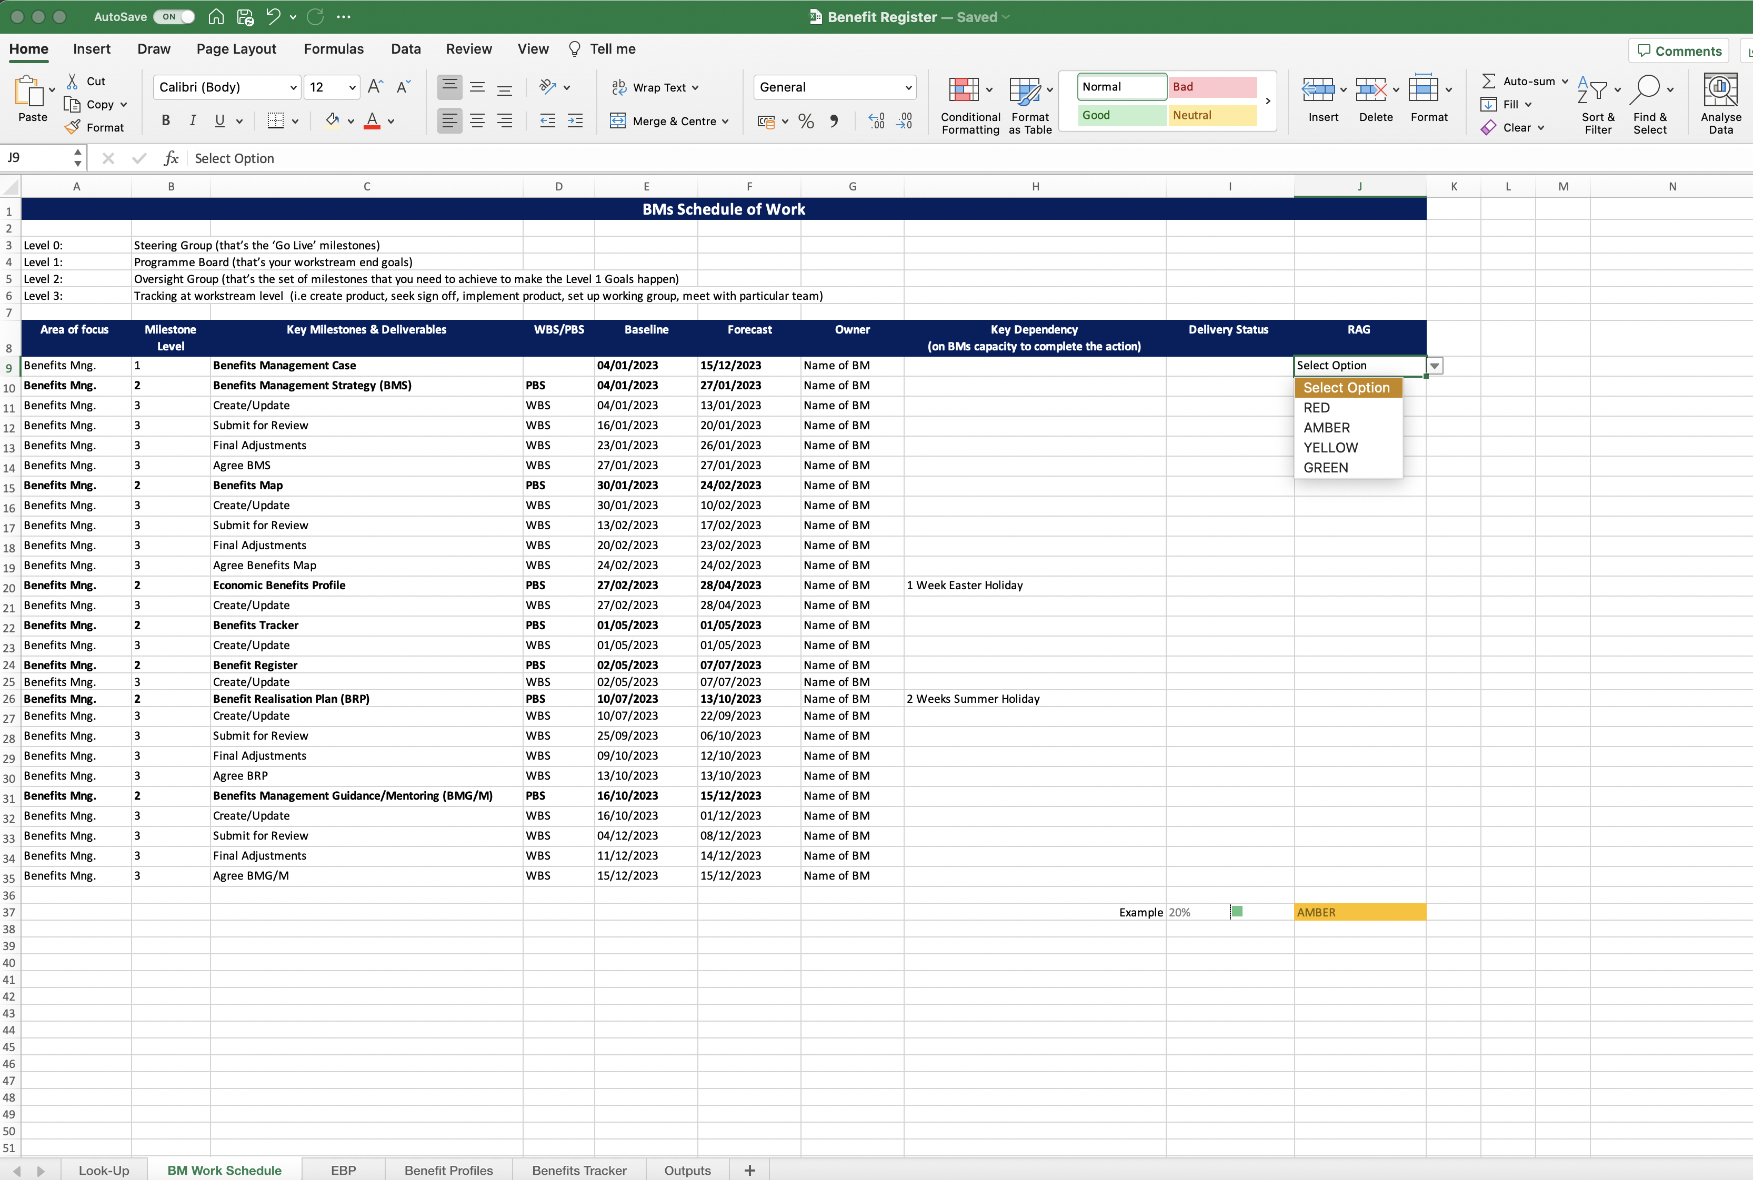
Image 31
When the data validation has been created, Excel will return you to the ‘BM Work Schedule’ worksheet. Select the drop-down arrow to check/see the Data Validations created in the previous steps.
Copy field J9 and paste it into J10–J35.
Test the ‘column J’ fields are working correctly (i.e. select AMBER and see if the field populates like the example in field J37).

