Slide 1
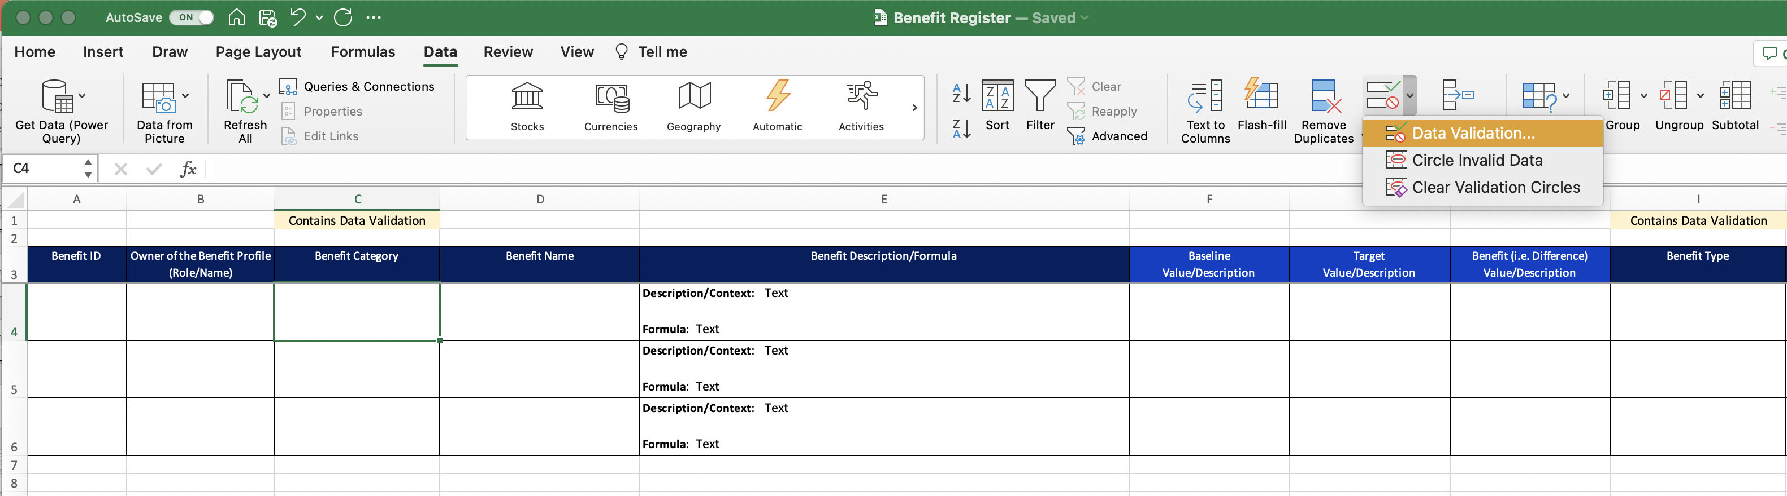
Image 33
2
Select ‘Data’
3
Select ‘Data Validation’
1
Edit field
4
Select ‘Data Validation’

