Slide 1
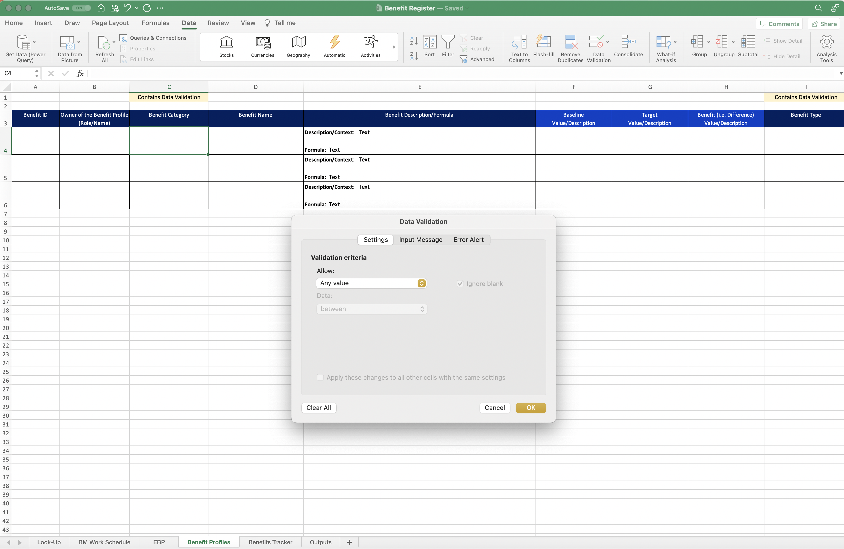
Image 34
When the Data Validation window opens, select ‘List’ from within the drop-down options.
1
2
Select ‘OK’.

