Slide 1
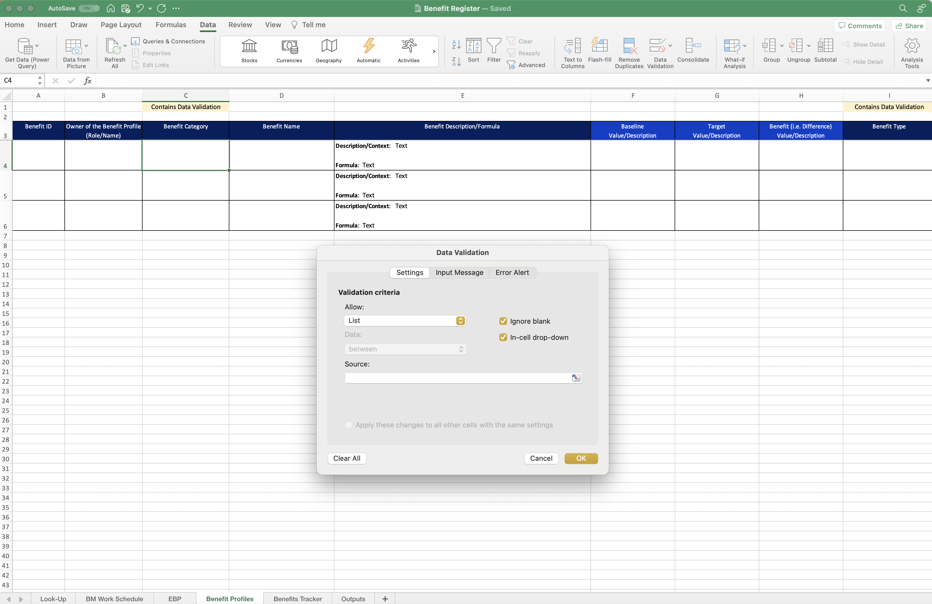
Image 35
2
Select the ‘Look-Up’ worksheet.
1
When the next Data Validation window opens, edit the ‘Source’ field.

