Slide 1
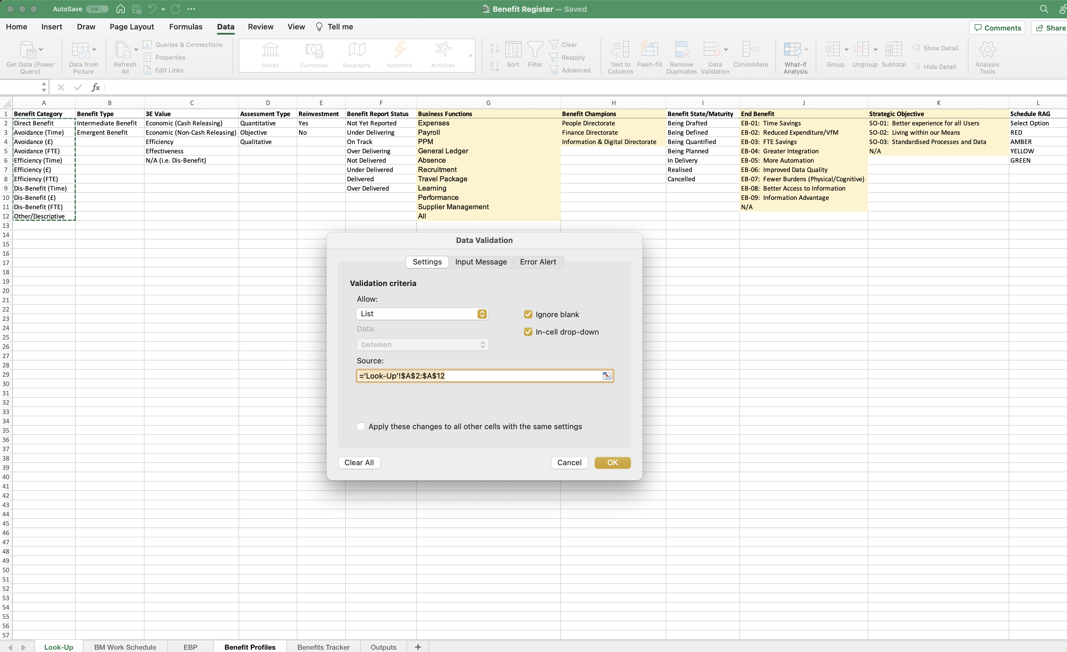
Image 36
Select all the ‘Benefit Category’ fields.
1
You will see the source field auto populate.
2
3
Select ‘OK’.

