Slide 1
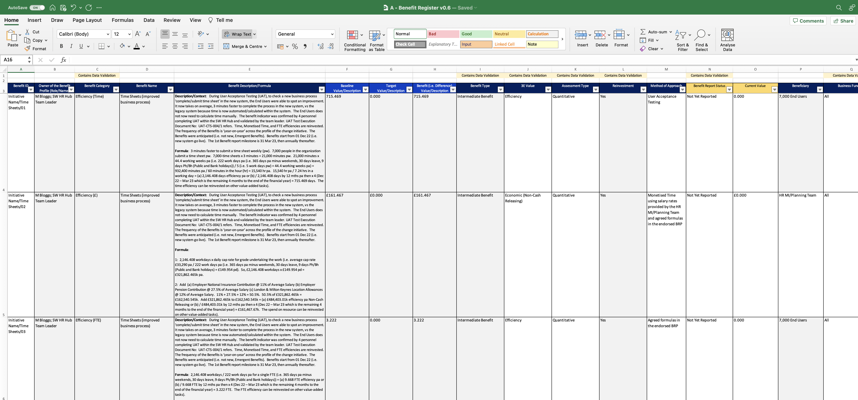
Image 38
It is important to understand the format of the values in the blue boxes that should be applied consistently when populating the Benefit Profiles.
The 3 Benefit Profiles are having an impact on the whole workforce, this means ‘all’ of the Business Functions are impacted by the change/improved business process.
Note: the ‘Description/Context’ are the same, but the Formulas are different because these 3 rows consist of 3 separate Benefit Profiles counting time, monetised time and the FTE.
Columns containing data validations.
On this occasion, the HR MI/Planning Team has been selected on the basis that aggregated monetised time savings can inform strategic decisions for the organisation.
Format these fields: (a) Numeric (b) Use 1000 Separator (c) 3 Decimal Places.
Numeric: TTT,HHH.UUU (left of comma = thousands). The example shown in column f, row 4 = seven hundred and fifteen days and four hundred and ninety-three units.
Note: When recording a dis-Benefit, insert ‘-’ before inserting the value.
Row 4 is a single Benefit Profile calculating time savings.
Be careful, check the simplified format
Row 5 is a single Benefit Profile calculating monetised time savings.
The ‘Current Value’ field can be populated when the BM receives the Benefit Reports.
Row 6 is a single Benefit Profile calculating FTE savings.
Format these fields: (a) Currency (b) Use £ Symbol (c) 3 Decimal Places.
Financial: £MMM,TTT.HHH (left of comma = millions). The example shows in column f, row 5 = one hundred and sixty-one thousand four hundred and sixty-seven pounds.
Note: When recording a dis-Benefit, insert ‘-’ before inserting the value.

