Slide 1
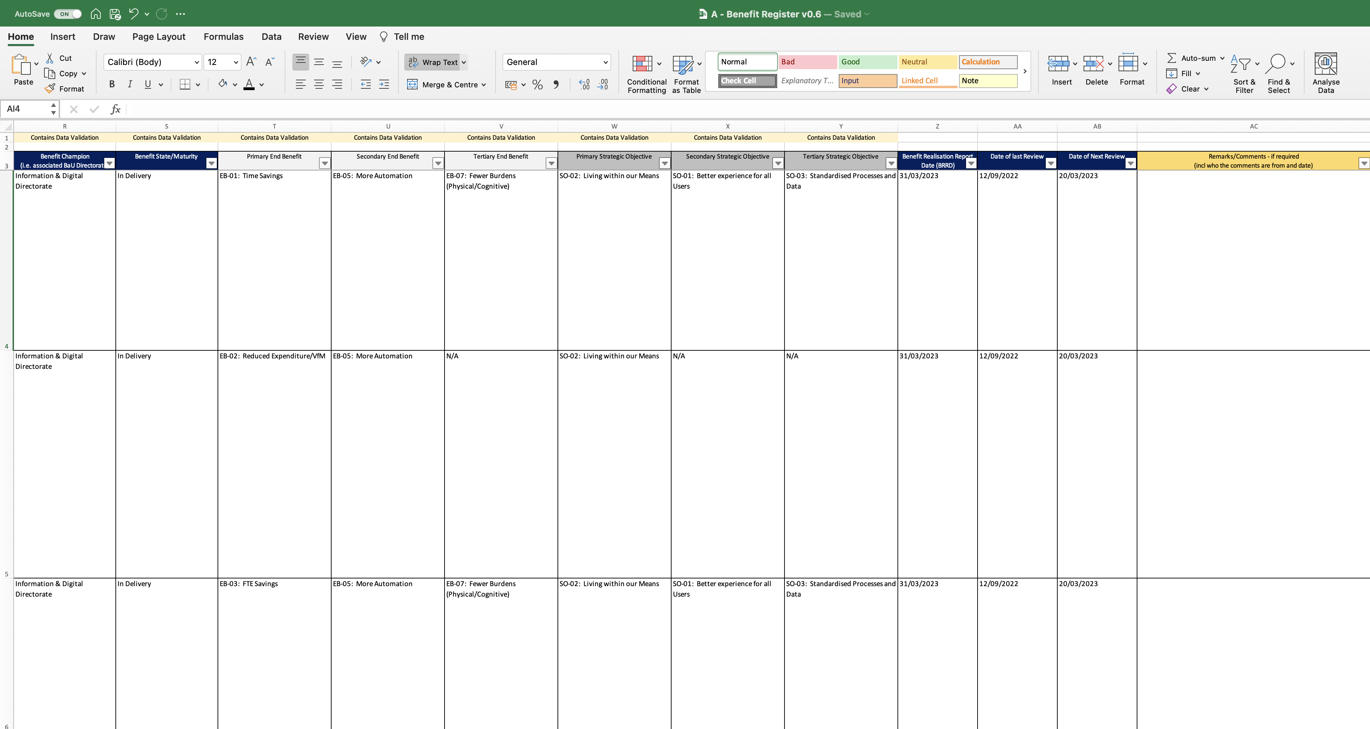
Image 39
See para 1.9 in respect to these columns.
This column groups the Benefits under BaU Directorates to (a) champion the Benefits and (b) facilitate handover/takeover of residual Benefits under the appropriate Directorates when the CI closes.
The IPA/Gateway Review process will take confidence in these arrangements to be articulated in the Benefit Realisation Plan.
See para 7.1.1 e and section 8.
See image 4 in respect to this column.
Important to include the name/date of the individual(s) providing remarks/comments in this column via the BM.
N/A applies if this low-level Benefit Profile cannot be associated with a secondary or tertiary End Benefit because the link would be too tenuous.
These 3 Benefit Profiles are grouped under the Information & Digital Directorate because they stem from an improvement to the system (i.e. More Automation). If the Benefits related to spend on the system itself, they would be grouped under the Finance Directorate. If the Benefits related to the people dimension (i.e. culture, behavior), they would be grouped under the People Directorate.
N/A applies if this low-level Benefit Profile cannot be associated with a secondary or tertiary Strategic Objective because the link would be too tenuous.
The BRRD triggers a report to the BM from the Owner of the Benefit Profile. The BM should receive the report on this date. See para 6.2.
Date of next review to be selected sensibly. If the review date is too frequent, they could reduce the BM’s capacity for other work. For example, the BM may have a significant number of Benefits Profiles in the Benefits Register.

