Slide 1
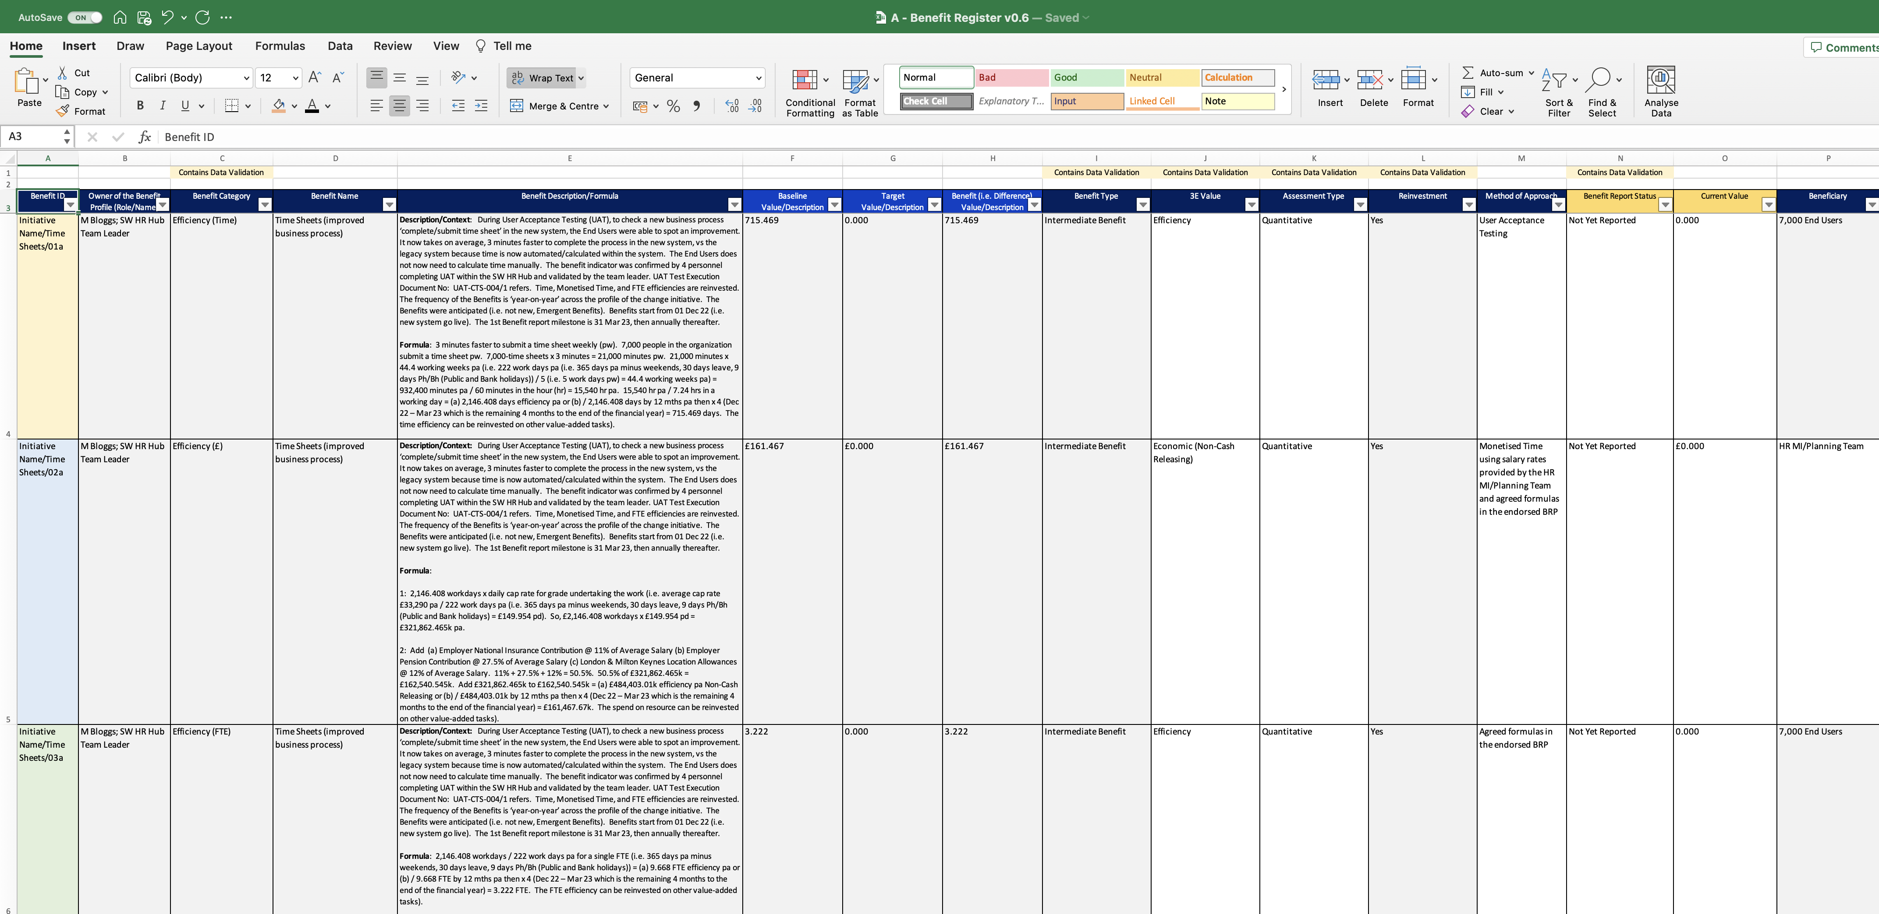
Image 40
Colour these fields before starting will help.

