Slide 1
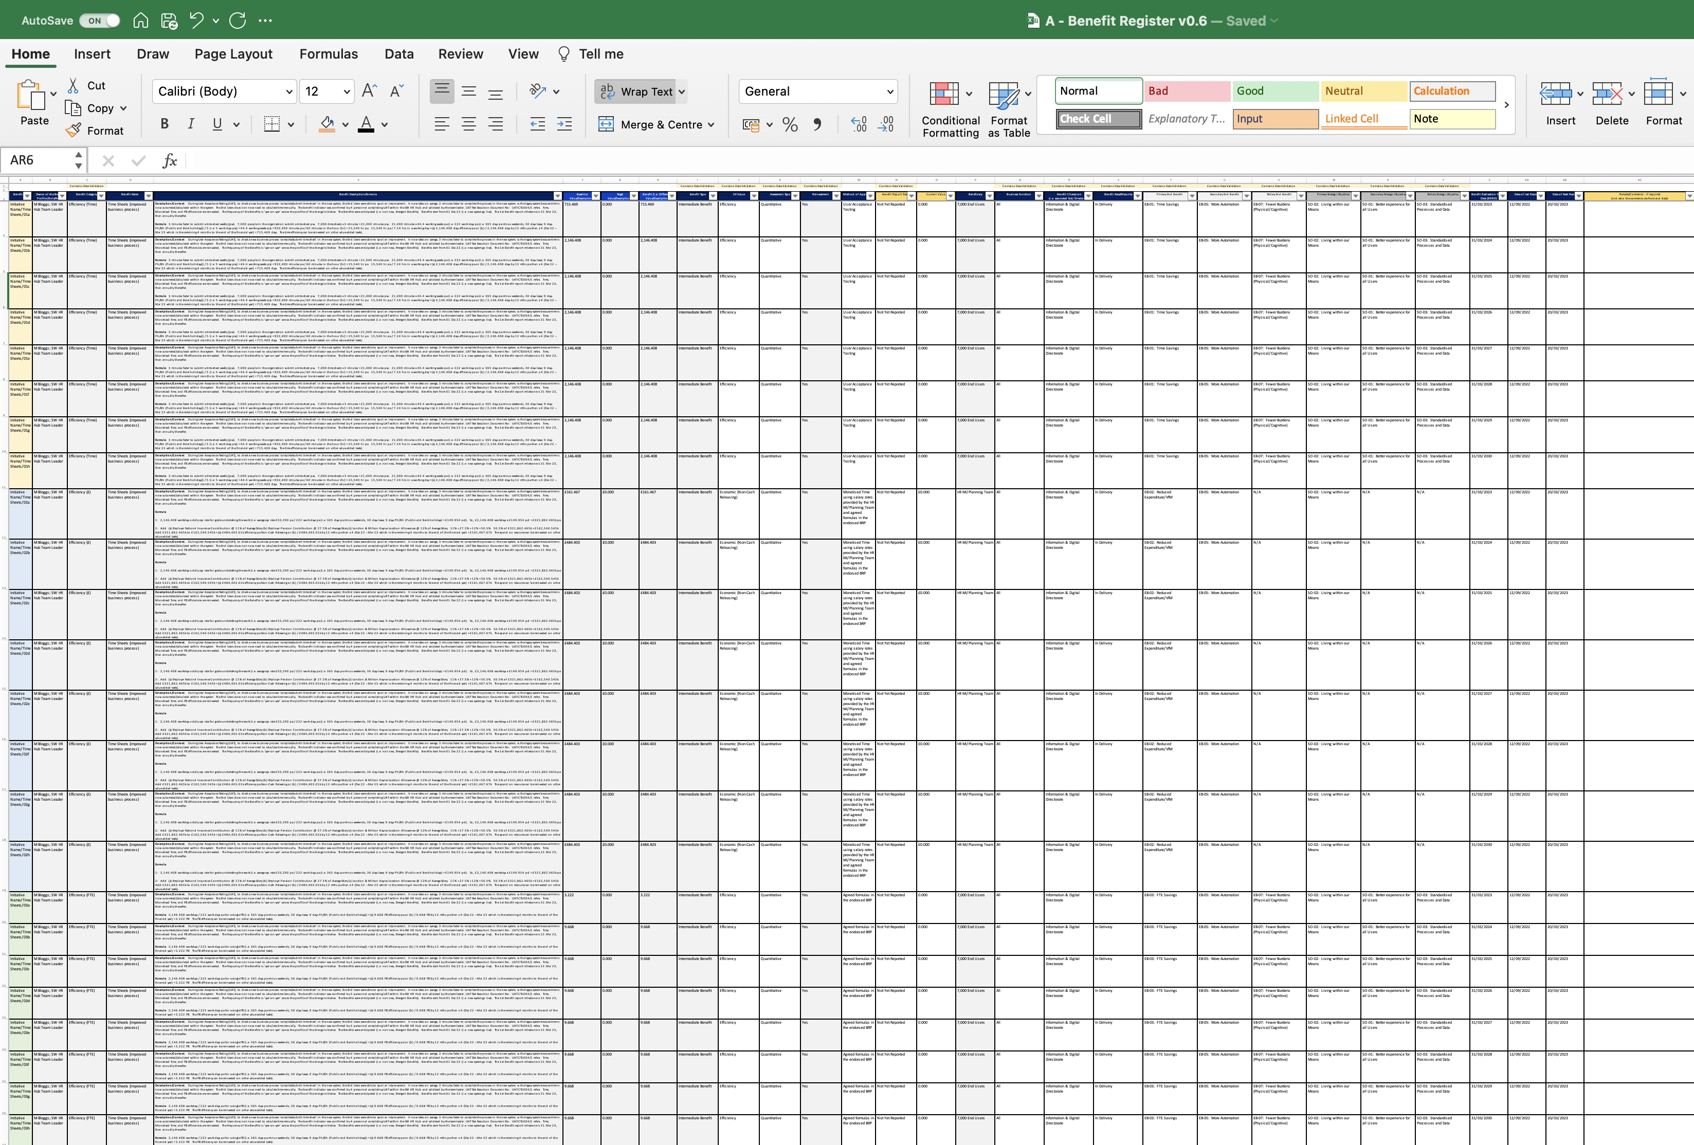
Image 42
This value represents 4 months (Dec 22 – Mar 23 incl). See explanation 5.6.5 and 5.6.6.
2
1
Baseline | Target | Benefit
715.469 | 0 | 715.493
2,146.408 | 0 | 2,146.408
2,146.408 | 0 | 2,146.408
2,146.408 | 0 | 2,146.408
2,146.408 | 0 | 2,146.408
2,146.408 | 0 | 2,146.408
2,146.408 | 0 | 2,146.408
2,146.408 | 0 | 2,146.408
Each of the 8 Benefit Profiles ID Numbers should look like this:
Initiative Name/Time Sheets/01a
Initiative Name/Time Sheets/01b
Initiative Name/Time Sheets/01c
Initiative Name/Time Sheets/01d
Initiative Name/Time Sheets/01e
Initiative Name/Time Sheets/01f
Initiative Name/Time Sheets/01g
Initiative Name/Time Sheets/01h
The Baseline, Target and Benefit columns F, G and H, should have the same values in the 3 tables provided on the right.
3
These values represent 12-month periods starting (Apr 23–Mar 24; Apr 24–Mar 25 and so on until and incl. Apr 29–Mar 30). See explanation 5.6.5 and 5.6.6.
Each of the 8 Benefit Profiles milestones, in the 3 colored groups, should look like this.
8 x (time efficiencies)
Baseline | Target | Benefit
£161.467 | 0 | £161.467
£484.403 | 0 | £484.403
£484.403 | 0 | £484.403
£484.403 | 0 | £484.403
£484.403 | 0 | £484.403
£484.403 | 0 | £484.403
£484.403 | 0 | £484.403
£484.403 | 0 | £484.403
BRRD | Last Review | Next Review
31/03/2023 | 12/09/2022 | 20/03/2023
31/03/2024 | 12/09/2022 | 20/03/2023
31/03/2025 | 12/09/2022 | 20/03/2023
31/03/2026 | 12/09/2022 | 20/03/2023
31/03/2027 | 12/09/2022 | 20/03/2023
31/03/2028 | 12/09/2022 | 20/03/2023
31/03/2029 | 12/09/2022 | 20/03/2023
31/03/2030 | 12/09/2022 | 20/03/2023
Each of the 8 Benefit Profiles ID Numbers should look like this:
Initiative Name/Time Sheets/02a
Initiative Name/Time Sheets/02b
Initiative Name/Time Sheets/02c
Initiative Name/Time Sheets/02d
Initiative Name/Time Sheets/02e
Initiative Name/Time Sheets/02f
Initiative Name/Time Sheets/02g
Initiative Name/Time Sheets/02h
8 x (monetized time)
Baseline | Target | Benefit
3.222 | 0 | 3.222
9.668 | 0 | 9.668
9.668 | 0 | 9.668
9.668 | 0 | 9.668
9.668 | 0 | 9.668
9.668 | 0 | 9.668
9.668 | 0 | 9.668
9.668 | 0 | 9.668
The review dates are before the next BRRD (i.e. 8 birds with 1 stone).
Be sensible – do not review too frequently.
Each of the 8 Benefit Profiles ID Numbers should look like this:
Initiative Name/Time Sheets/03a
Initiative Name/Time Sheets/03b
Initiative Name/Time Sheets/03c
Initiative Name/Time Sheets/03d
Initiative Name/Time Sheets/03e
Initiative Name/Time Sheets/03f
Initiative Name/Time Sheets/03g
Initiative Name/Time Sheets/03h
Date profile(s) agreed or last reviewed.
8 x (FTE efficiencies)

