Slide 1
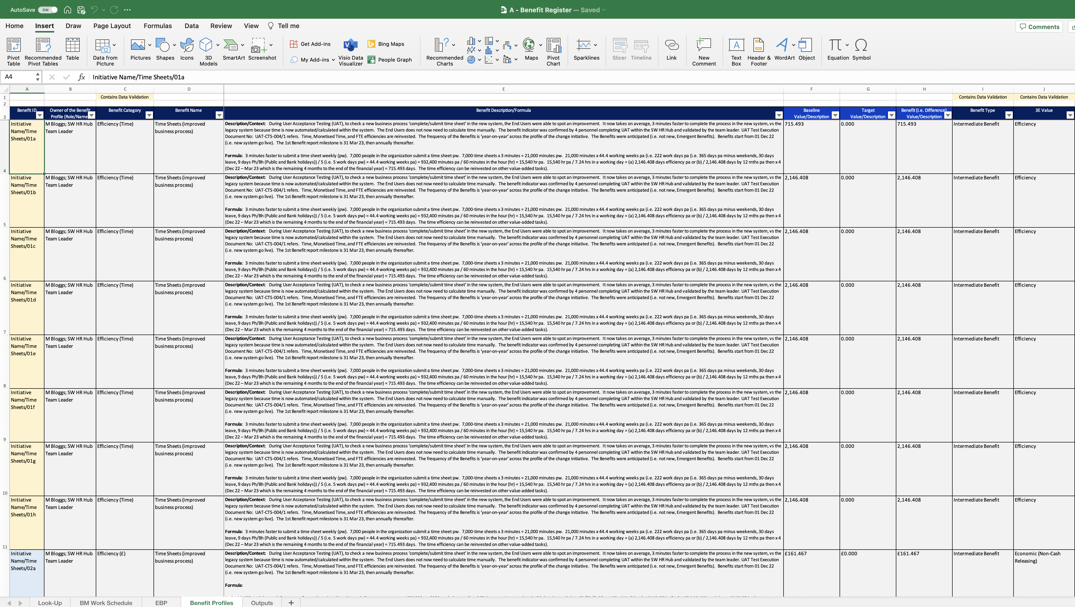
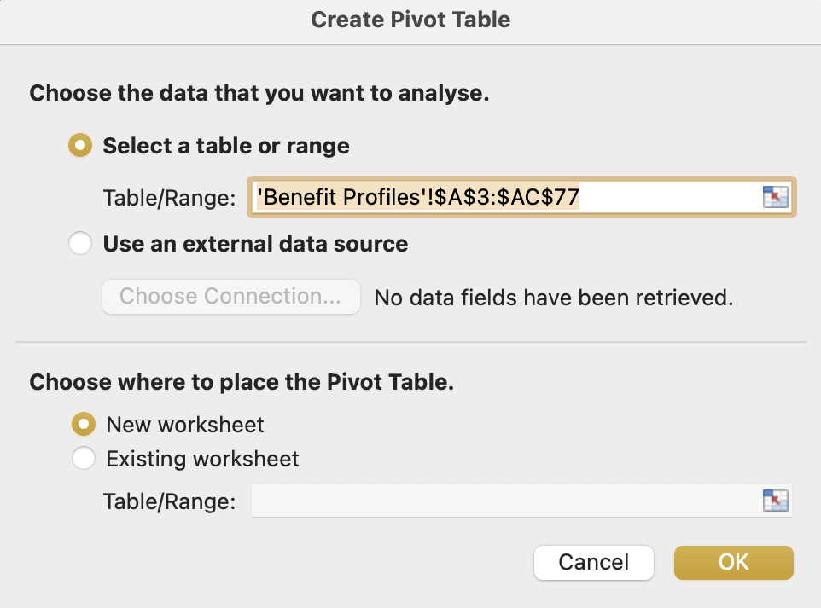
Image 44
Select the ‘Insert’ tab.
2
3
Select ‘PivotTable’.
You are looking at the Benefit Profiles worksheet in the Benefit Register. Edit any field within the data table.
1
The Create PivotTable window will appear and be pre-populated. Ensure ‘New worksheet’ is selected, then Select ‘OK’.
4

