Slide 1
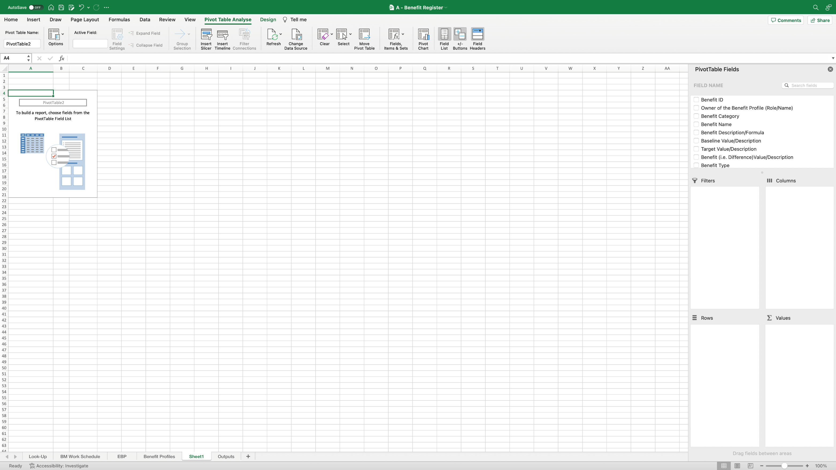
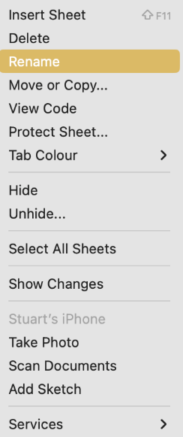
Image 45
4
The order of the worksheets should look like this
Rename the worksheet ‘Benefit Tracker’. When complete, ensure the Benefit Tracker worksheet is to the right of the ‘Benefit Profiles’ worksheet. You can do this by click/hold on the worksheet name, then drag it to the desired position.
3
When inserting a new PivotTable into its own worksheet, you will see this screen; Excel created this new worksheet and called it ‘Sheet1’.
1
Right click on the worksheet name ‘Sheet1’. The window on the right will appear. Select ‘Rename’.
2

