Slide 1
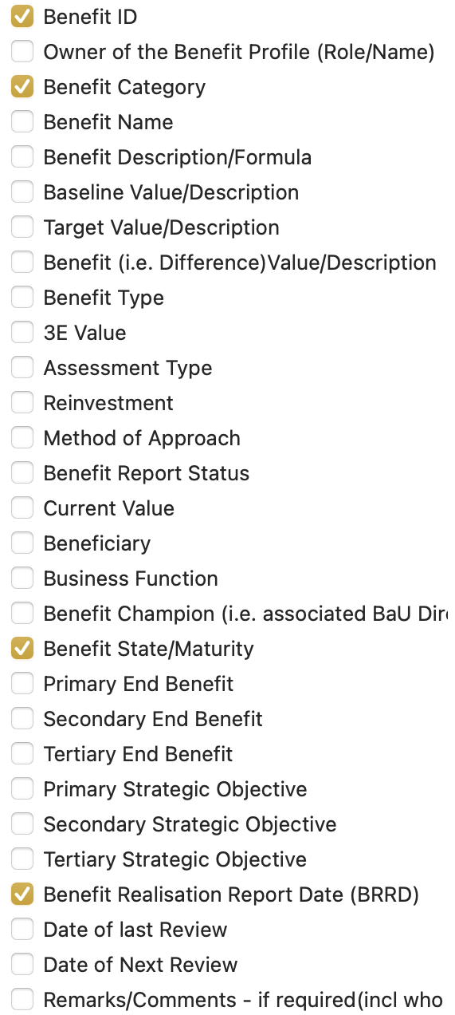
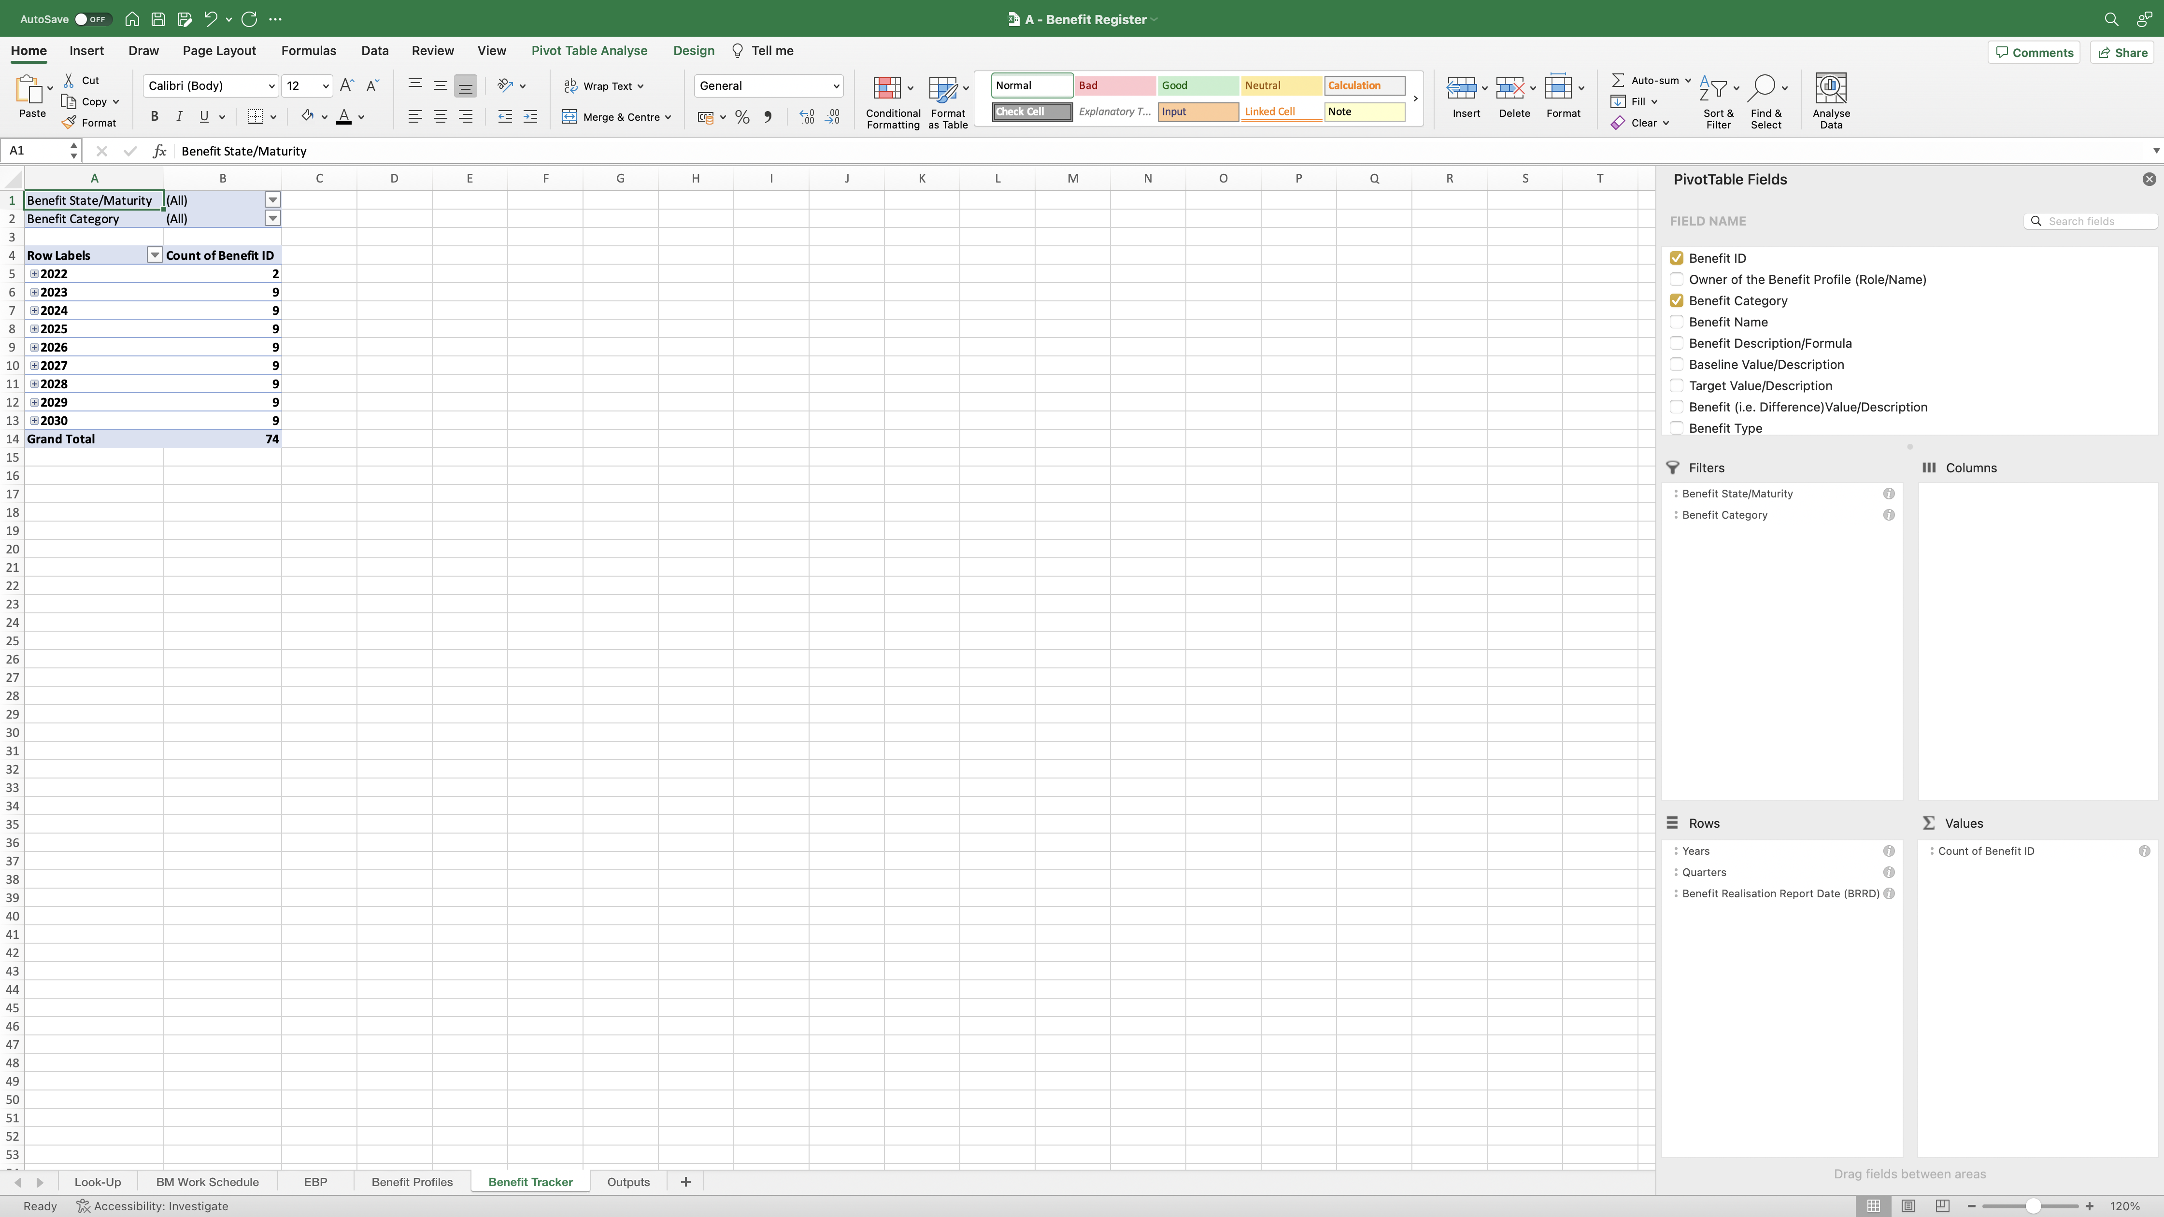
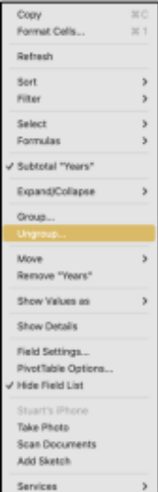
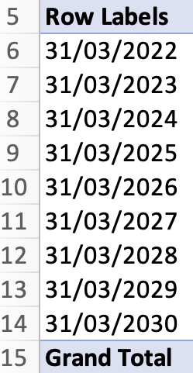
Image 46
2
Right click on the first date field as shown. You will see this window appear on the right; select ‘Ungroup’. The dates will then look like this image at the bottom.
1
Drag and drop the highlighted field names from the ‘Field Name’ group at the top, into the ‘Filters, Rows and Values’ fields at the bottom as shown.
When complete, note the following points:
The named field ‘Benefit ID’ auto populates with the additional text ‘Count of’, when it has been dropped into the ‘Values’ field. Allow that to happen – do nothing.
(b) When the ‘Benefit Realisation Report Date (BRRD)’ is first dropped into the ‘Rows’ field, it usually adds ‘Years’ and ‘Quarters’ as shown. Move to step 2.

