Slide 1
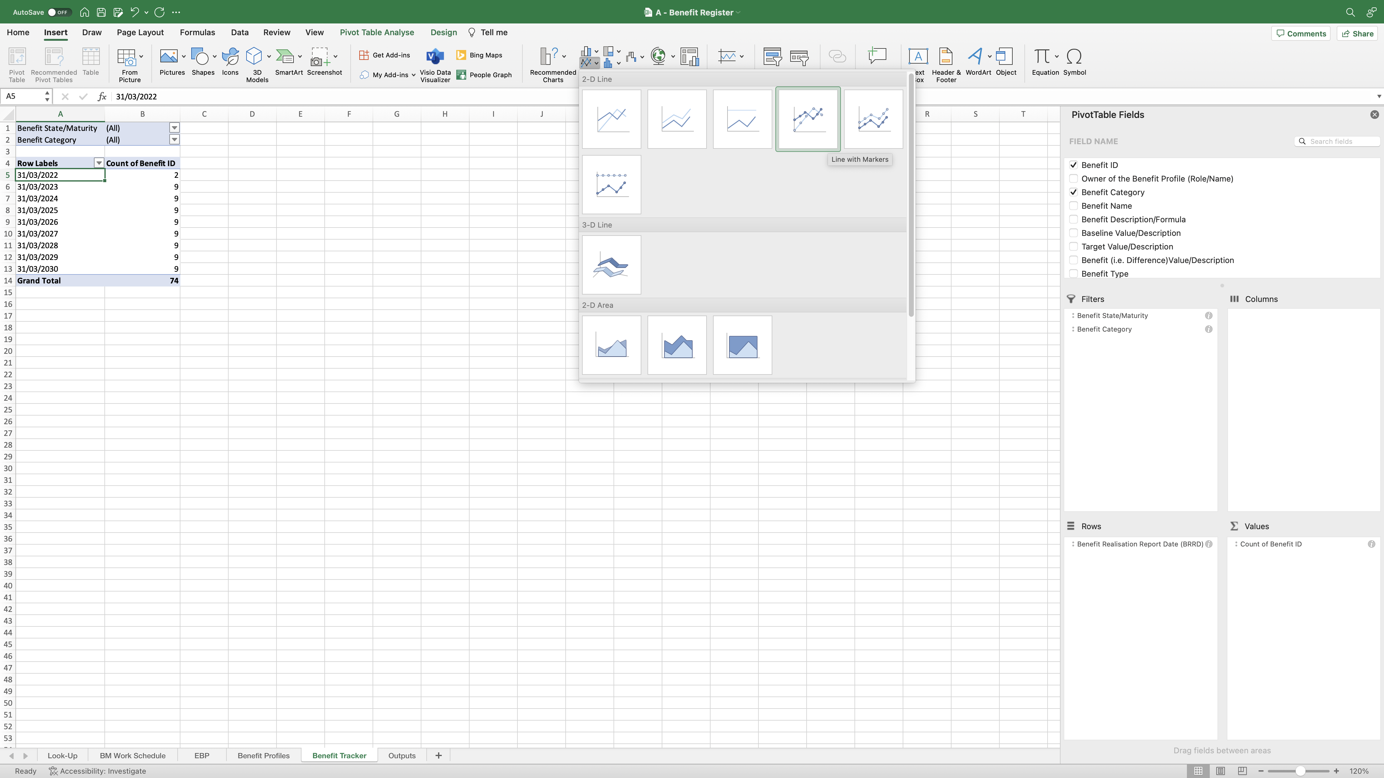
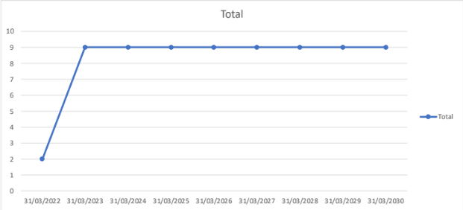
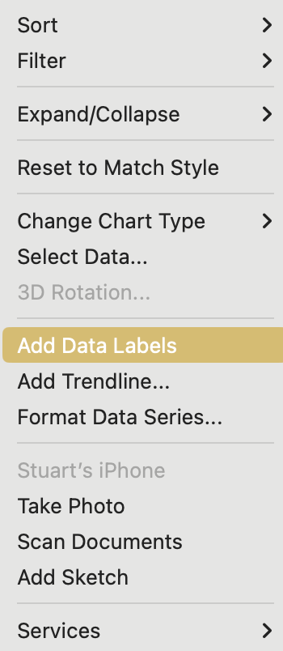
Image 47
2
Select the ‘Insert’ tab.
3
Select the Line Chart field.
After selecting the specified Line Chart in step 4, it will drop into the middle of your screen and look like this. You can click onto the chart then ‘drag’ one of the 4 corners to increase its size so you can see what you are doing.
Ensure the cursor is in the data table.
1
Select this Line Chart.
4
5
Right click on the ‘Line’ or the ‘Point’ on the line, to open the window on the right. Select ‘Add Data Labels’.
6

