Slide 1
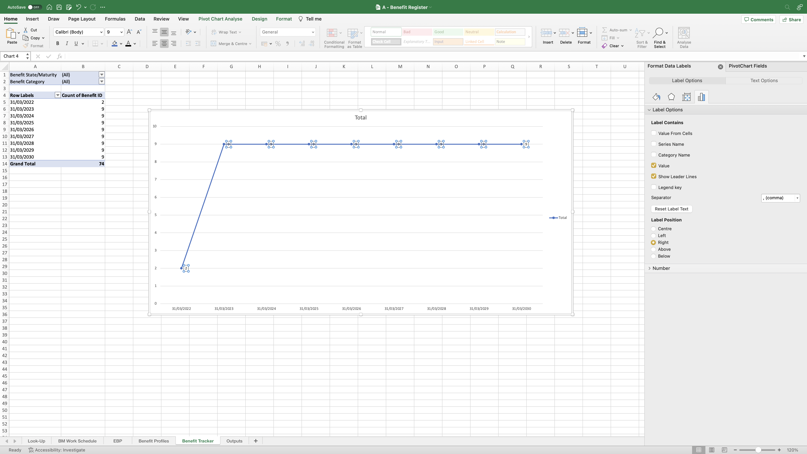
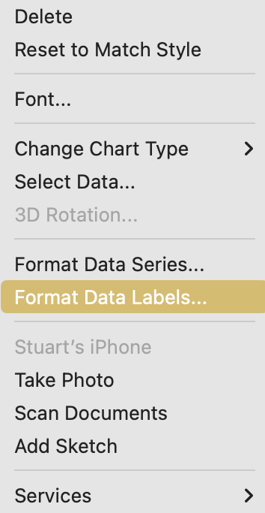
Image 48
Right click once onto any of the numbers which will highlight all of them and this window will open on the right. Select ‘Format Data Labels’.
2
3
When the ‘Format Data Labels’ window opens, it shows the position of the numeric values on the right of the ‘point’. Select ‘Above’ instead.
The Line Chart in the middle of your screen will contain numbers to the right of the ‘points’ on the line.
1

