Slide 1
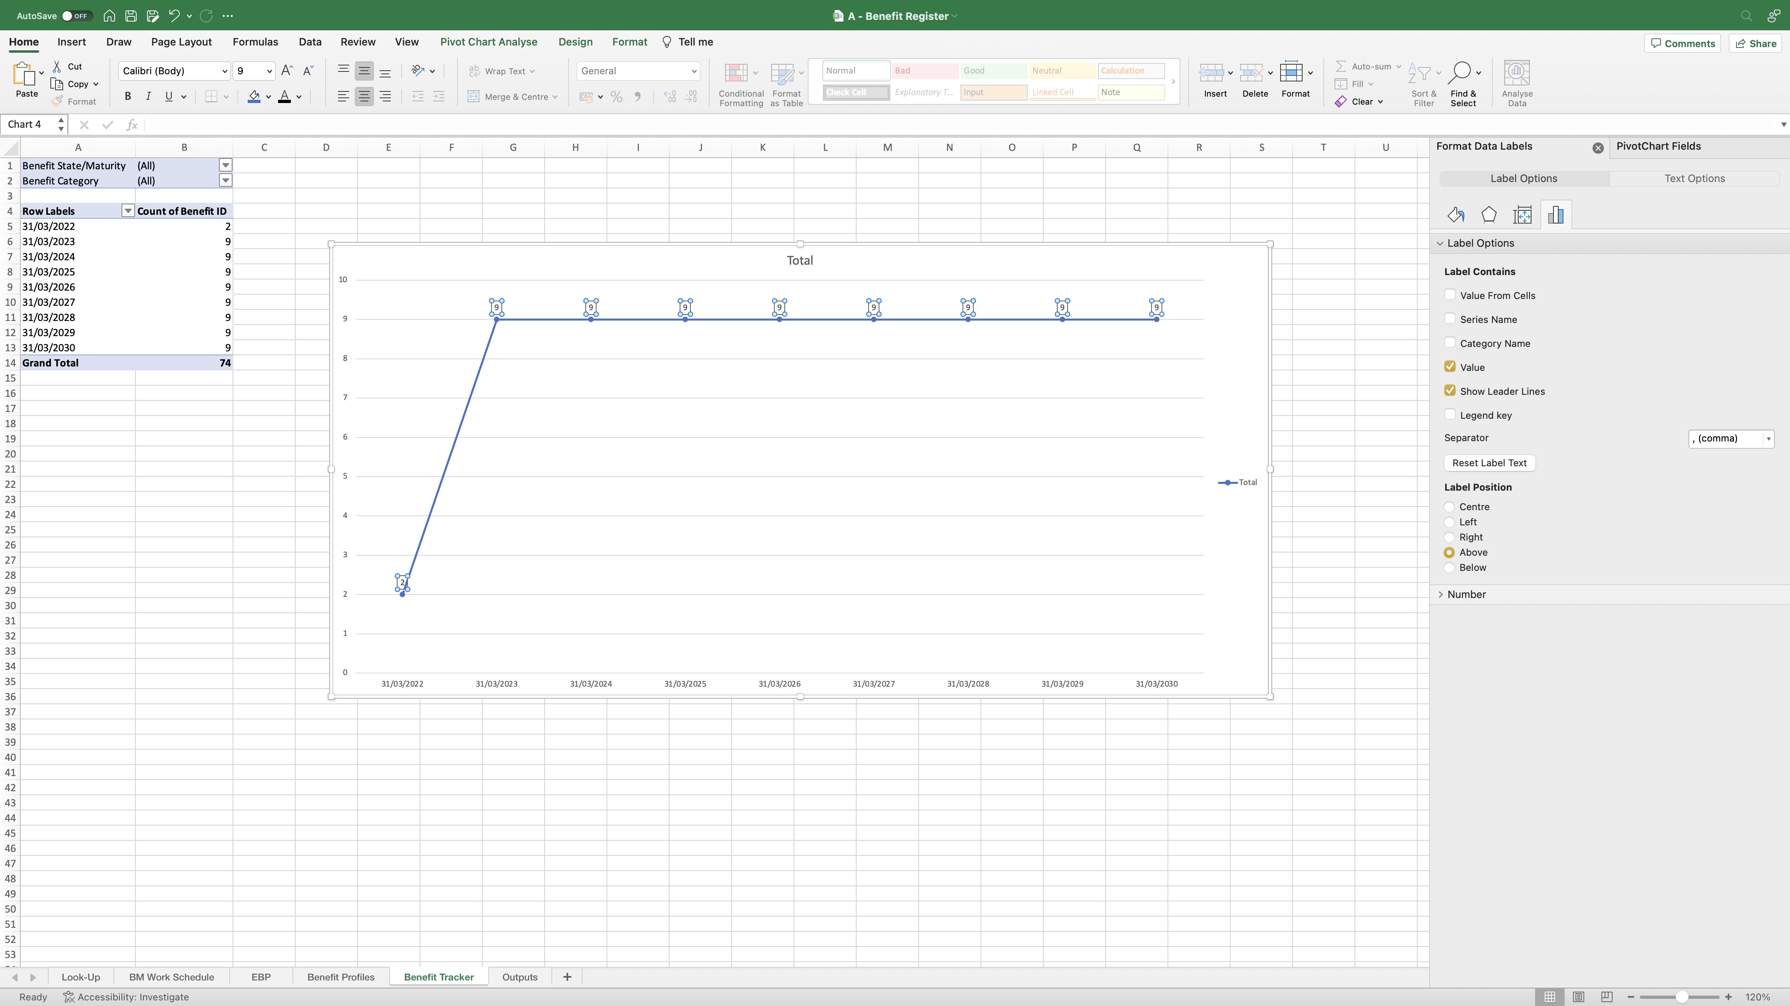
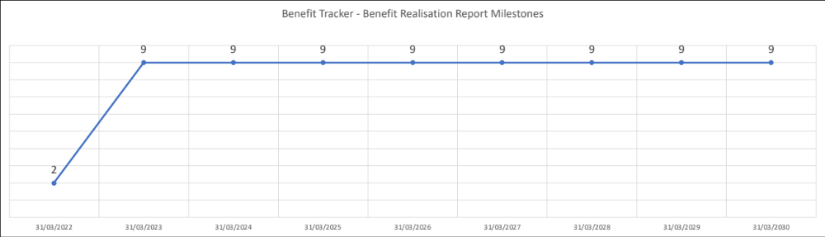
Image 49
1
The numeric values on the line are now above the points.
2
Use/develop your Excel skills to make the Line Chart look like this; you are just a few steps away from the end-product. If you have limited experience with Excel, and you are not sure, I want you to use ‘YouTube’ for example and search for ‘create line chart in excel’ to be able to achieve it. You want the line chart looking tidy and presentable.

