Slide 1
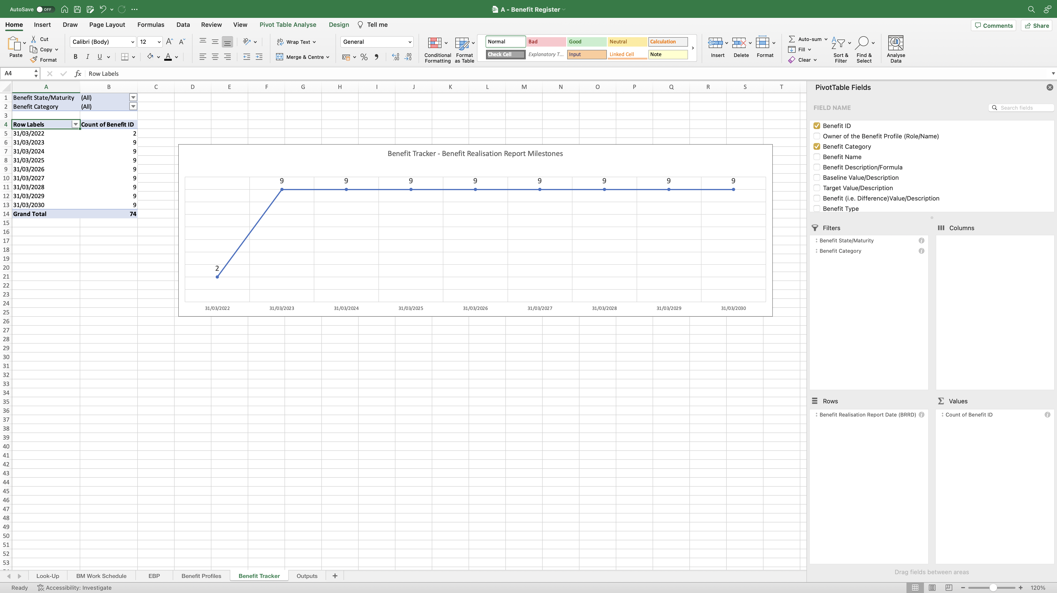
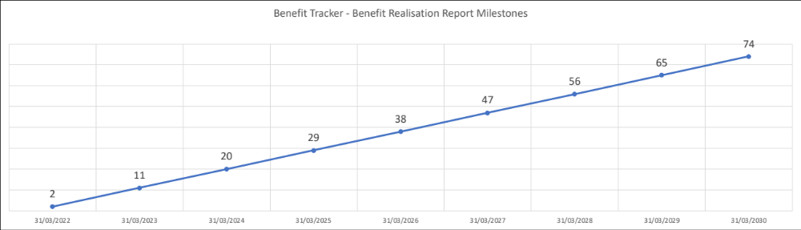
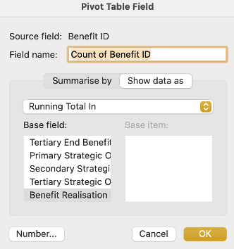
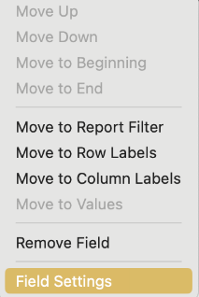
Image 50
The Line Chart now looks like this; it shows how many Benefits are being reported on the specified BRRD at the bottom. The information has been drawn from the Benefit Profiles worksheet.
1
The BM may want to change the view, to show the accumulative count of Benefits being reported across the BRRDs. See step 3.
2
3
Right click on this field; the window at the bottom opens. Select ‘Field Settings’.
The Line Chart with accumulative count now looks like this. To change it back go through step 3 and 4 again. At step 4 (b) select ‘No Calculation’.
5
4
This next window will open. Select (a) ‘Show data as’ (b) ‘Running total in’ (c) ‘Benefit Realisation Report Date’ (d) ‘OK’.

