Slide 1
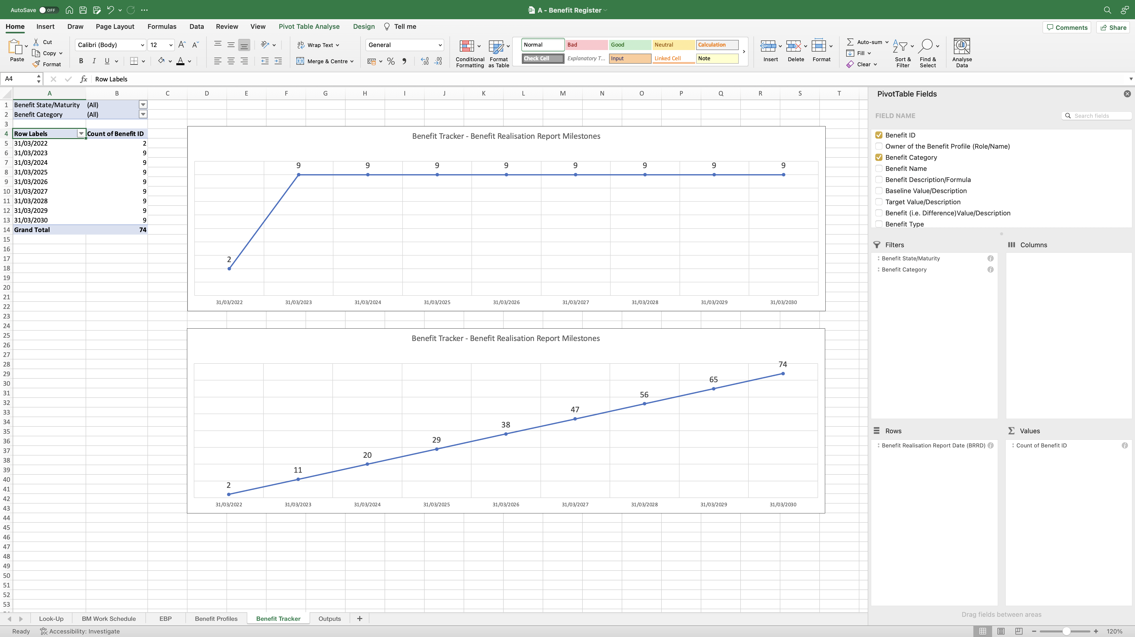
Image 51
The author prefers to show both Line Charts together in the same Benefit Tracker worksheet. To achieve it, see images 52 and 53.

