Slide 1
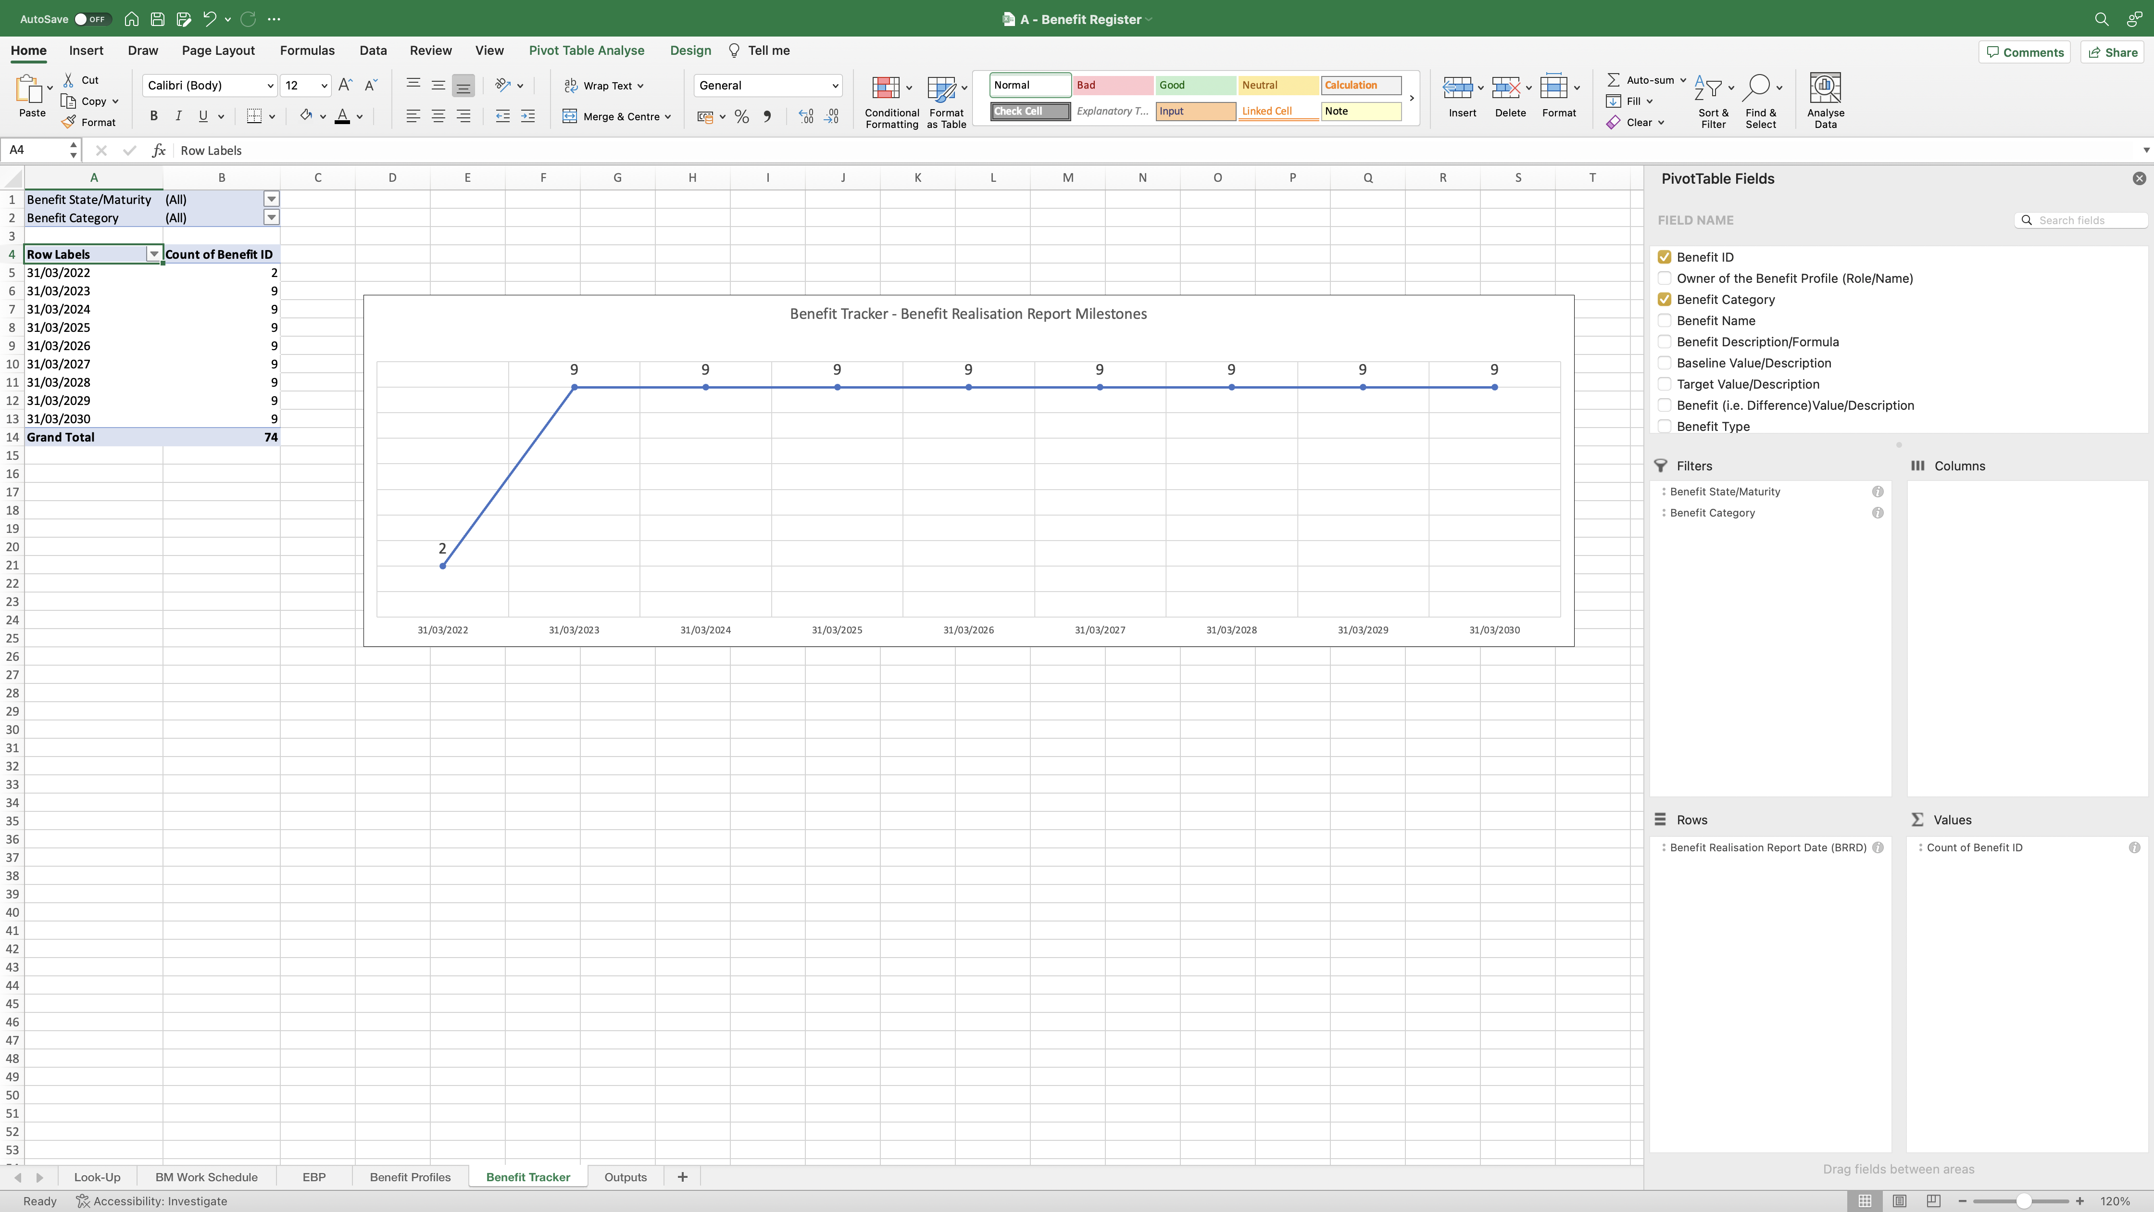
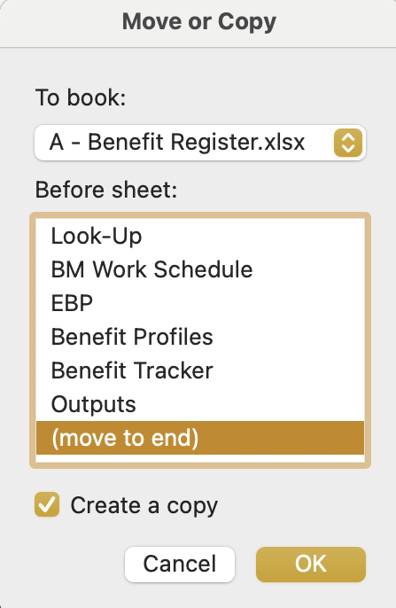
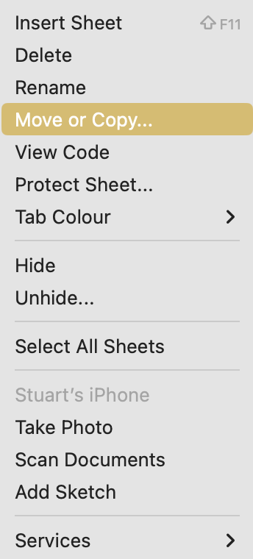
Image 52
2
Select ‘Move or Copy’
3
1
Right click on the ‘Benefit Tracker’ worksheet name.
The Move or Copy window opens. Select (a) ‘Move to end’ (b) ‘Create a copy’ (c) ‘OK’.

