Slide 1
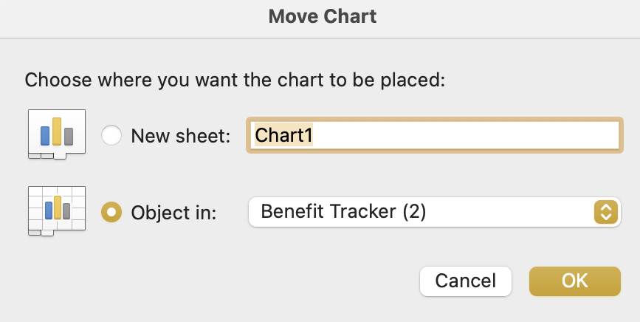
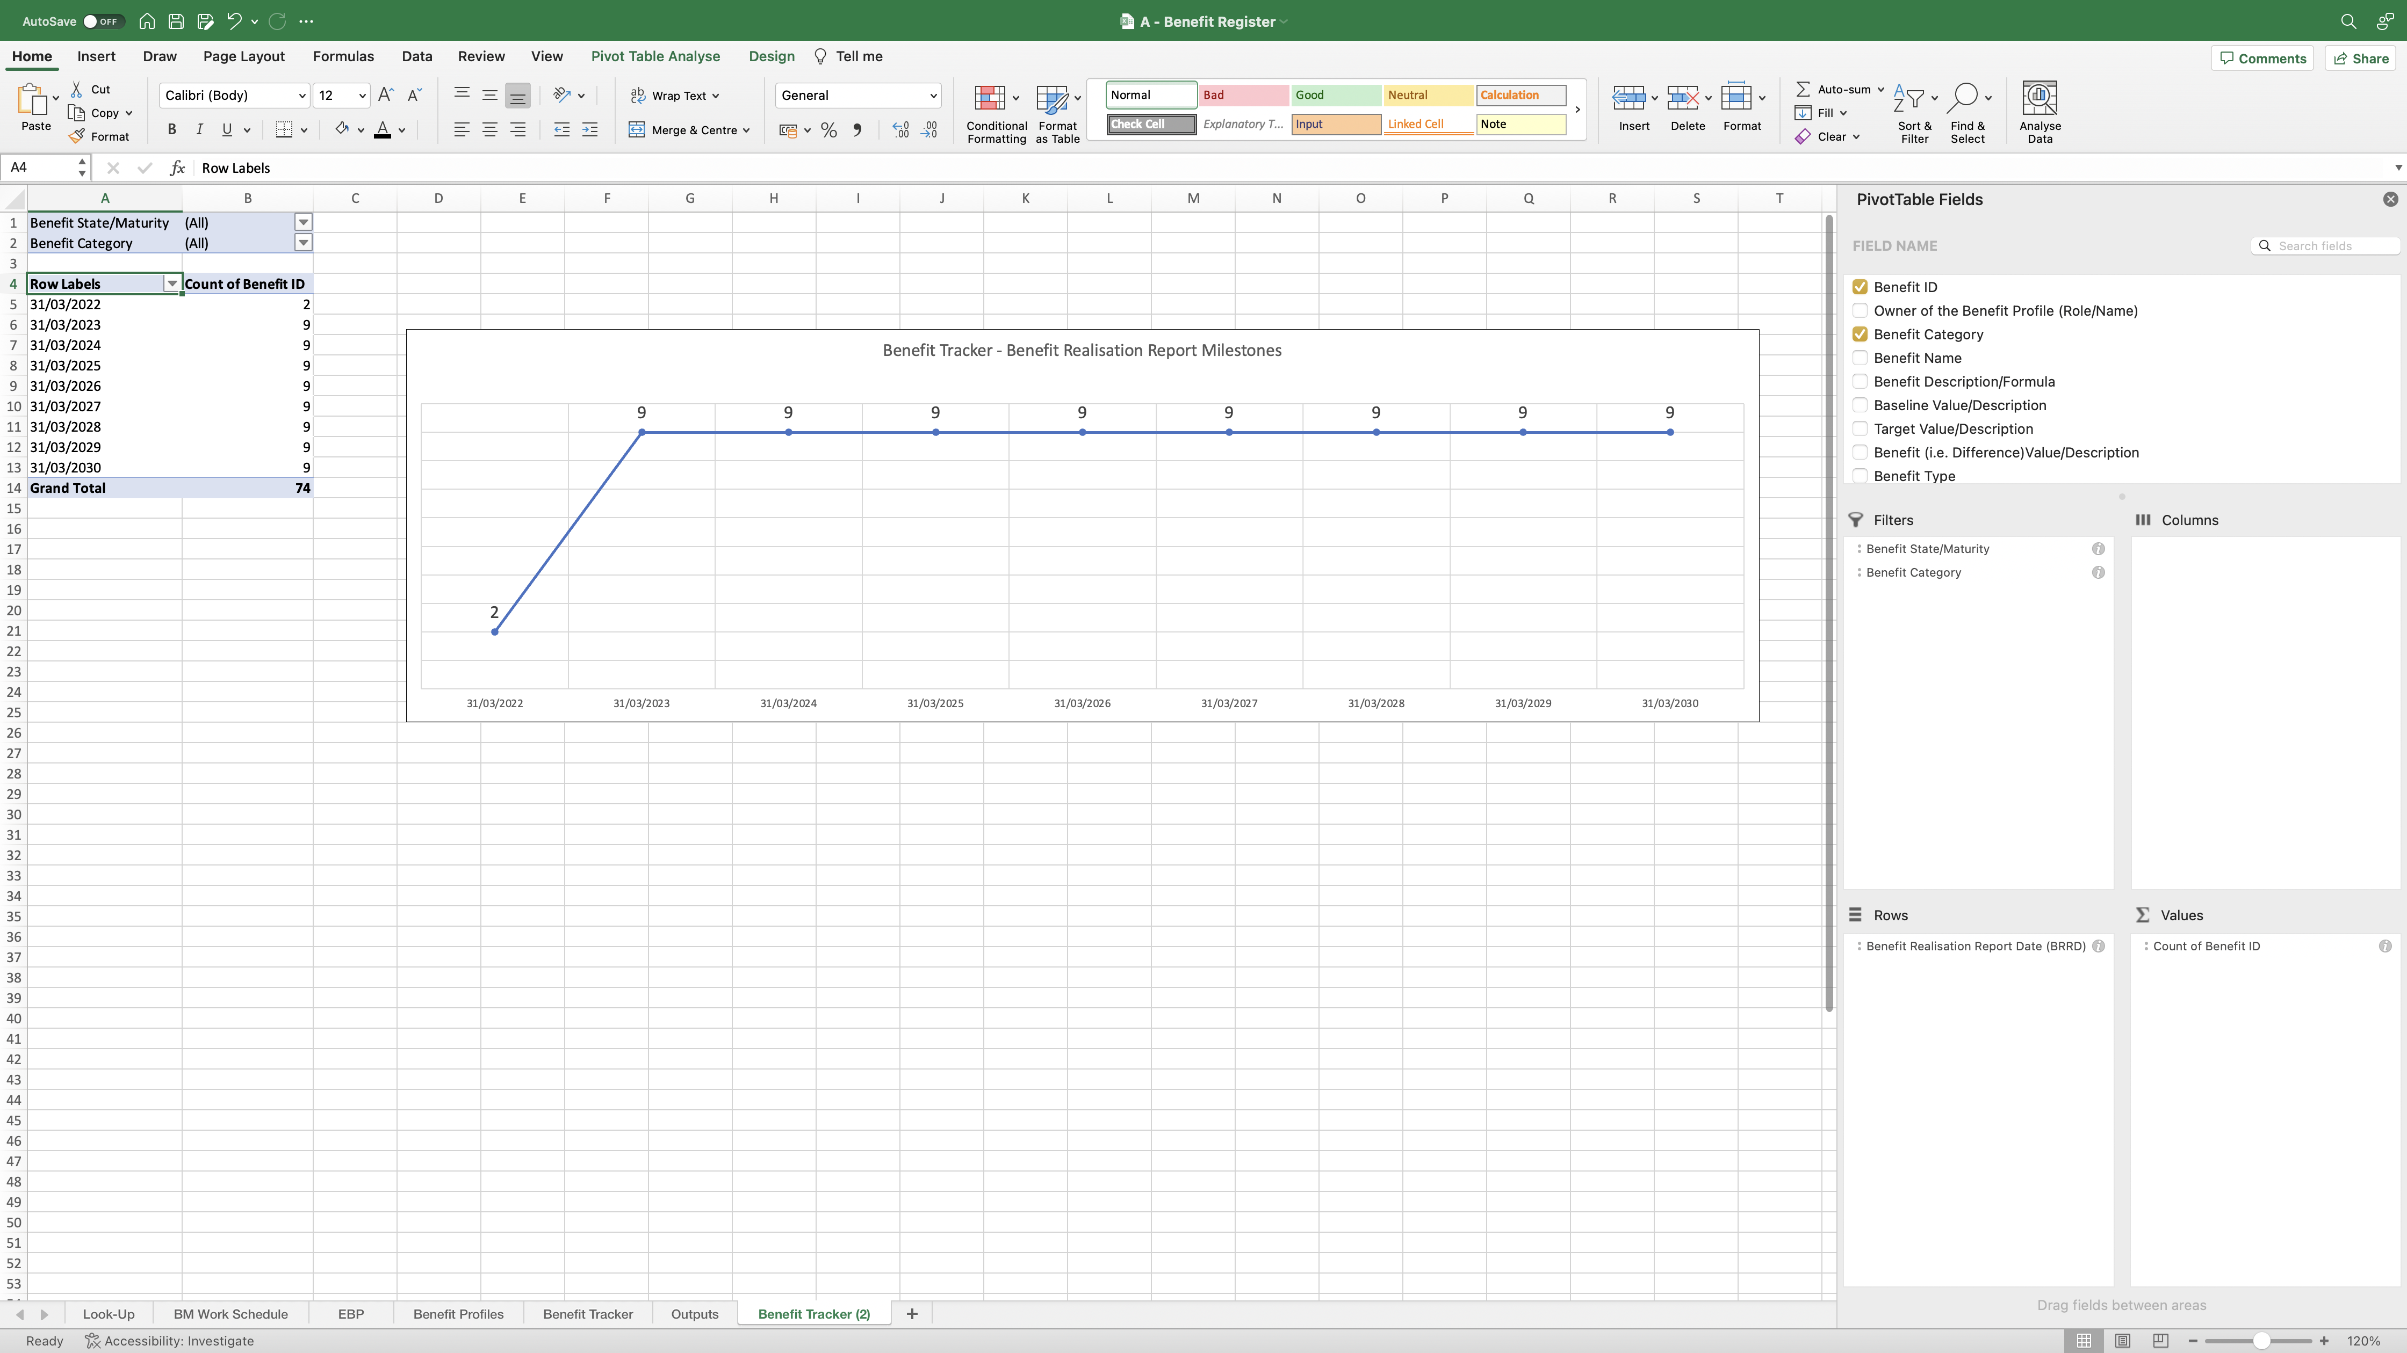
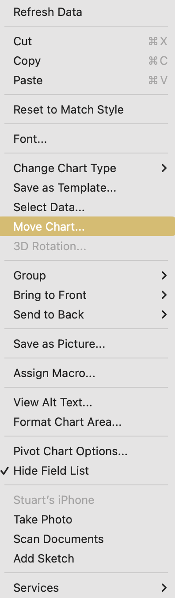
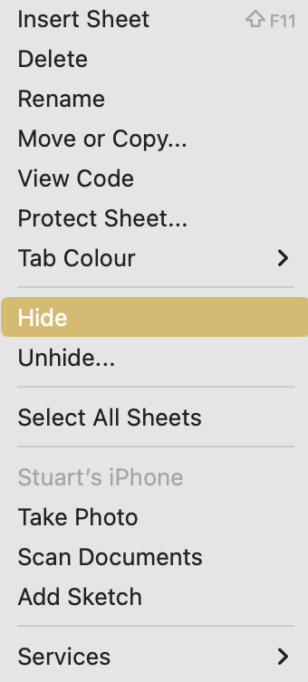
Image 53
5
3
Right click into the Line Chart in this space. The window at step 4 opens.
Remember, this Line Chart is in ‘Benefit Tracker (2)’. Select (a) ‘Benefit Tracker’ from the drop-down selection (b) ‘OK’.
Note: When next editing the ‘Benefit Tracker’ worksheet, the Line Charts are likely to appear one on top of the other. Simply click on the top Line Chart, then drag it down to reveal both.
Complete steps 3 and 4 in image 50 for this Line Chart, so the view becomes accumulative.
2
Select ‘Move Chart’. The window at step 5 opens.
4
1
This is the copied ‘Benefit Tracker’ worksheet. Excel named it ‘Benefit Tracker (2)”.
When complete, right click on the ‘Benefit Tracker (2)’ worksheet name (b) select ‘hide’.
6
7
Select the ‘Benefit Tracker’ worksheet. You will see the accumulated Line Chart. Click on it, then drag it down – you can now see both Line Charts in the ‘Benefit Tracker’ worksheet. Tidy and arrange them to look like image 50.

