Slide 1
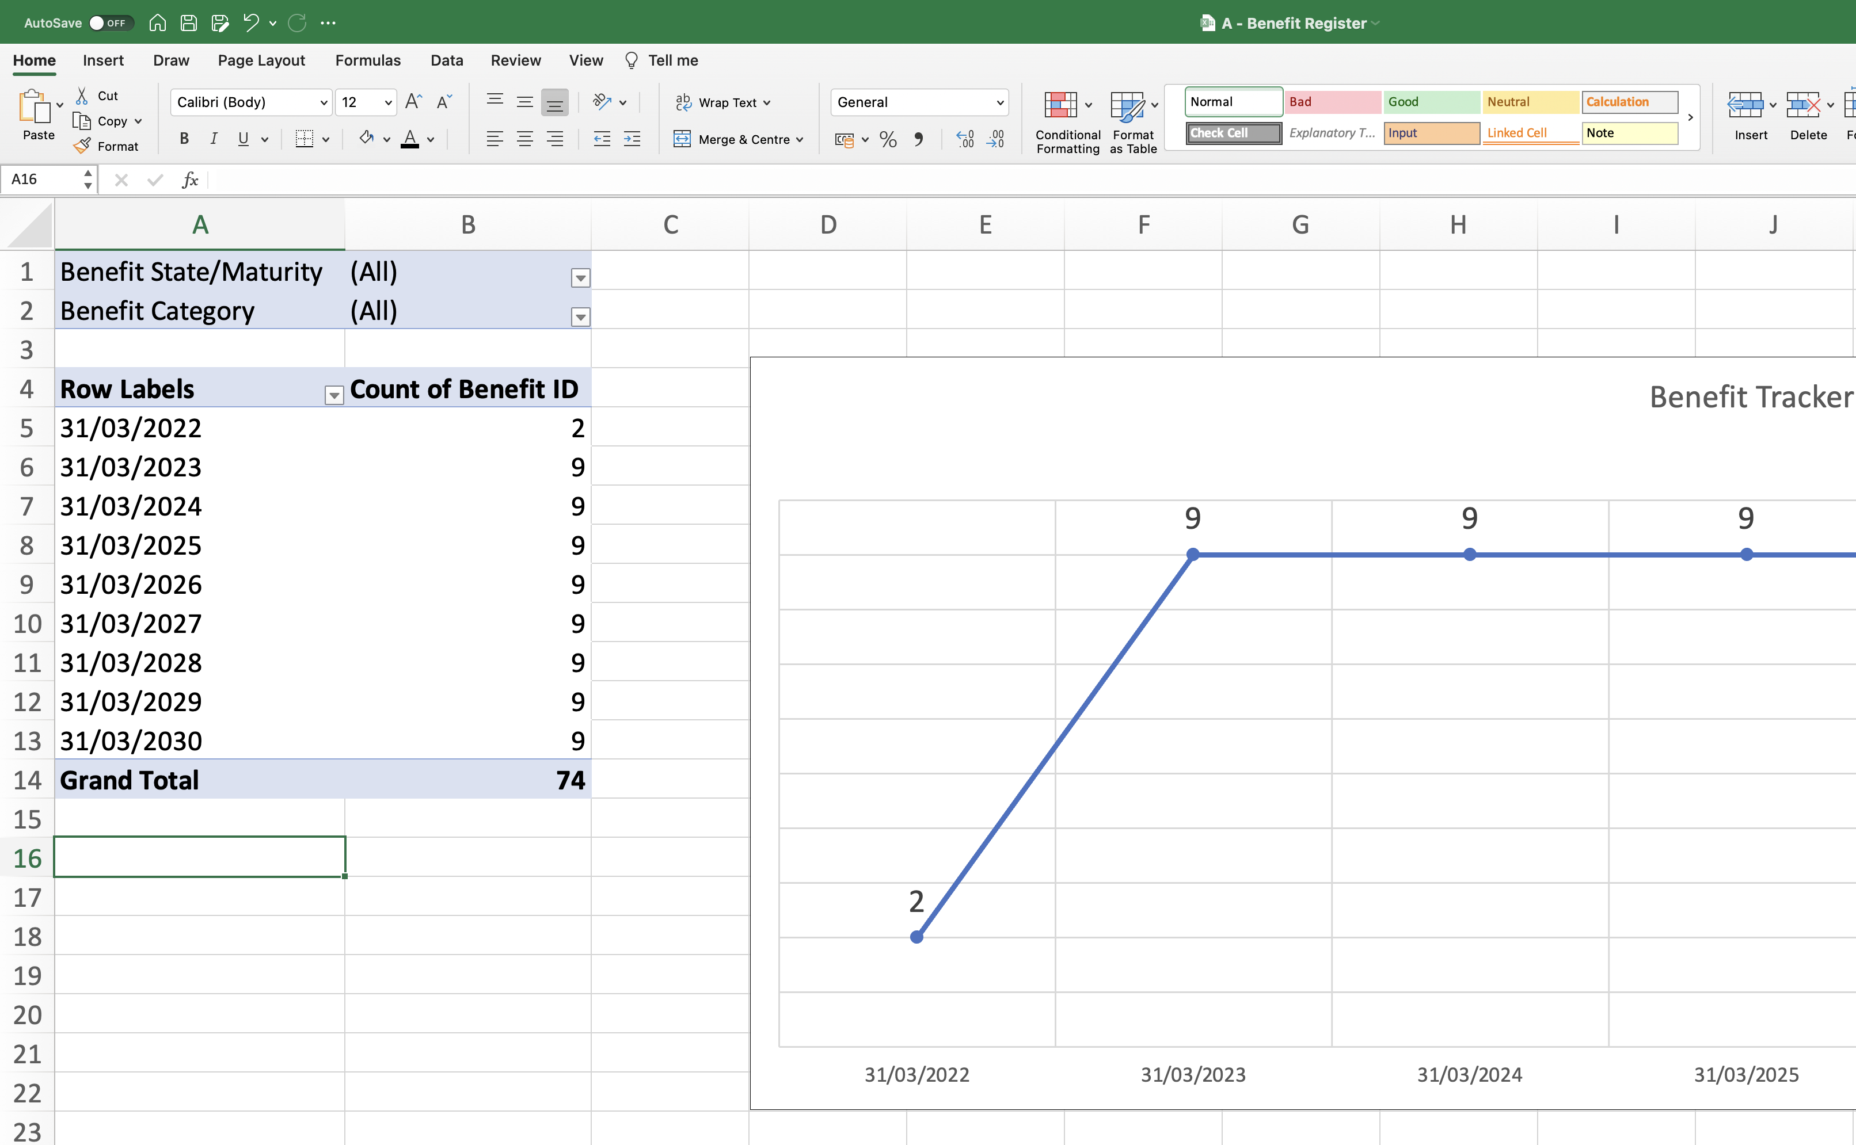
Image 54
Use the Benefit State/Maturity drop-down field to de-select any Benefits that have been categorised as (a) Cancelled or (b) Delivered.

