Slide 1
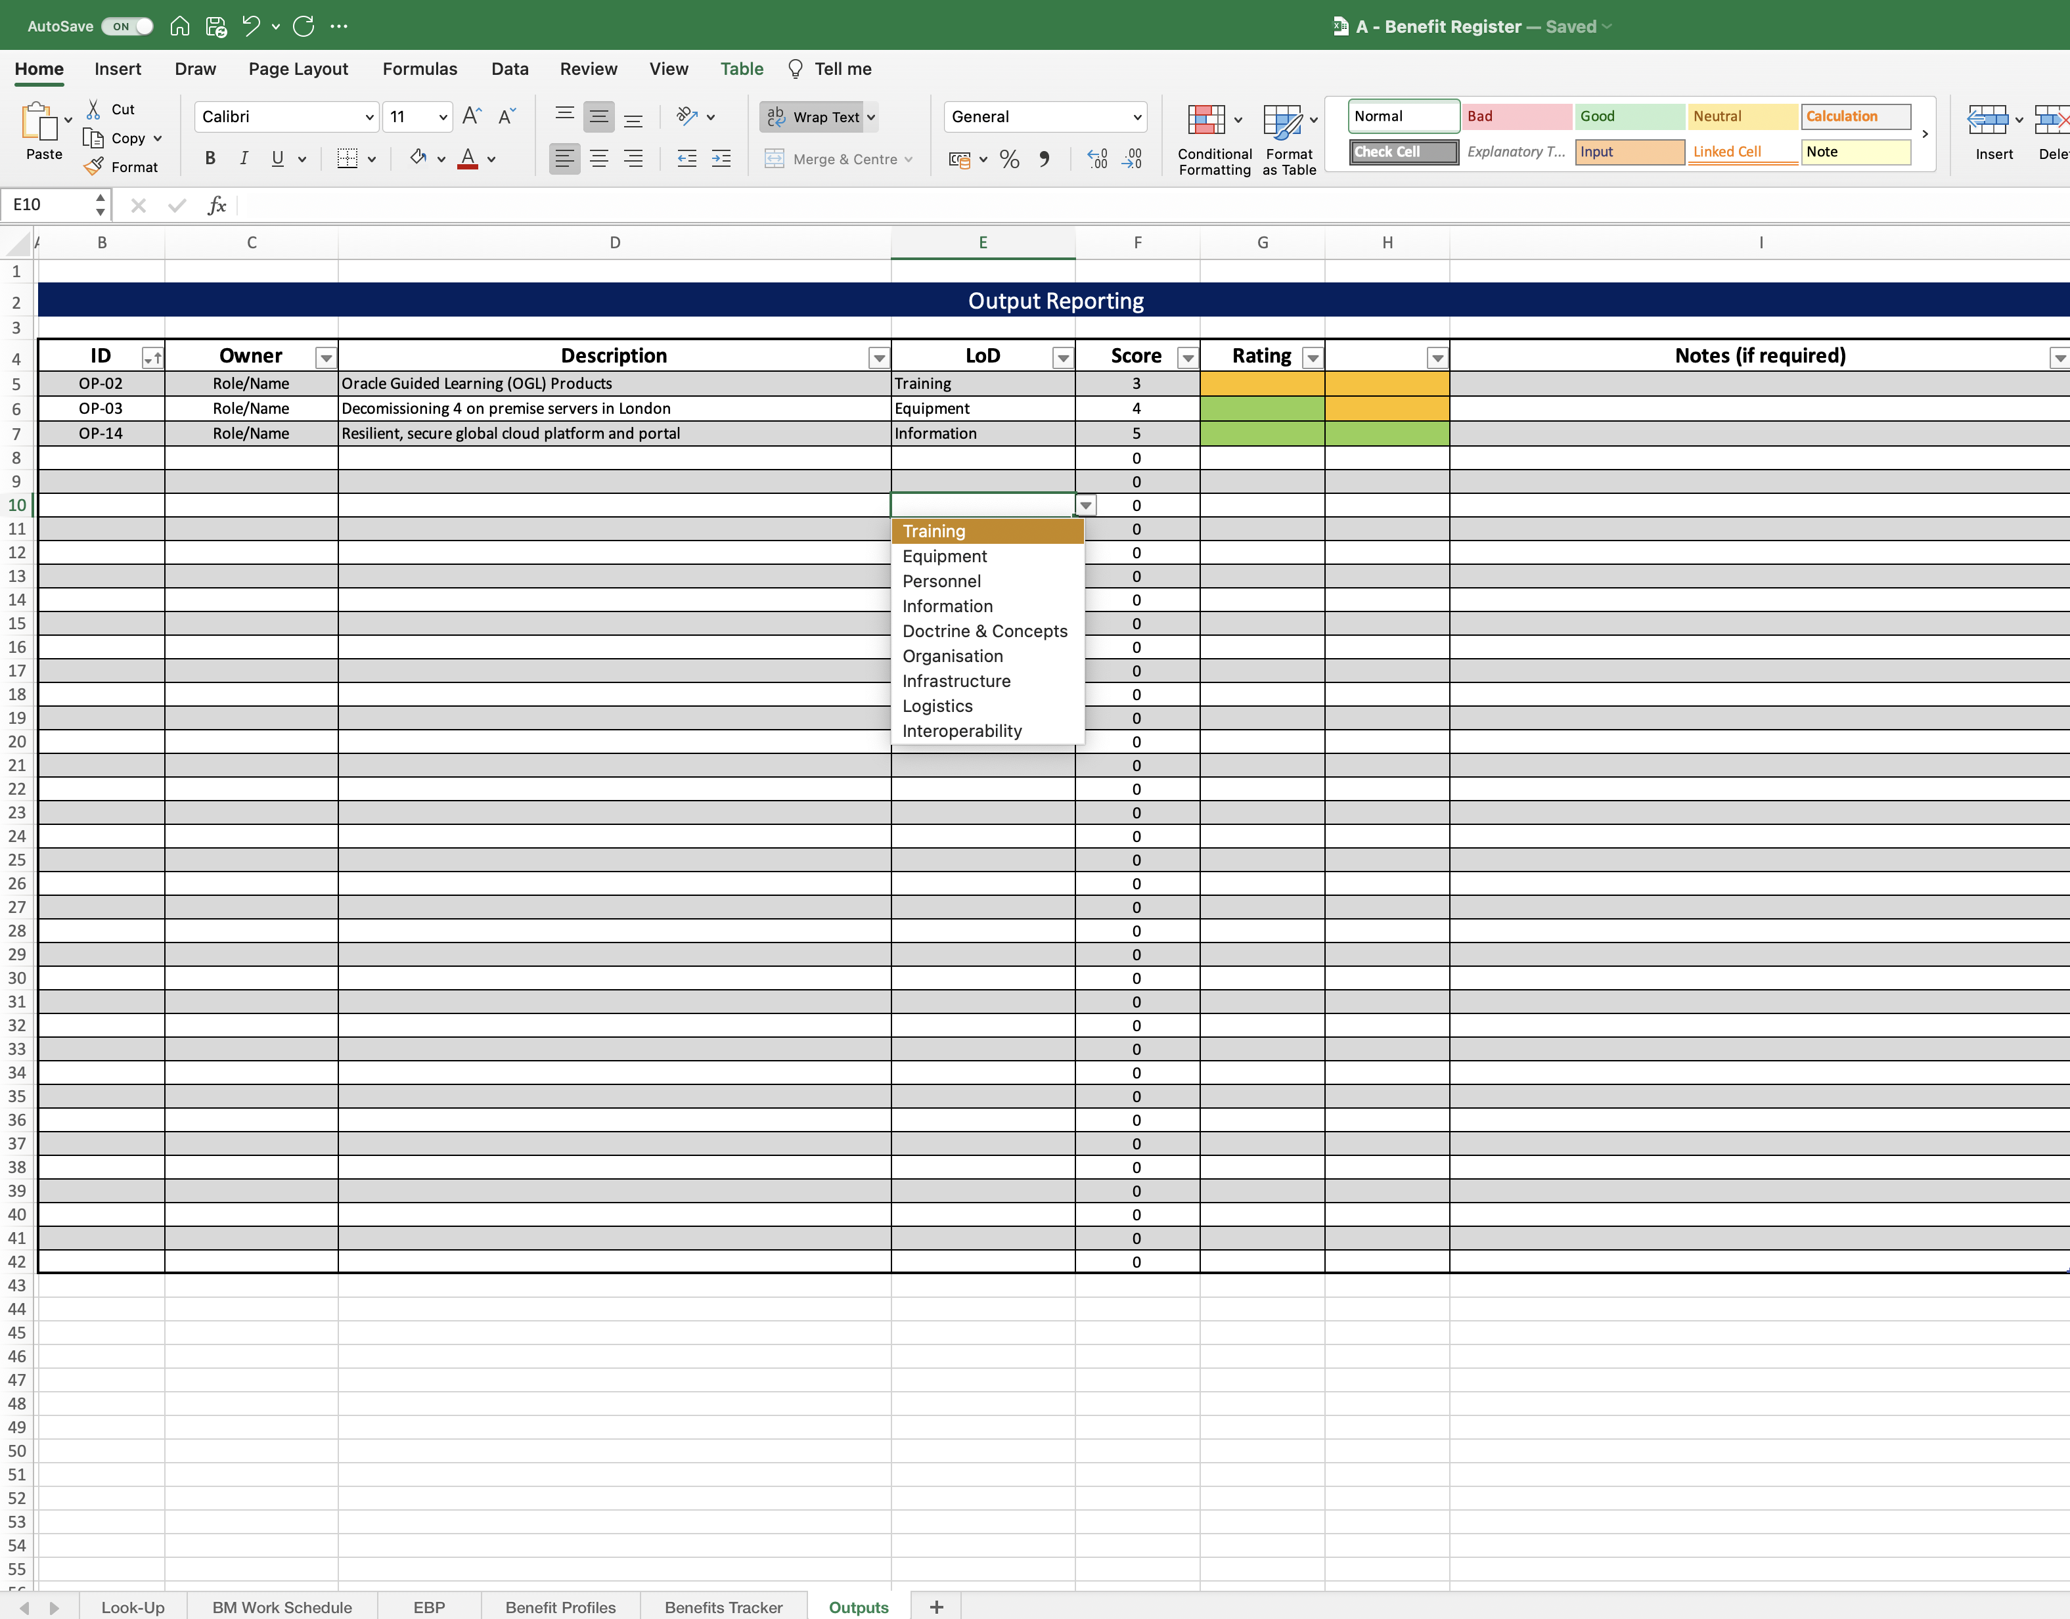
Image 55
How to create the rating columns is shown in images 56–60.
Examples taken from the Benefit Map at image 16.
The Lines of Development are explained at para 3.3.
How to create data validations is shown in images 33 to 37.
Output delivery confidence score and rating can be seen at Table 10.

