Slide 1
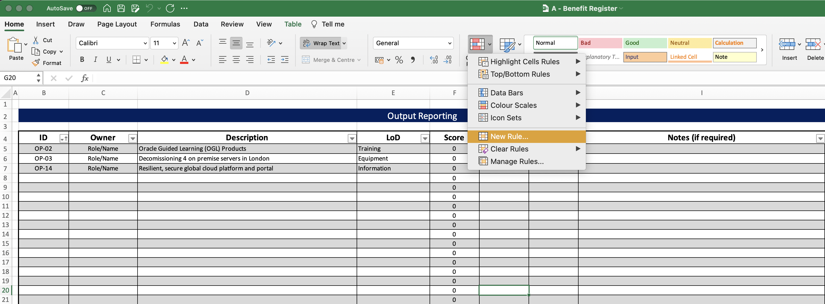
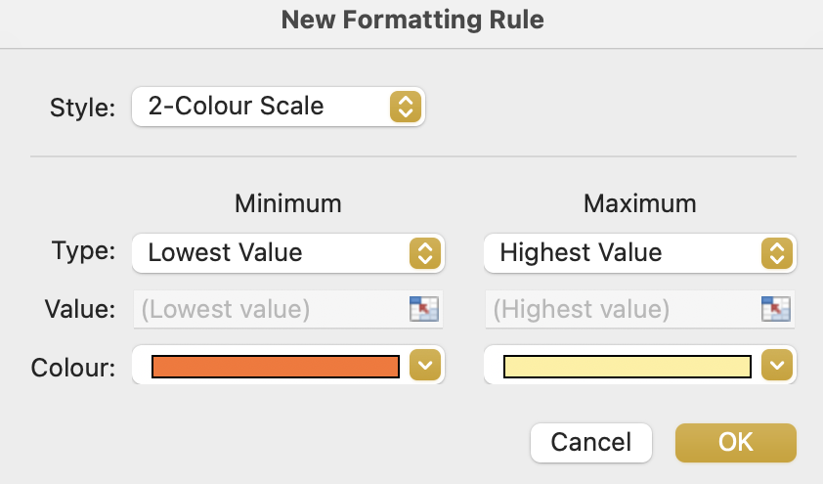
Image 56
2
Select ‘Home’.
3
Select ‘Conditional Formatting’.
Select ‘New Rule’.
4
When the ‘New Formatting Rule’ window opens, select ‘Classic’ from within the ‘Style’ drop-down options.
5
1
Edit field ‘G20’.

