Slide 1
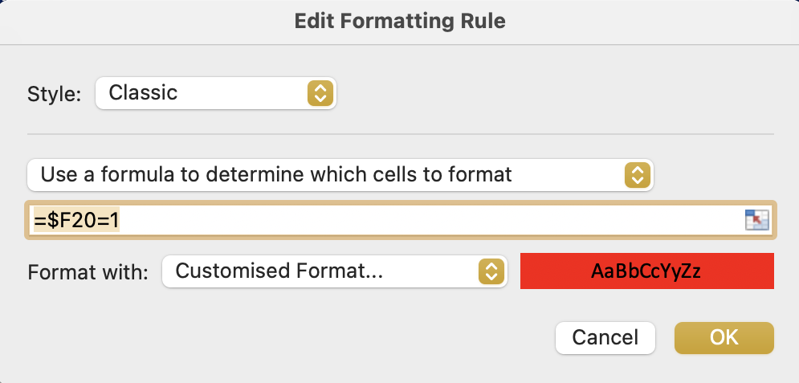
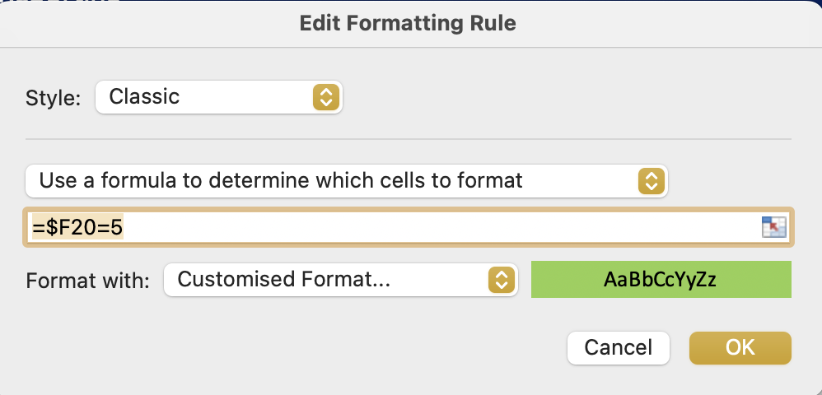
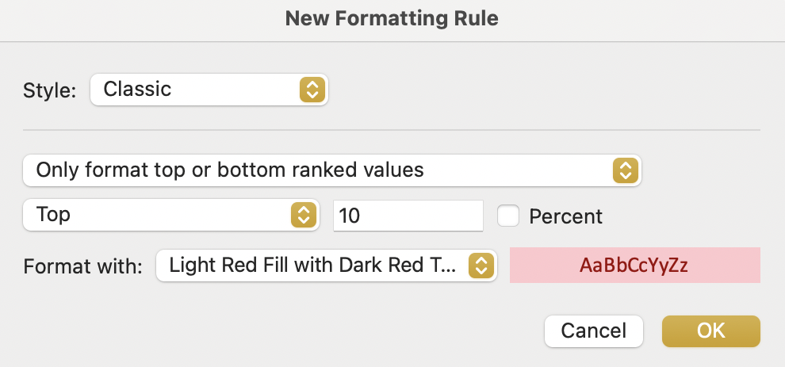
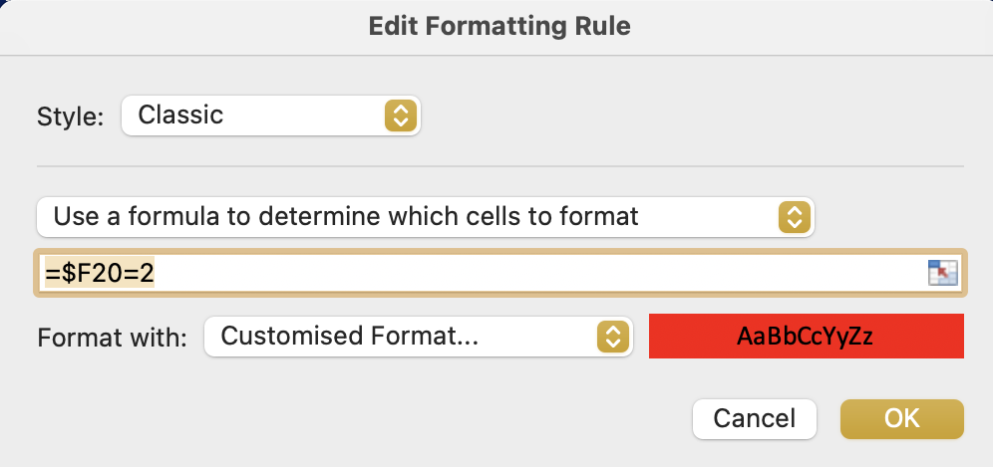
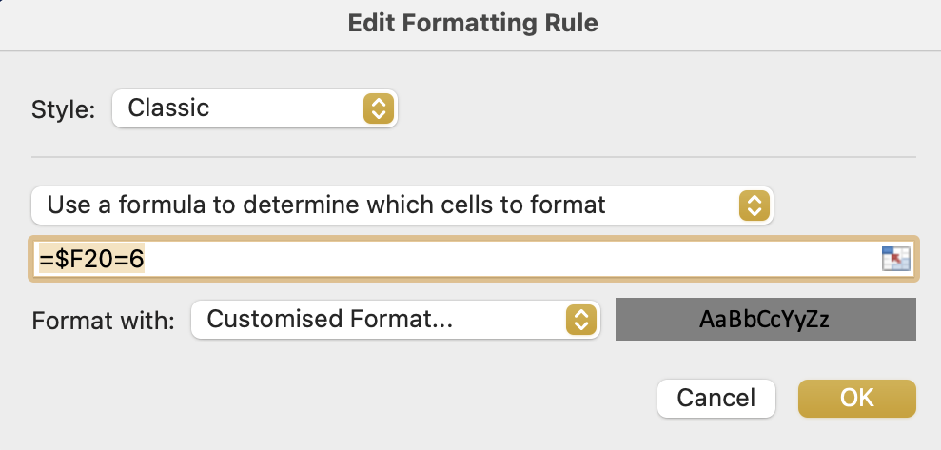
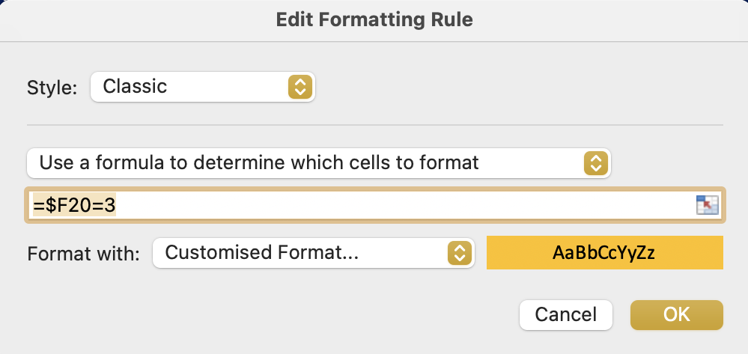
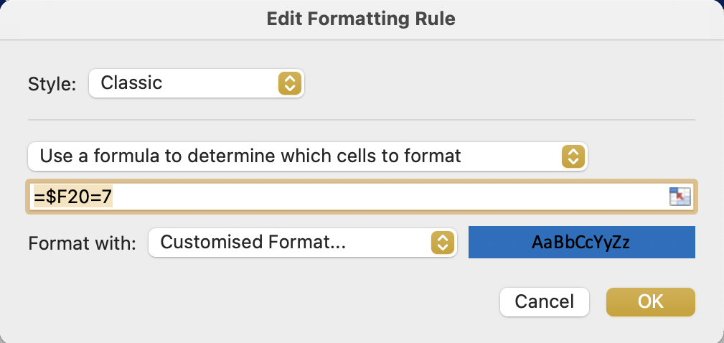
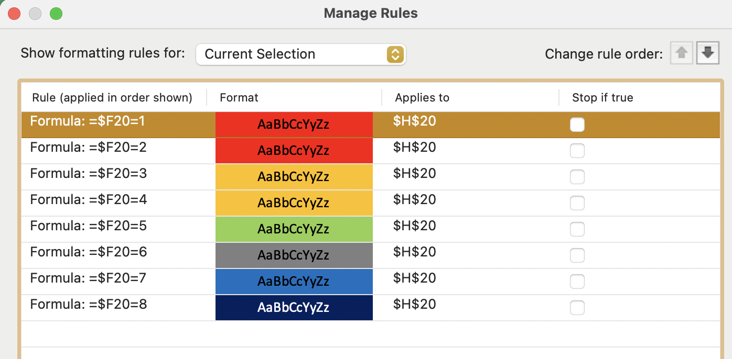
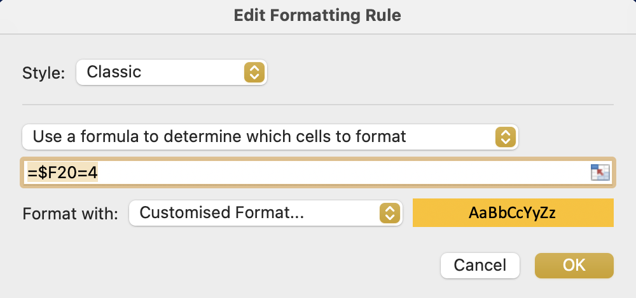
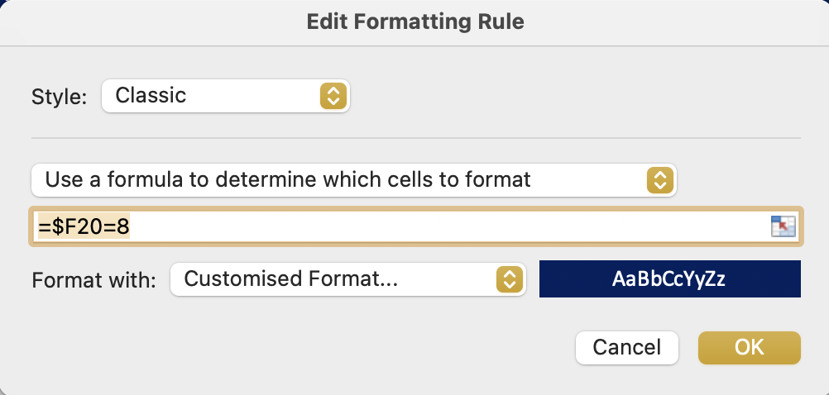
Image 59
3
7
Refer to image 26, step ‘2a’, concerning the ‘Format with’ fields, if required.
1
When the ‘Classic’ option is selected, this window will appear.
4
8
Populate the fields so they look like each of the 8 steps on the right.
In other words, undertake this process 8 times to create 8 new rules in the G20 field. The 8 new rules differ slightly as seen in the images.
Note: When the 8 rules have been created, you can see them by doing this (a) refer to image 24 step 4 and (b) select ‘Manage Rules’ not ‘New Rule’.
5
9
2
6
10
They should look like this

