Slide 1
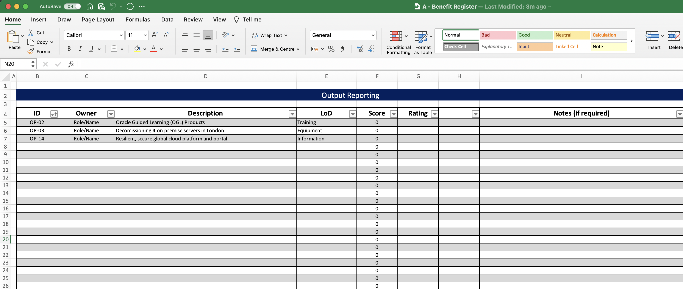
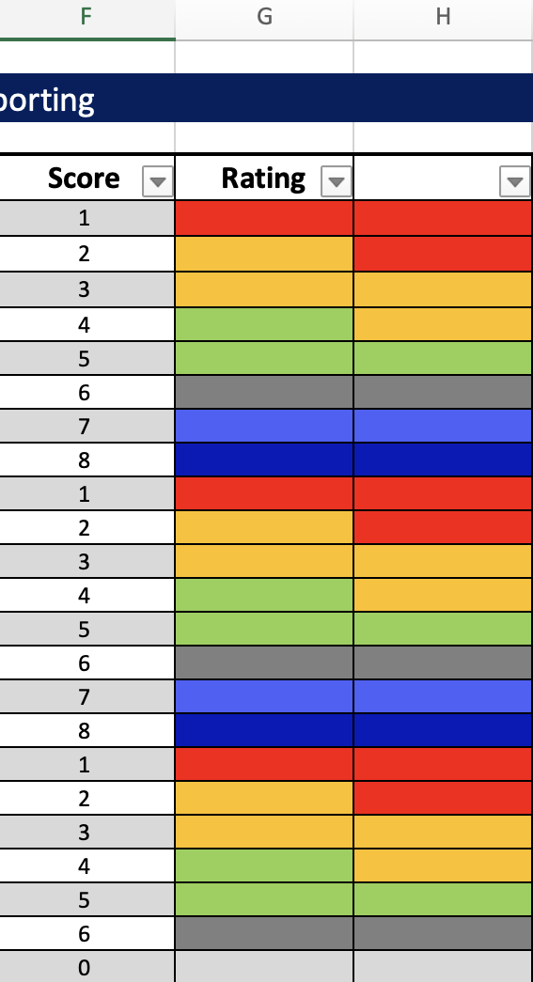
Image 60
Paste them into the block in blue.
2
1
Copy fields F20, G20 and H20.
Test the rules are working by numbering column F between 1 and 8; columns G and H should look like this.
3

