Slide 1
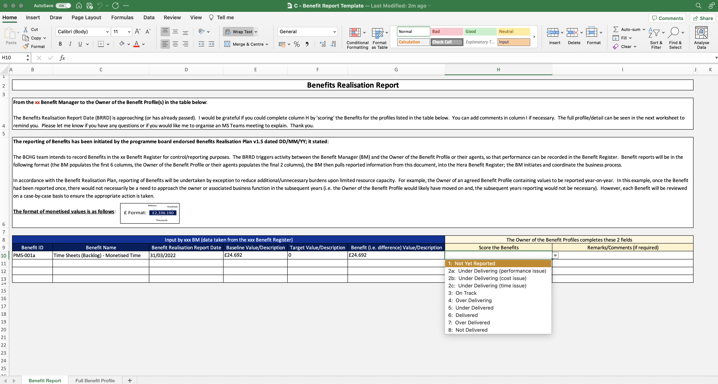
Image 61
Data validation.

