Slide 1
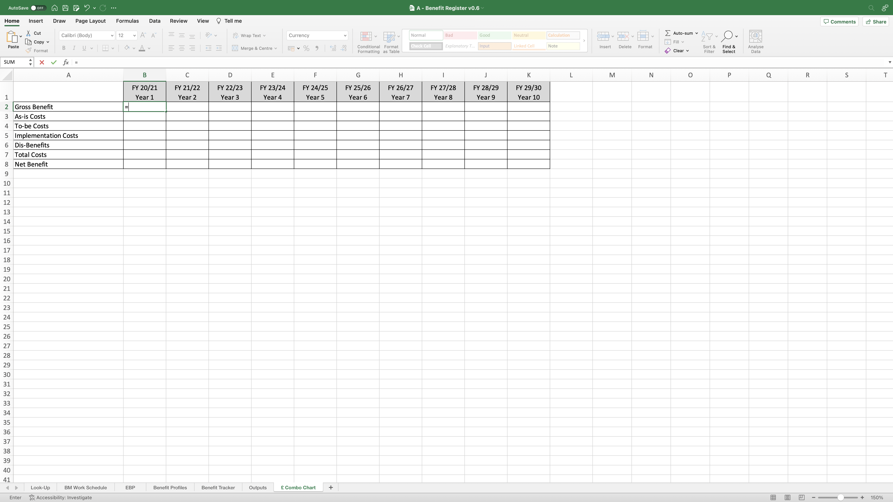
Image 67
Manually create this table into the worksheet.
2
Edit field ‘B2’, type ‘=‘ as shown, then edit the EBP worksheet.
3
Create a new worksheet by selecting the ‘+’ field. Right click on the worksheet name; select ‘Rename’; name the new worksheet ‘£ Combo Chart’.
1

