Slide 1
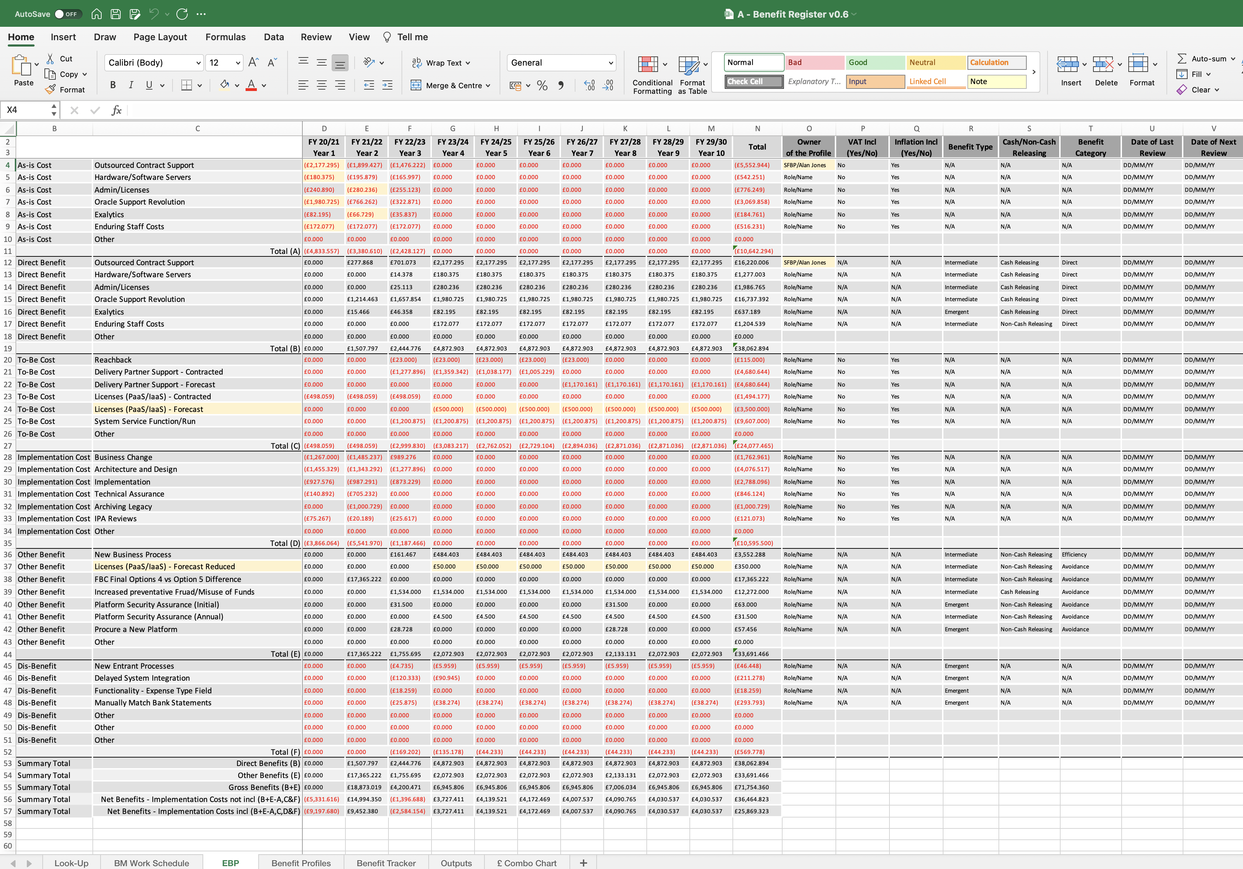
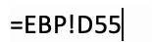
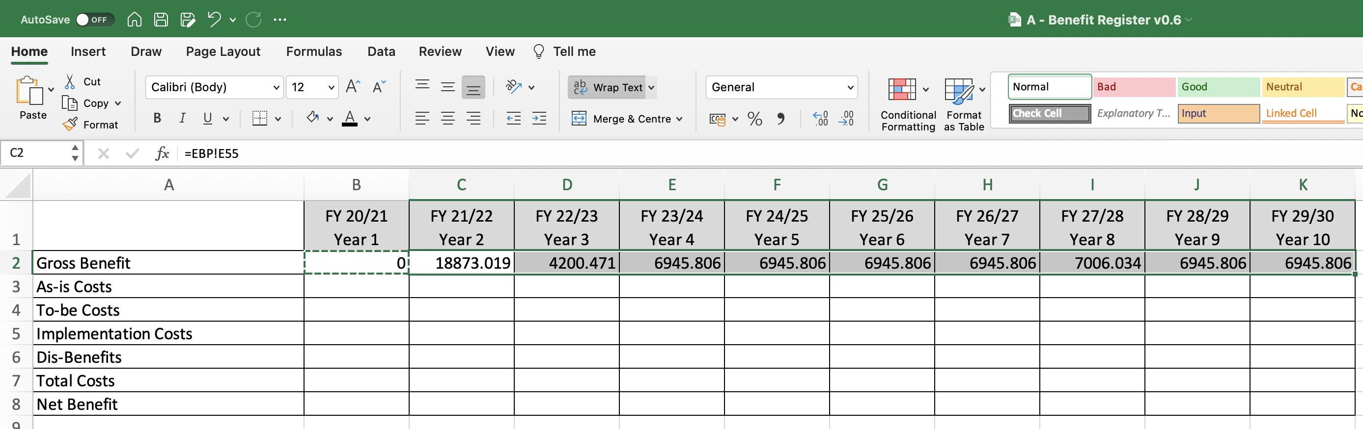
Image 68
Accept the formula.
3
You will see this formula auto populated here.
2
Excel will return you back to the ‘£ Combo Chart’ worksheet/field ‘B2’. Right click on this field and select ‘copy’.
4
Edit year 1 ‘Gross Benefit’ field.
1
Select fields ‘C2–K2’, right click, then paste. You will see these values being populated into the data table from the EBP worksheet.
5

