Slide 1
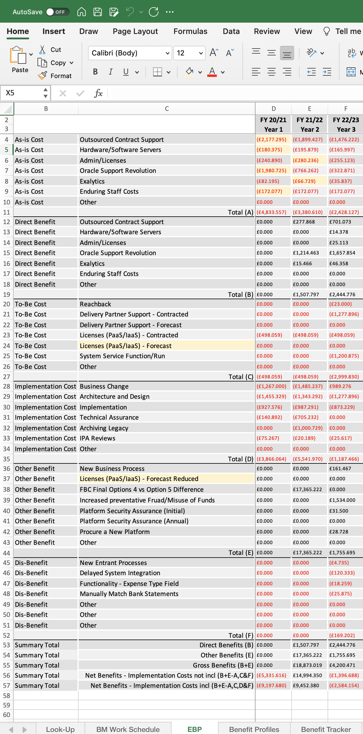
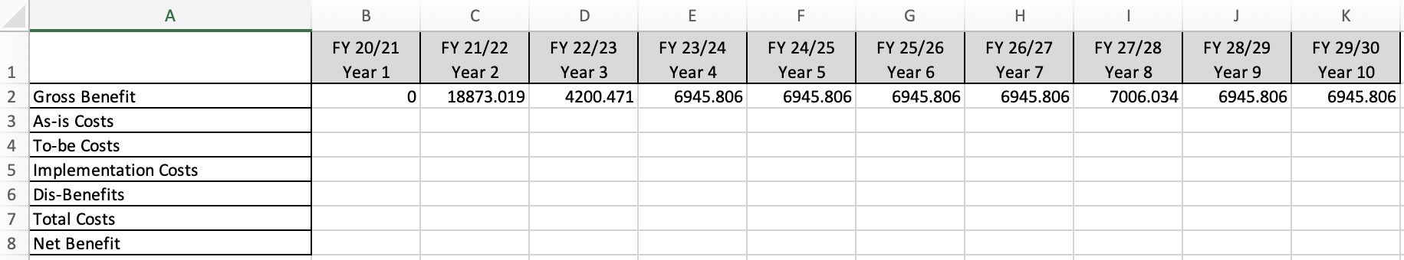
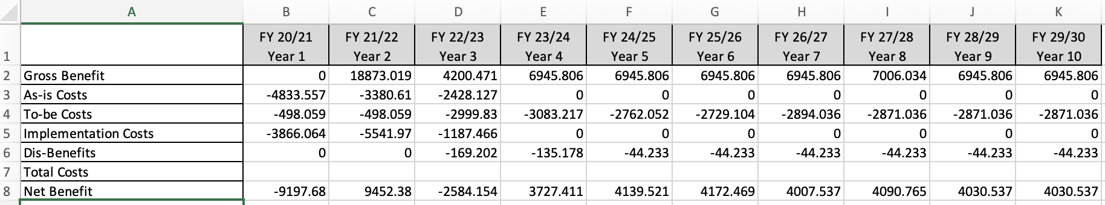
Image 69
The second ‘Net Benefit’ row has been selected; select the one that applies to you. See para 2.9.2.
3
1
The data table now looks like this.
A
Use image 67 (step 3) and image 68 (steps 1–5), repeat the actions again for the highlighted rows (A–E) below, so the fields in the data table are all populated except for the ‘Total Costs’ row, as shown in the example. The screen shot of the EBP on the right is show to help you.
2
B
C
A
B
C
D
D
E
E

